Slide 1
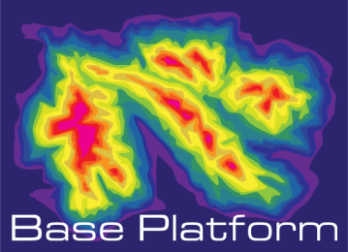
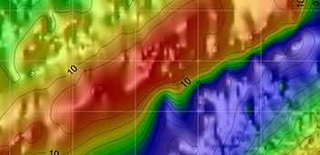
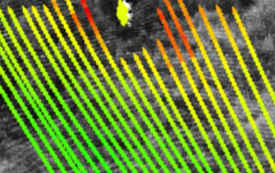
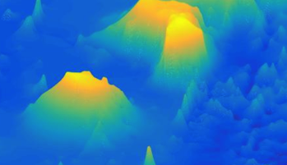
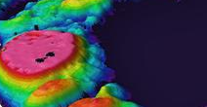
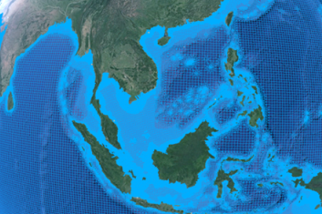

Merging Bathymetry Data
Co-Funded by the European Union
Sandra Gaytan Aguilar, Martin Verlaan

Slide 2
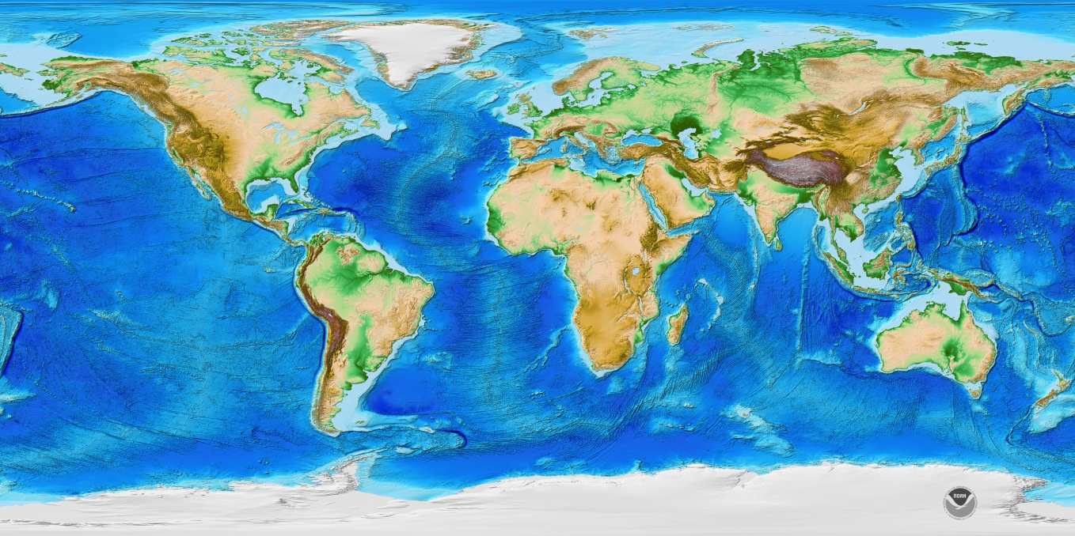
Bathymetry
71% of the Earth surface is covered with water
85% of the world ocean floor remains unmapped with modern mapping methods
Source: NOAA
Notes:
Extended areas are not mapped to sufficient accuracy, or existing data is out of date.
Bathymetry is essential for various user groups and for multiple applications.

Slide 3
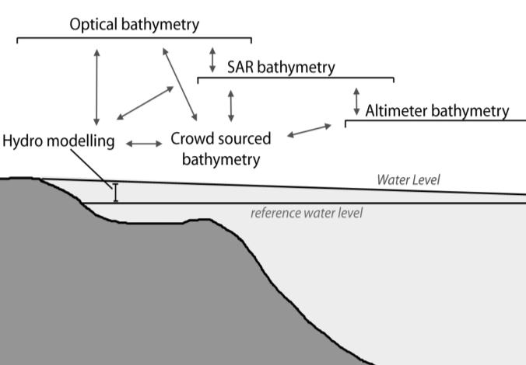
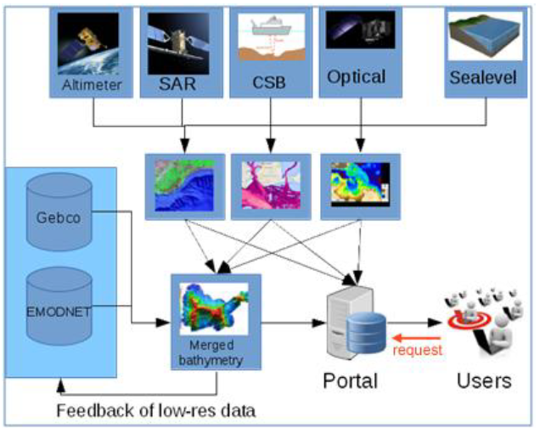
BASE-platform
Deriving the bathymetry from combined satellite data

Slide 4
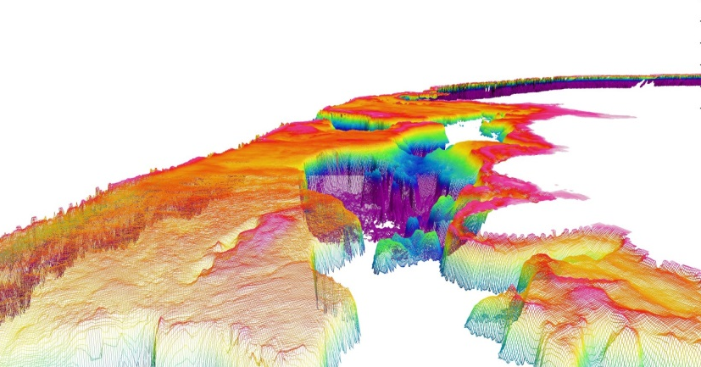
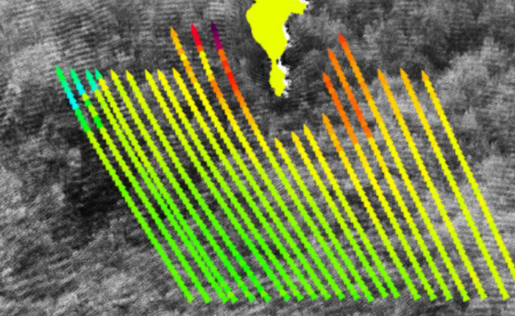
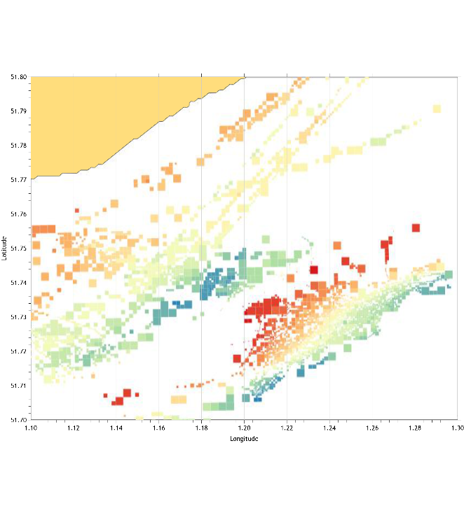
Products and services
Optical
SAR
CSB
Altimeter

Slide 5
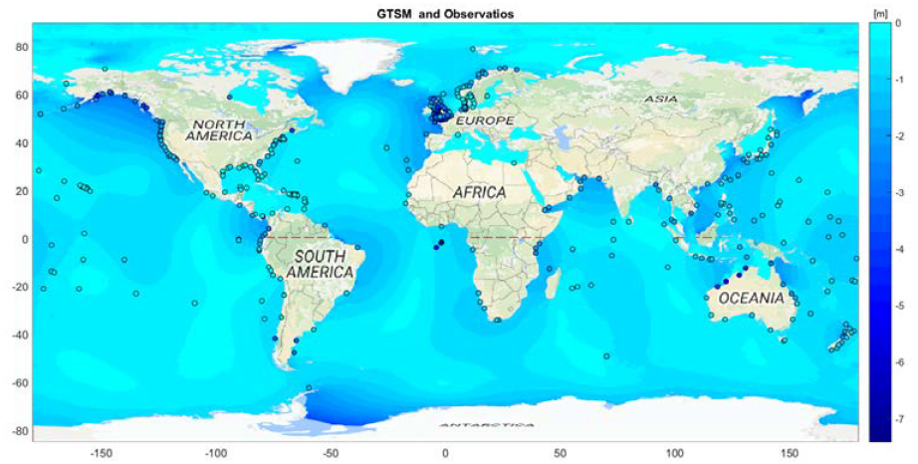
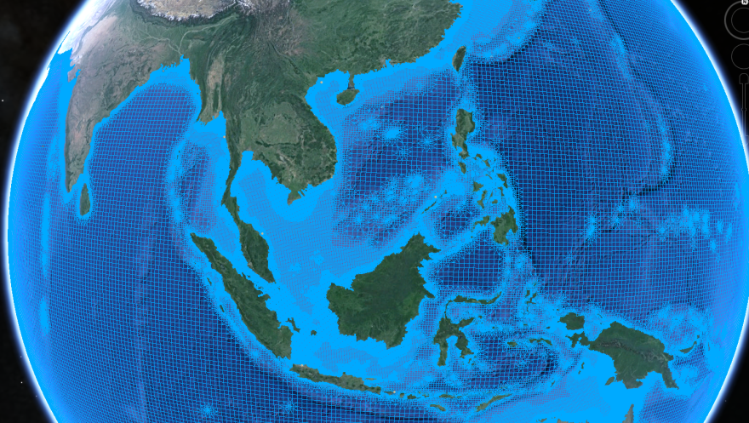
Products and services
Combination of the products obtained, transformed to the same vertical datum using corrections for sea level changes.
Spatial resolution:10 m gridded data
Vertical accuracy: depending on the source data
Time resolution: on demand
Merged Bathymetry
Grid near to the coast. 1.25km at European coasts (2.5km at other coasts).

Slide 6
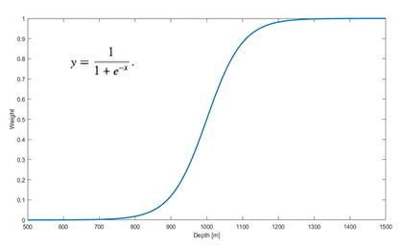




Merging Methods
Average
Weighted averaging
Multiple linear regression
Kriging
Notes:
Multiple linear regression
The advantage of this method is that it doesn’t require prior harmonization. Multiple
linear regression attempts to model the relationship between two or more explanatory variables
and a target variable by fitting a linear equation to observed data
Regression Kriging is a technique that exploits potential spatial
correlation of regression residuals to locally improve predictions. In a Regression Kriging model, the
dependent and independent variables are made spatially explicit and the spatial correlation of the
regression residual is modelled with a variogram

Slide 7
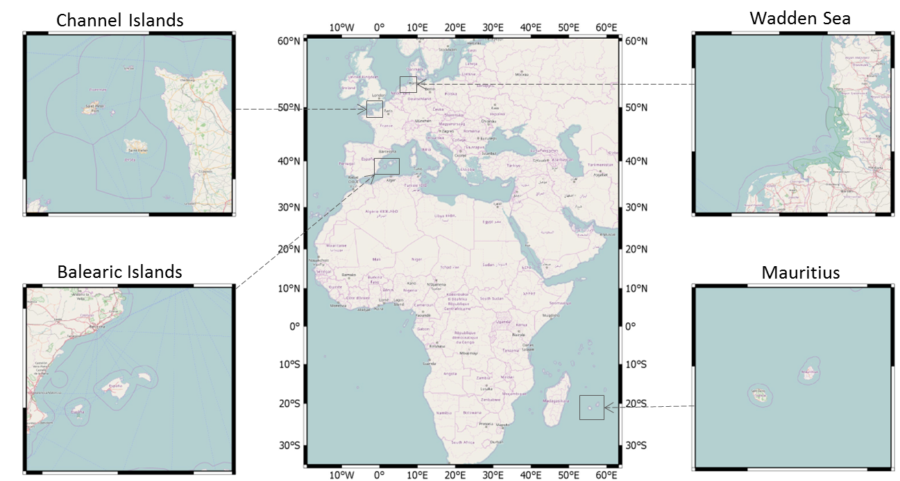
Study Cases

Slide 8
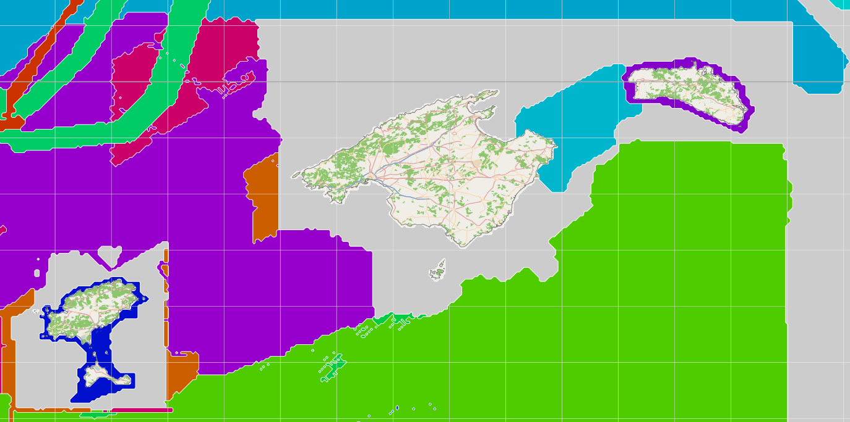
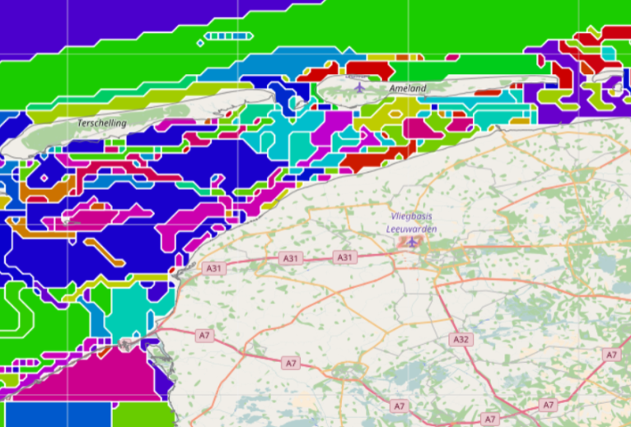
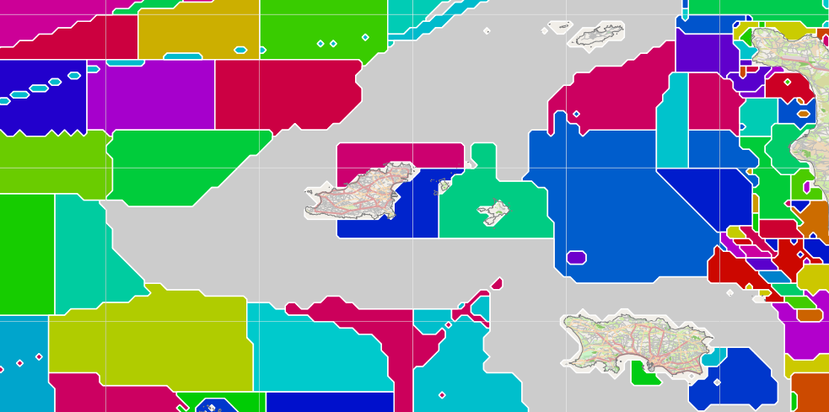
Data available
Balearic Islands
Channel Islands
Mauritius Islands
Wadden Sea
Sources: EMODnet.

Slide 9
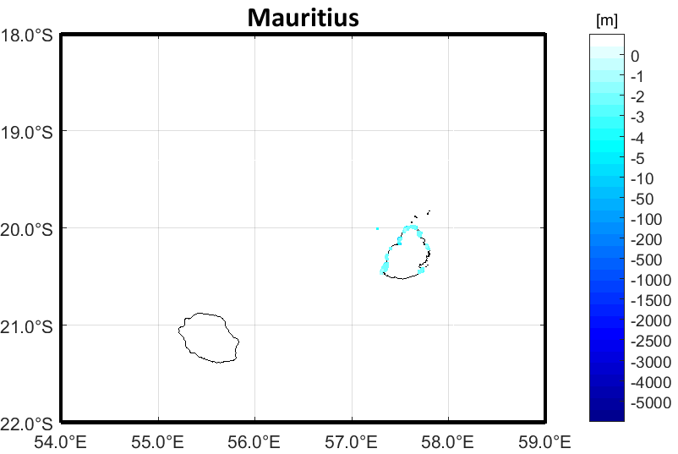
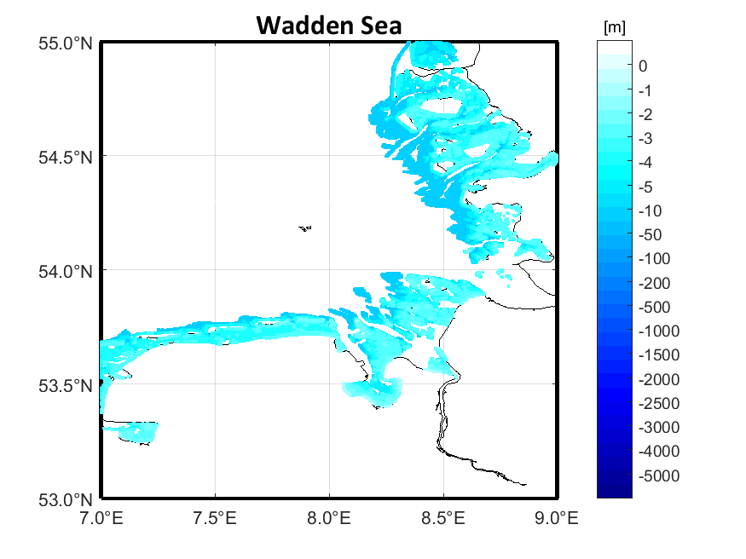
Validation of BASE products.
Data used for validation:
MOI (Mauritius Oceanographic Institute)
EMODnet (No GEBCO data included)
Multibeam German Surveys
NGDC/NOA

Slide 10
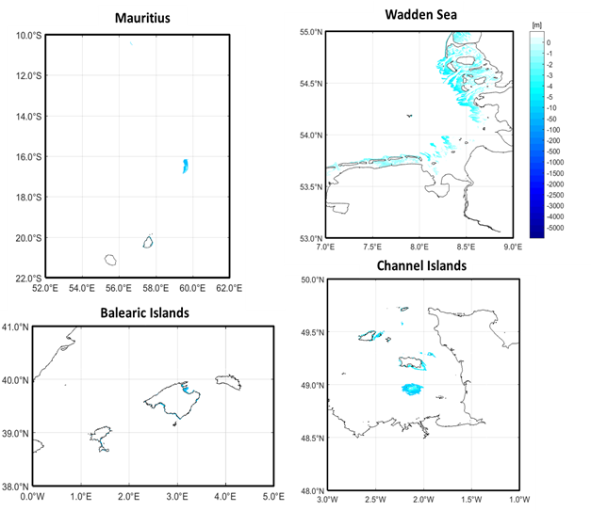
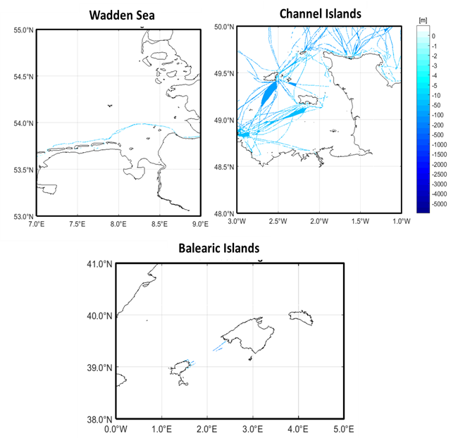
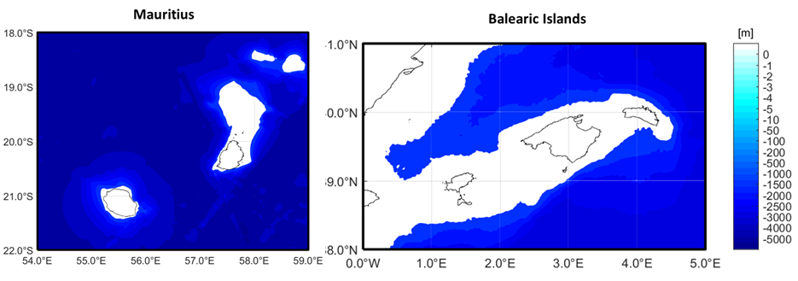
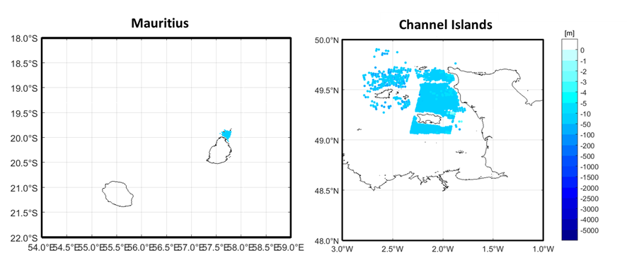
Data Availability
Optical
CSB
Altimeter
SAR

Slide 11
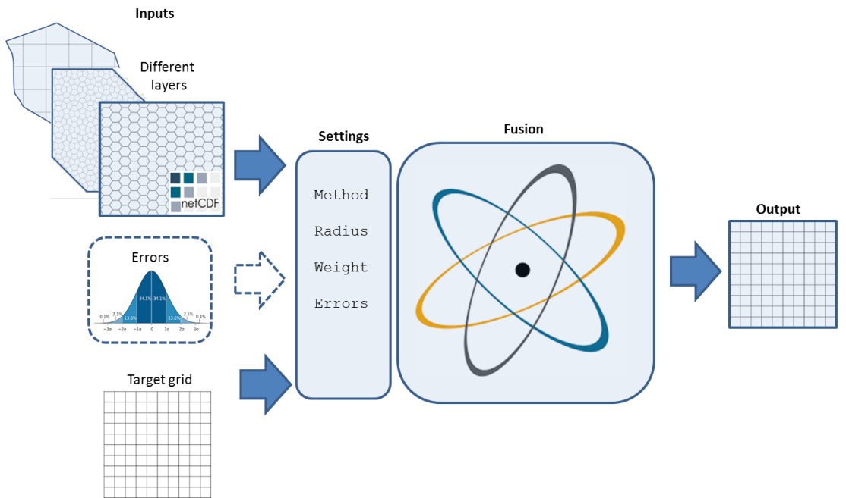
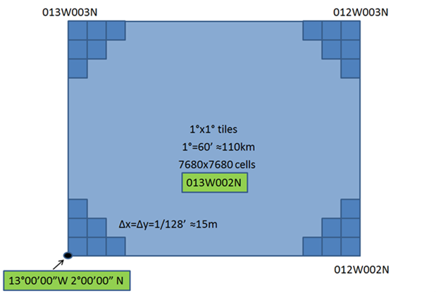
Flow chart
Regular grid
WGS 84
1/128th arc minute is used (about 15 meters at the equator to e.g. 7.5 meters at 60° north)
Notes:
The flow chart for the merged bathymetry has been described in the Figure. The general idea is that the different bathymetry data sets (layers or images) for a certain area are used to compose a seamless bathymetry product.
Following the data formatting guidelines, the spatial reference of the merged data is WGS 84 and will be produced in a common grid. A standard grid of 1/128th of a minute is used, unless decided otherwise for a custom delivery. Each grid cell has coordinates that are a multiple of 1/128th of a minute. The value for each cell is to represent an average value for the cell. Note that the cell centres will be shifted by half the cell width and height with respect to the corners of the cell. This type of grid is regular in latitude longitude coordinates, but will have a variable size in meters, decreasing from about 15 meters at the equator to e.g. 7.5 meters at 60° north. The height of the cells remains roughly 15 meters at all latitudes. Figure 2 shows the schematization of each tile, the resolution and the number of grid point per tile
58,982,400

Slide 12
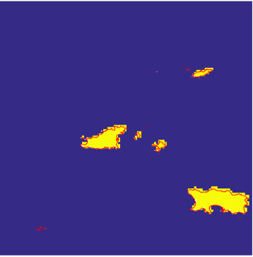
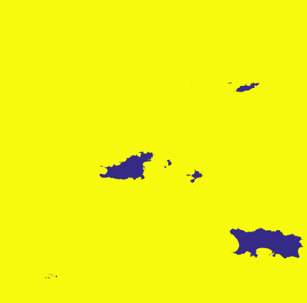
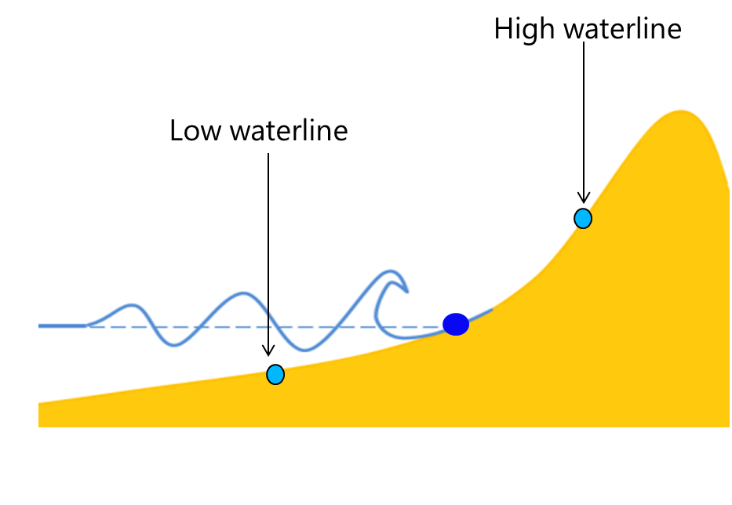
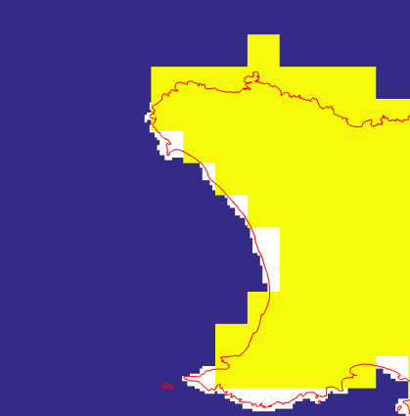
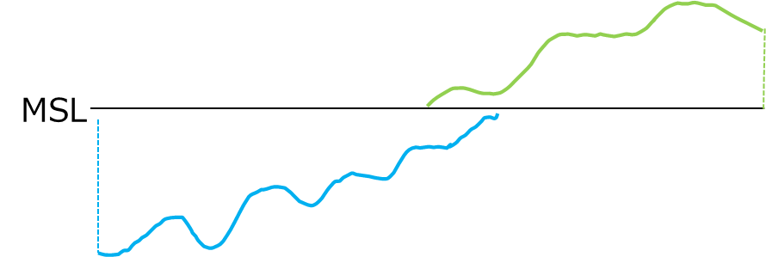
Coastline
Mismatch between GEBCO and SRTM
Mask definition base on OSM
SRTM
GEBCO

Slide 13
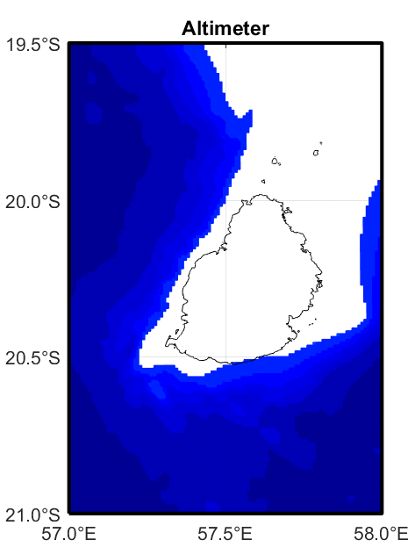
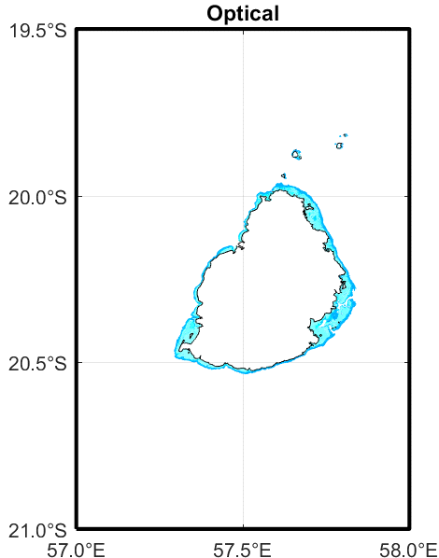
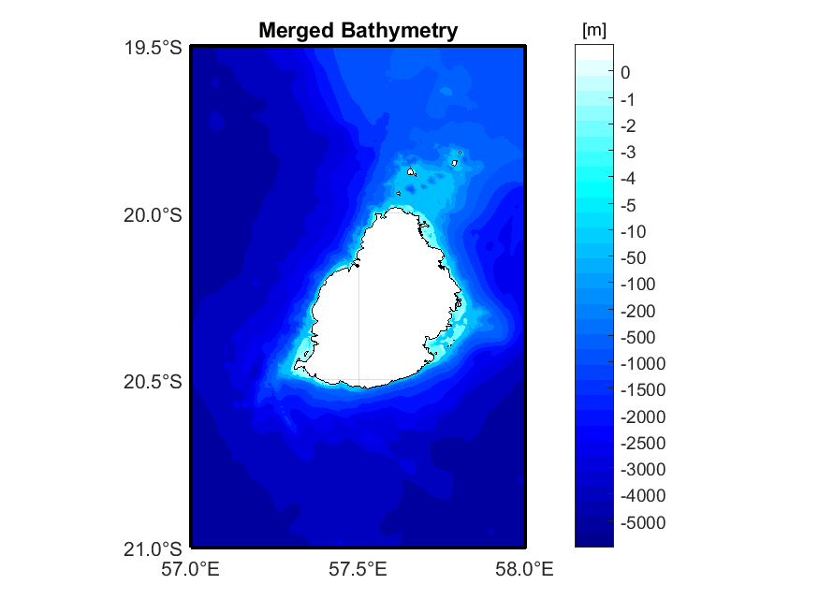
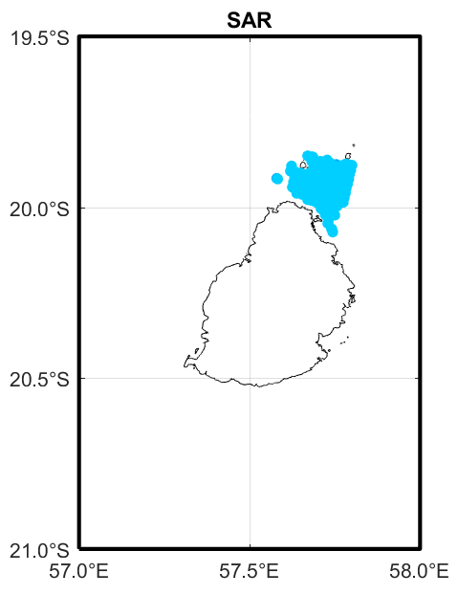
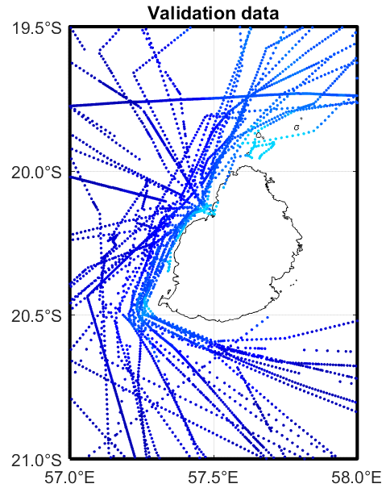

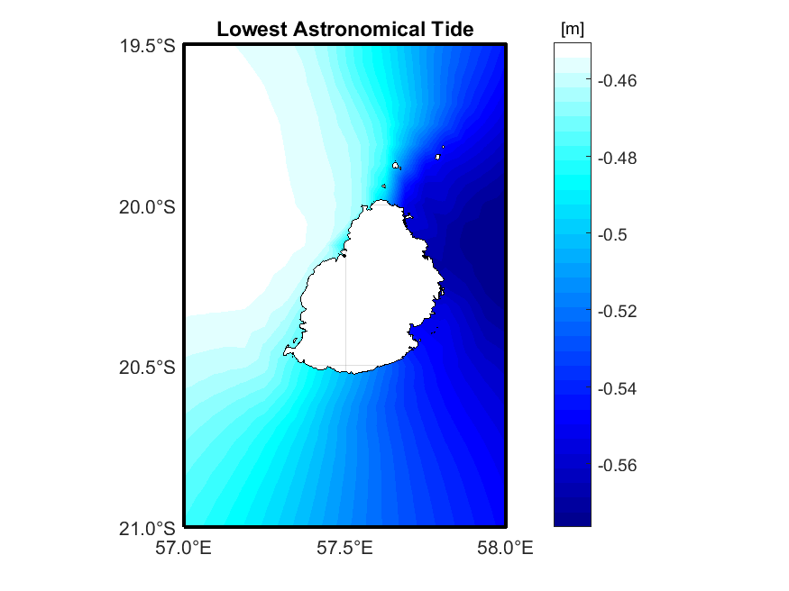
Example: Mauritius

Slide 14
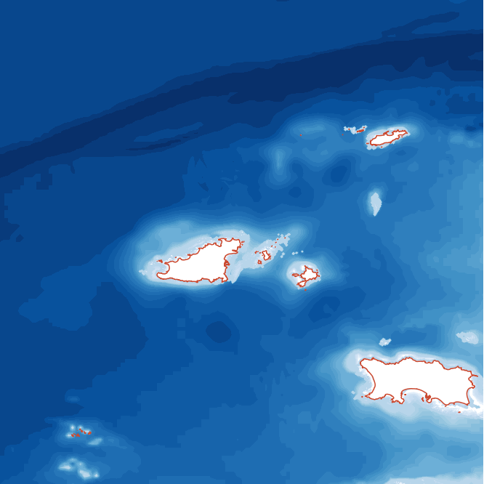
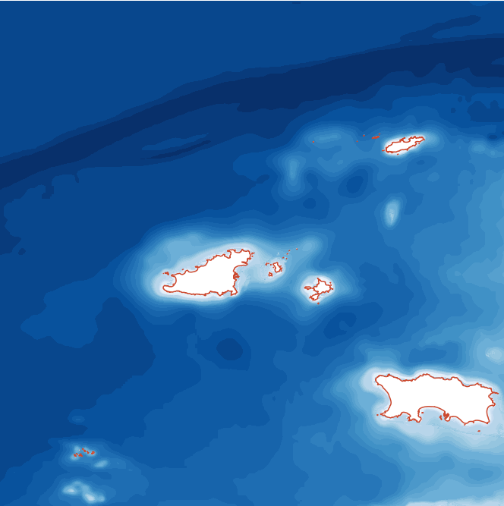

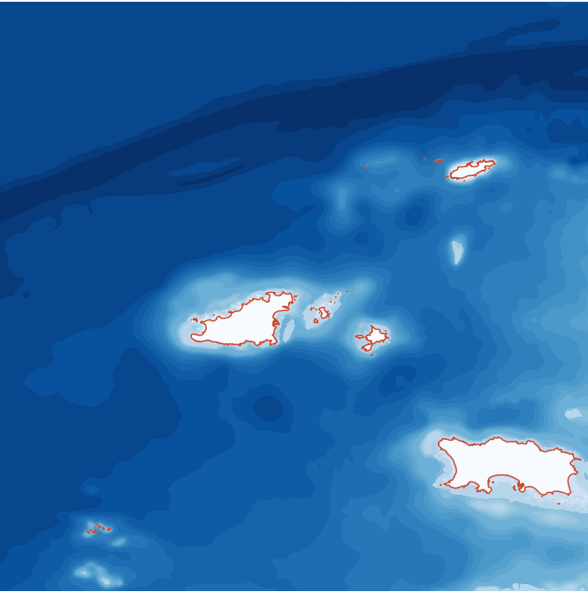
Merged bathymetry
Average
Weighed Average
Regression
Kriging
Data | RMSE | Computing (min/tile)
Average | 1.38 | 0.0280
Weighted average | 1.21 | 0.1836
Multiple regression | 1.22 | 0.3230
Regression Kriging | 1.02 | 0.5002

Slide 15
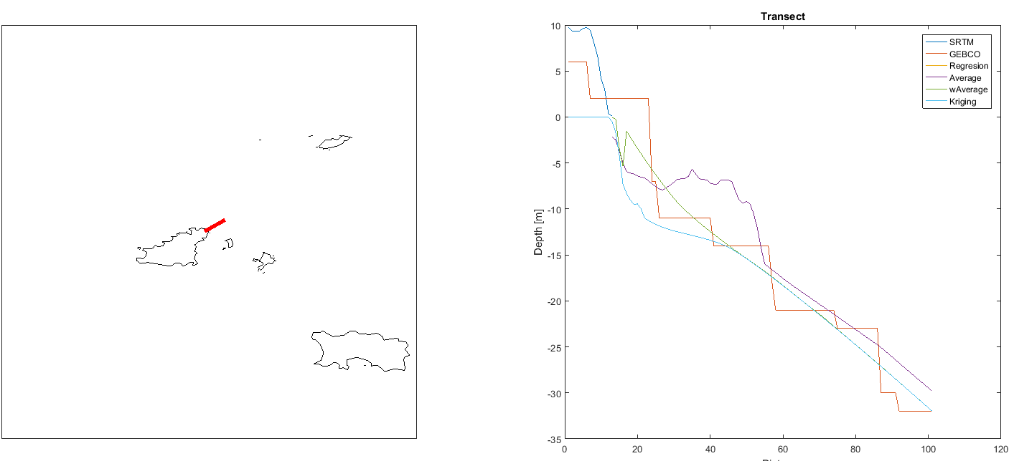
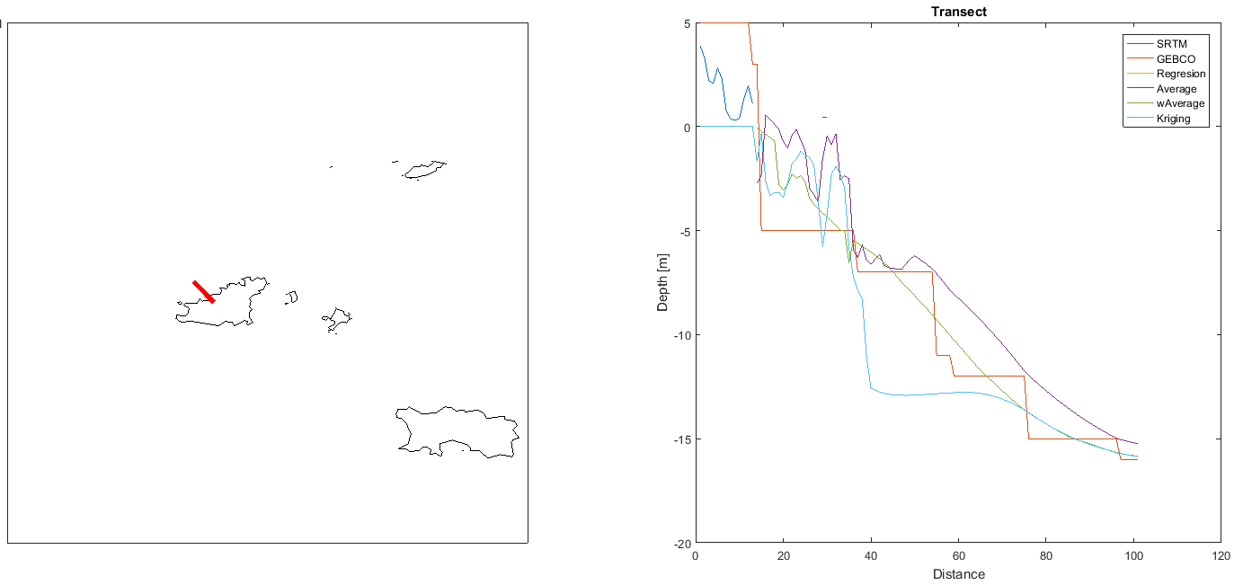
Merged bathymetry: Transect

Slide 16
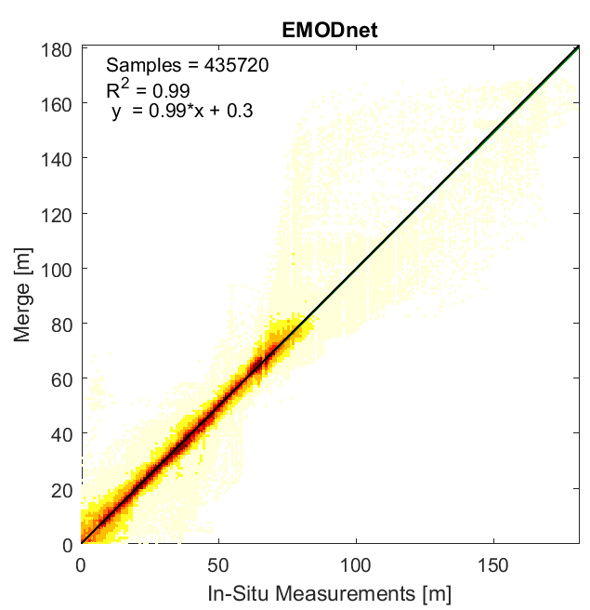
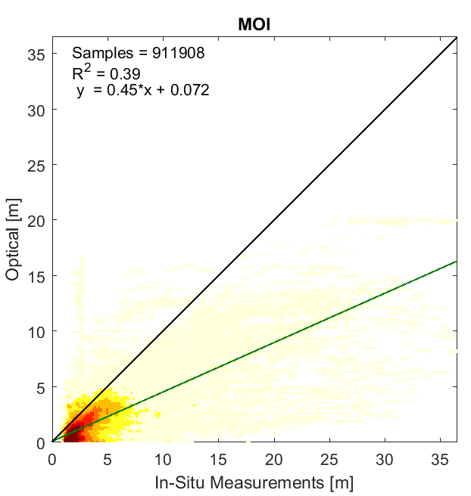
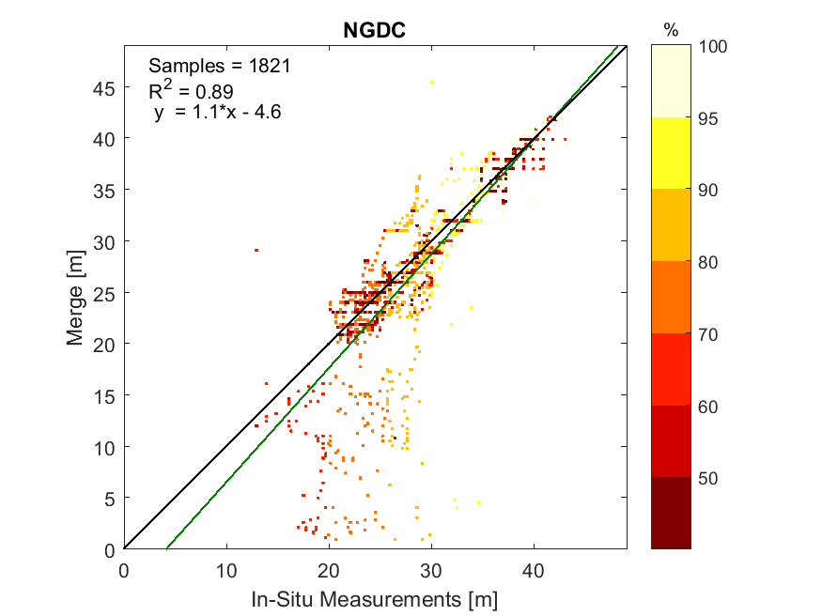
Merged bathymetry
Channel Islands
Mauritius
Mauritius

Slide 17
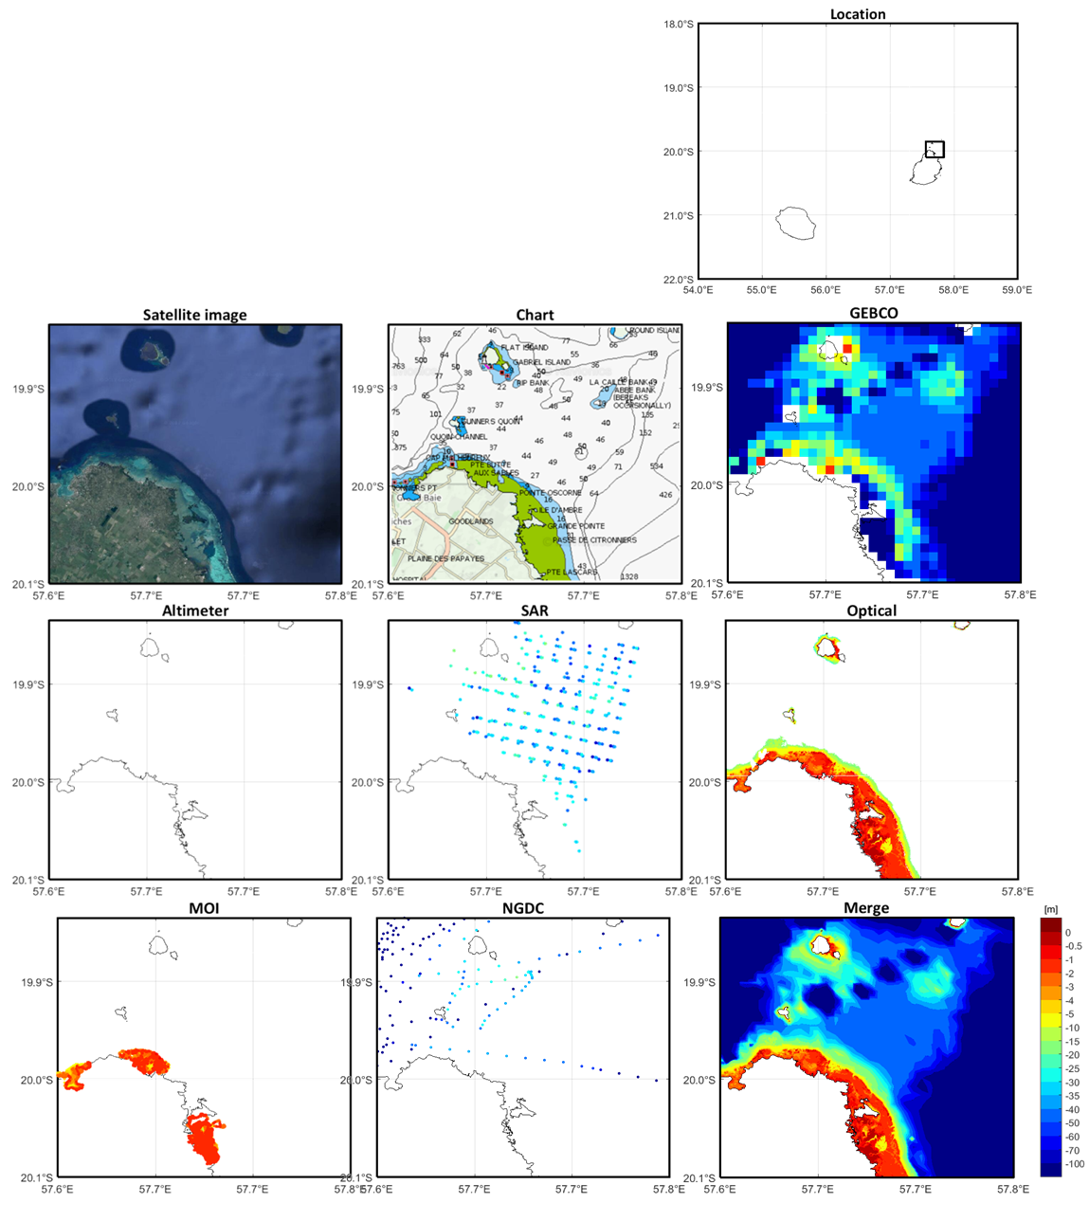
Merged bathymetry

Slide 18
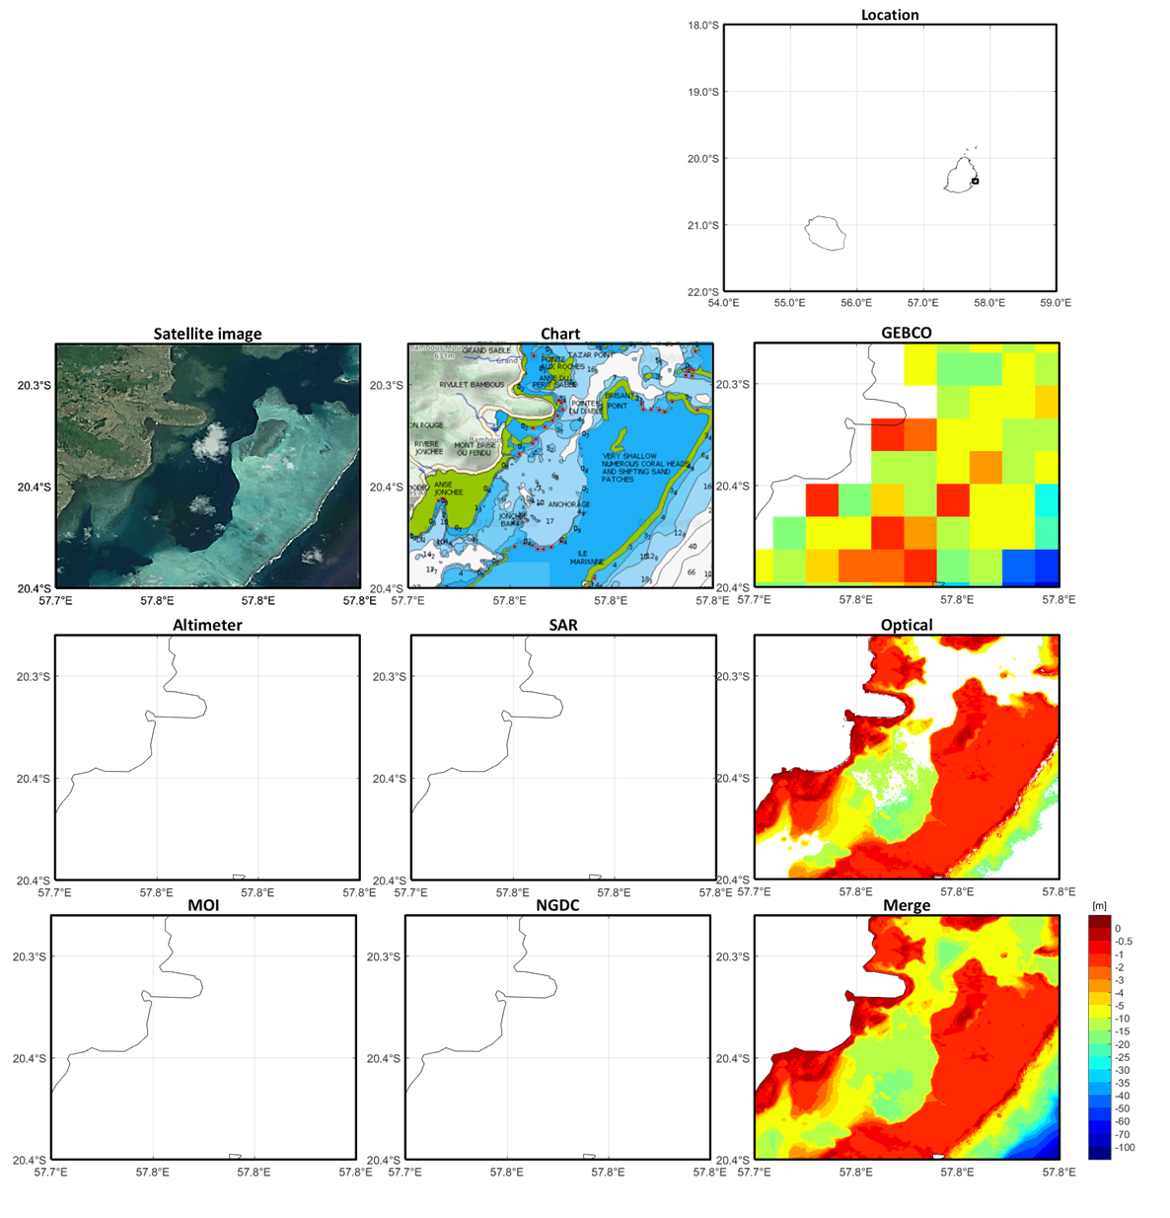
Merged bathymetry

Slide 19
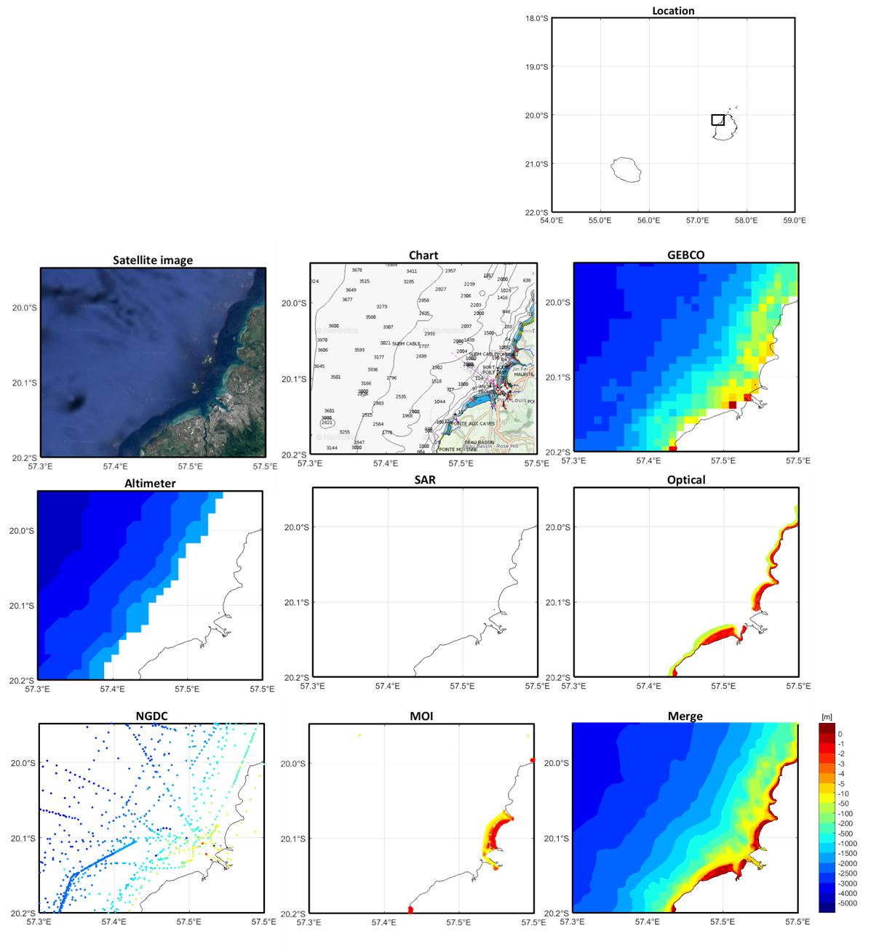
Merged bathymetry

Slide 20
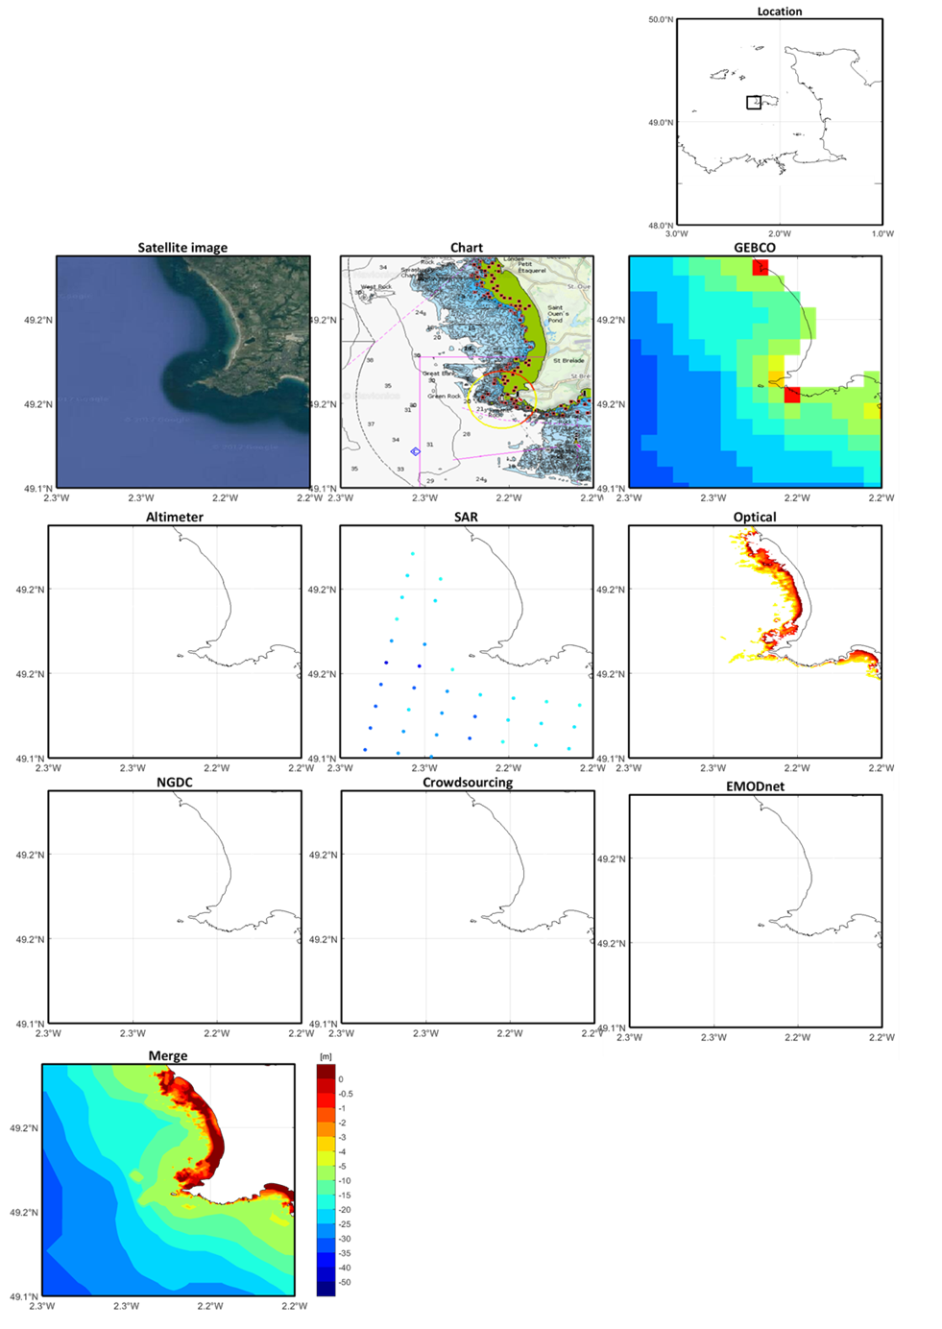
Merged bathymetry

Slide 21

Merged bathymetry

Slide 22

BASE-Platform Portal for Bathymetry

Slide 23

BASE-Platform Portal for Bathymetry
http://base-platform.com/

Slide 24
Conclusion and further work
The biggest challenge when integrating bathymetry in in the nearshore. The resolution difference and large discrepancy between data sets make difficult to find a unique technique able to perform well in all nearshore areas
In waters deeper than 50m the algorithms here presented show a fair performance
A well referenced and high-resolution coastline is crucial for integrating Bathymetry. [Working in EMODnet project in coastline definition at different vertical datum ]
Implementation of EnKF as merging algorithm.

