Slide 1
Evaluating High-Density Swath Bathymetry Sonars Against IHO-S44 Specifications: Ping DSP 3D Sidescan, a case study
David Dodd, IIC Technologies and University of Gothenburg
Paul Kraeutner, Ping DSP Inc.

Slide 2
Overview
SCAHS S-5B Program
S-44 Standards
Meeting the standards
High resolution Swath Bathymetry systems
HOs approach to SSS hybrids
Example; PING 3D SSS

Slide 3
Swedish Consortium for Applied Hydrographic Science

Slide 4
Swedish Consortium for Applied Hydrographic Science
Phase I (2 years):
IHO/FIG S-5B program
Cater to:
industry (MMT and SMA personnel)
other Nordic region hydrographic organizations
GU, Chalmers and SU graduate students
Others
Phase II:
IHO/FIG S-5A
GU Marine Science Hydrographic research component

Slide 5
Consortium Approach
Master’s Course
20-weeks
Four 5-week sections
Section 1 (5 weeks) : Intro to Hydro, Computation Tools, Nautical Science and Meteorology, Remote Sensing, Water levels
Sections 2 and 3 (10 weeks): Theory and applied hydrography intertwined
Section 4 (5 weeks):
Hydro Projects
Comprehensive Final Field Project

Slide 6
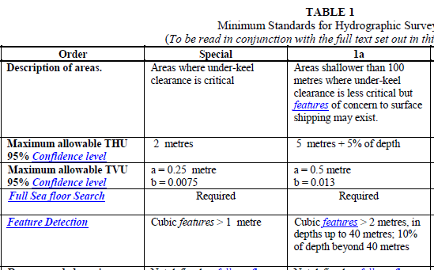
S-44 V5 Standards
Special Order and Order 1a
THU – easy with HA GNSS
TVU – main challenge
Target Detection/Resolution – relatively easy, at appropriate speed/ping rate

Slide 7
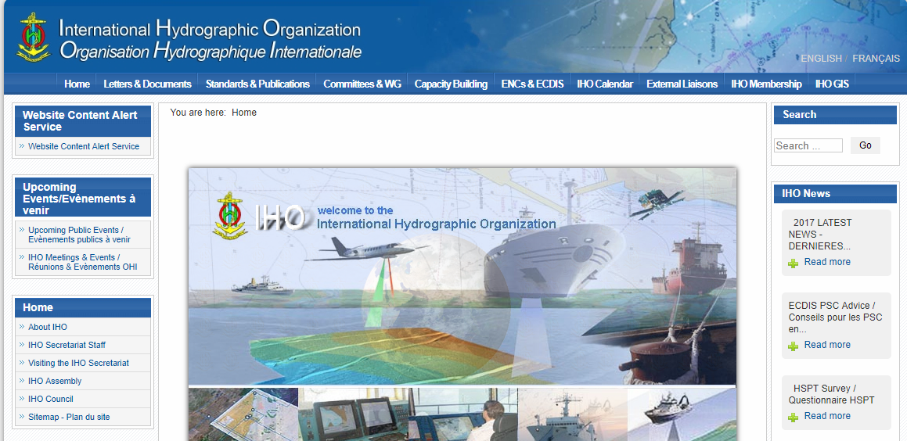
S-44 V6 Questionnaire
Open until November 17, 2017 (this Friday)
https://www.surveymonkey.co.uk/r/HSPT_S-44_Q

Slide 8
Meeting the standards
Can system meet the standards (TPU)?
Can system meet target detection (and resolution; i.e. 9 hits/target size - 3 along and 3 across)?
Prove system can meet the requirements (evaluate over reference surface)
Surface comparison – does the surface have high enough resolution to effectively evaluate higher resolution systems?
Positioning must be HA
Need GNSS heights, not tide
Keep in mind, uncertainty includes bottom topography
Prove standards were met:
Final surface uncertainty (TPU or SD)
Crosscheck lines

Slide 9
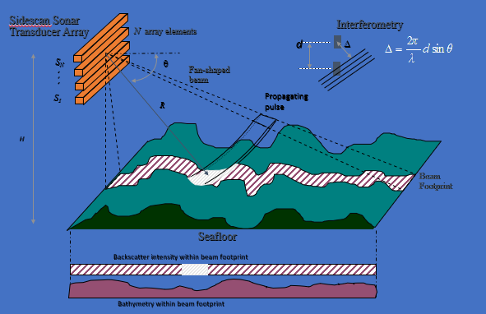
High-resolution Swath Bathymetry
SSS Bathymetry
Swath Bathymetry
Phase Differencing
Interferometric
Angle and range for each pixel (3D SSS)
Thousands of returns per ping
High uncertainty in “raw”
Binning to create smoothed “sounding”

Slide 10
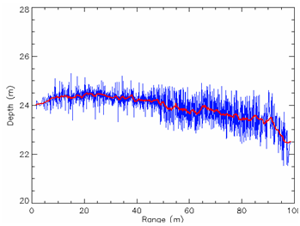
Taken from: http://www.bathyswath.com/iho-standards

Slide 11
MB compared to Swath Bathymetry
Angle of return determined through data analysis rather than beam forming

Slide 12
Hydrographic Office approach to Swath Bathymetry
No
Yes, but binned, not “raw”
Yes, maybe - needs to be approved (show you can meet standards)

Slide 13
Evaluation of High Resolution Swath Systems
Can the system that created the reference surface achieve the same resolution as the system being evaluated?
Is it valid to evaluate using surfaces created from the same system?

Slide 14
Ping DSP 3D SSS

Slide 15
Evaluation
Vancouver Island
Nova Scotia

Slide 16
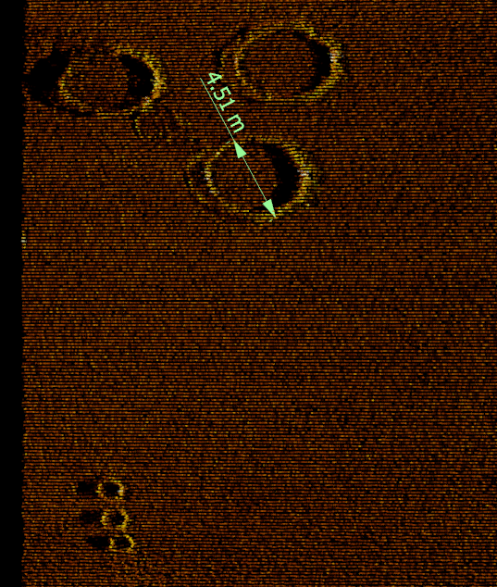
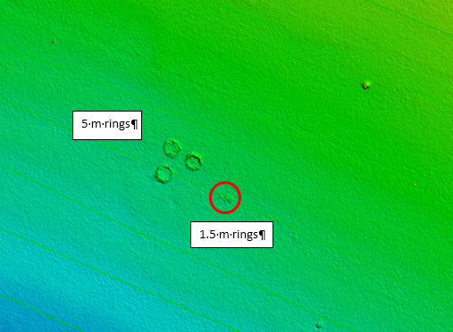
20 m of water

Slide 17
1A to 6X WD

Slide 18
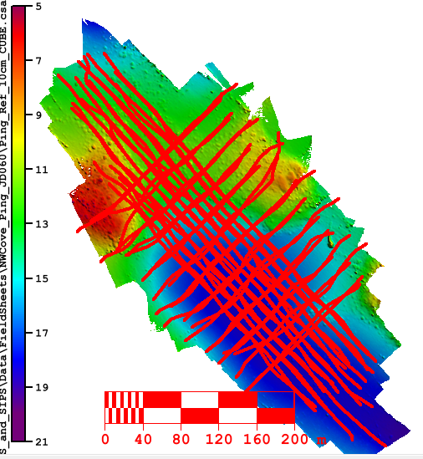
NS, NW Cove 10 cm Reference Surfaces
PING: 25.4 density
R2Sonic: 9.5 density
10 cm surface difference, 0.00 m bias, 0.08m SD

Slide 19
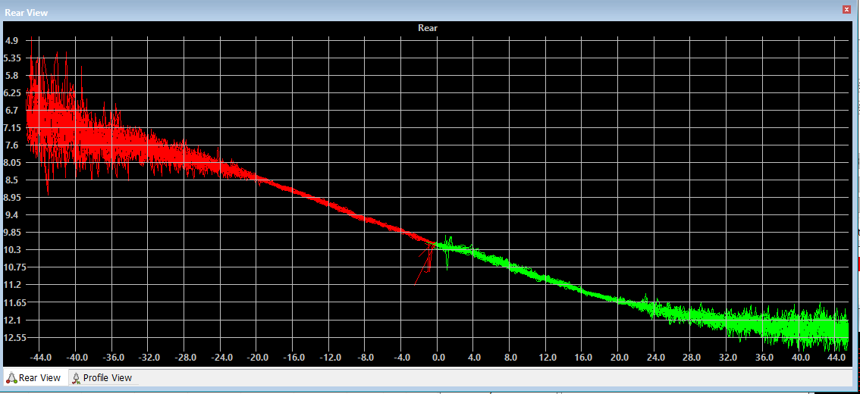
~1000 “beams” for ~100m swath, 6 to 12 m water depth

Slide 20
Ping X-check line, 10 cm bins, Special Order

Slide 21
Ping X-check line, 10 cm bins, Order 1A

Slide 22
Ping L48 JD 053, compared to R2Sonic 0.10, 0.25, 0.50, 1, 2, and 5m surfaces, Special Order

Slide 23
Ping L48 JD 053, compared to R2Sonic 0.10, 0.25, 0.50, 1, 2, and 5m surfaces, Order 1A

Slide 24
Ping L48 JD 053, compared to R2Sonic 0.10, 0.25, 0.50, 1, 2, and 5m surfaces, SD

Slide 25
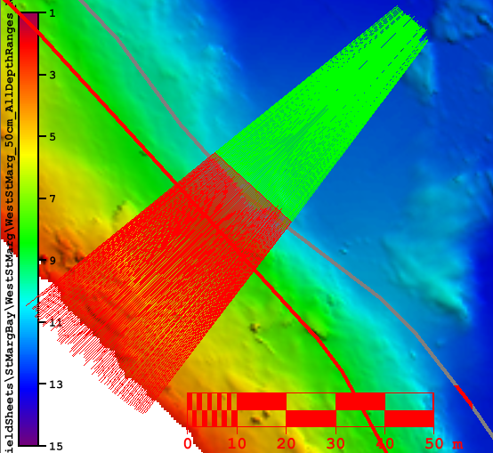
Coastline
Line 52 South to north. Port side to coastline

Slide 26
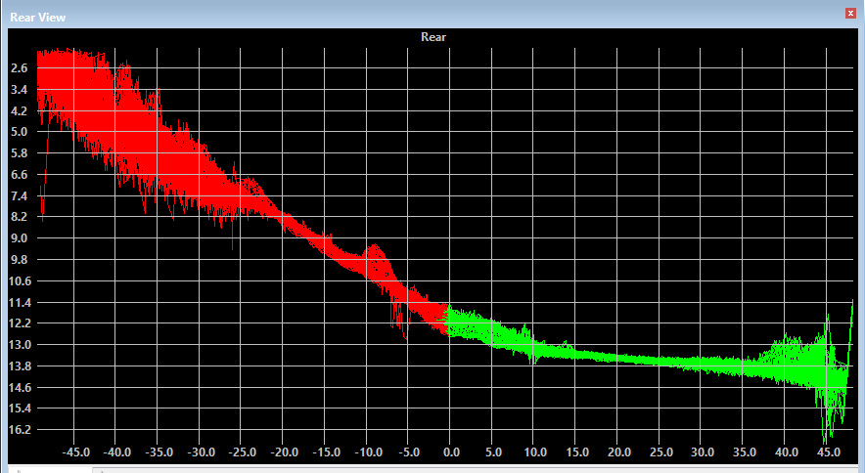
Coastline, Line 52

Slide 27
Coastline 51
Deep on port side

Slide 28
Coastline 51
Deep on port side

Slide 29
Conclusions
High-resolution systems can meet IHO specs
Reference surface from beamforming MB adequate for evaluating high-resolution Swath Bathymetry
Reference surfaces developed from the same system being evaluated provide valid results, but do not take into account any vertical offsets
High resolution SSS swath bathymetry:
Issues at nadir, especially for Special Order
Suitable for high-resolution imagery requirements
Especially useful in shallow harbours and along rugged coastlines

