Slide 1
Hydro17 – Accuracy in Depth Rotterdam, November 15th, 2017
Peter Dugge, Design Lean Navigation, Mission and Charting Systems
Notes:
Version 6

Slide 2
Hydro17 – Accuracy in Depth
Outline
The hydrographic pros and cons of UUVs compared to surface vessels have been discussed for a while.
A topic which has received less attention so far
is
the considerable gain in accuracy of depth measurements
achievable
when using UUVs rather than surface vessels.
Objective
IHO S-44
AUV Design
Error Budget
Total Errors
Conclusion

Slide 3
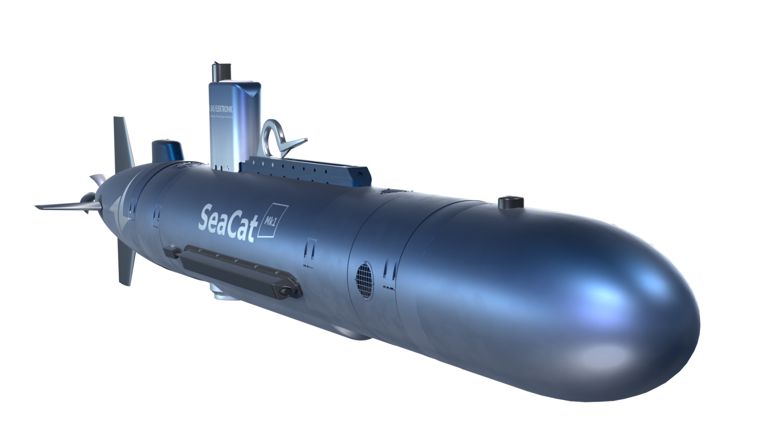
Hydro17 – Accuracy in Depth
Objective
To design an AUV
which allows to achieve and exceed
the requirements of IHO S-44 Special Order
with a strong focus on depth.
Objective
IHO S-44
AUV Design
Error Budget
Total Errors
Conclusion

Slide 4
Hydro17 – Accuracy in Depth
IHO S-44 Maximal Total Horizontal Uncertanity (THU) (95 %)
Objective
Depth | Order
 | SO (2 m) | 1a / 1b (5 m + 5 % of depth) | 2 (20 m + 10 % of depth)
5 m | 2.0 m | 5.25 m | n/a
10 m | 2.0 m | 5.5 m | n/a
20 m | 2.0 m | 6.0 m | n/a
50 m | 2.0 m | 7.5 m | n/a
100 m | 2.0 m | 10.0 m | 30 m
200 m | n/a | n/a | 40 m
300 m | n/a | n/a | 50 m
400 m | n/a | n/a | 60 m
500 m | n/a | n/a | 70 m
600 m | n/a | n/a | 80 m
IHO S-44
AUV Design
Error Budget
Total Errors
Conclusion

Slide 5
Hydro17 – Accuracy in Depth
IHO S-44 Maximal Total Vertical Uncertanity (TVU) (95 %)
Objective
Depth | Order
 | SO | 1a / 1b | 2
5 m | 0.25 m | 0.50 m | n/a
10 m | 0.26 m | 0.52 m | n/a
20 m | 0.29 m | 0.56 m | n/a
50 m | 0.45 m | 0.82 m | n/a
100 m | 0.79 m | 1.39 m | 2.51 m
200 m | n/a | n/a | 4.71 m
300 m | n/a | n/a | 6.97 m
400 m | n/a | n/a | 9.25 m
500 m | n/a | n/a | 11.54 m
600 m | n/a | n/a | 13.84 m
$\sqrt{\text{0.06 + }{\text{(}\text{0.0075 }\text{x} \text{d}\text{)}}^{2}}$ $\sqrt{\text{0.}\text{25}\text{ + }{\text{(}\text{0.0}\text{13} \text{x} \text{d}\text{)}}^{2}}$ $\sqrt{\text{1.00}\text{ + }{\text{(}\text{0.0}\text{23} \text{x} \text{d}\text{)}}^{2}}$
IHO S-44
AUV Design
Error Budget
Total Errors
Conclusion

Slide 6
Hydro17 – Accuracy in Depth
Components of Navigation System
Objective
GNSS Receiver
Sound Velocity Sensor
IHO S-44
USBL Transponder
AUV Design
Pressure Sensor
Error Budget
Accuracy 0.07 m ($δ$₉₅)
INS
Total Errors
Position
Depth
DVL
N
Conclusion

Slide 7
Hydro17 – Accuracy in Depth
Vertical Error Components, AUV navigation in 200 m depth (𝛿₉₅)
Objective
Pressure sensor
0.07 m
Tide correction
0.1 m
RTK, commercial SBAS
IHO S-44
Density profile
0.019 m
200 m depth, external CTD
Stagnation pressure
0.0 m
AUV Design
Acceleraton of gravity
0.012 m
200 m depth
Computation of depth with pressure
Error Budget
0.0 m
computation error
Surface waves
0.0 m
20 m depth, 1 m wave hight , 20 m wave length
Total Errors
Installation error of the position between pressure sensor and INS
0.005 m
Atmospheric pressure
0.0 m
Conclusion
Total propagated depth error of navigation
0.125 m

Slide 8
Hydro17 – Accuracy in DepthAccuracy in Depth
Standard Deviation of Vertical Error Components of MBES (σ)
Objective
IHO S-44
AUV Design
Error Source | Alitude over seabed / Beam Angle
 | 20 m / 30° | 50 m / 30° | 20 m / 70° | 50 m / 70°
Acoustic wave detection limit | Not relevant
Sound Velocity Profile | 0.007 m | 0.018 m | 0.051 m | 0.127 m
Roll Error | 0.020 m | 0.050 m | 0.096 m | 0.240 m
Pitch Error | 0.003 m | 0.008 m | 0.003 m | 0.008 m
Installation Error * | 0.005 m | 0.005 m | 0.005 m | 0.005 m
Total propagated MBES Error | 0.022 m | 0.054 m | 0.109 m | 0.272 m
Error Budget
Total Errors
Conclusion
*) of the position between MBES and INS

Slide 9
Hydro17 – Accuracy in Depth
Total Vertical Error Components of DTM (𝛿₉₅)
Objective
Depth | Error source ($δ$₉₅) |  |  |  |  | Total propagated vertical error ($δ$₉₅)
 | Navigation System |  |  |  | MBES
 | Pressure sensor | Density profile | Gravity model | Tide
5 m | 0.070 m | 0.001 m | 0.001 m | 0.1 m | 0.054 m | 0.134 m
10 m | 0.070 m | 0.001 m | 0.001 m | 0.1 m | 0.107 m | 0.163 m
20 m | 0.070 m | 0.002 m | 0.001 m | 0.1 m | 0.214 m | 0.247 m
50 m | 0.070 m | 0.005 m | 0.003 m | 0.1 m | 0.214 m | 0.247 m
100 m | 0.070 m | 0.010 m | 0.006 m | 0.1 m | 0.214 m | 0.247 m
200 m | 0.070 m | 0.019 m | 0.012 m | 0.1 m | 0.214 m | 0.248 m
300 m | 0.070 m | 0.028 m | 0.018 m | 0.1 m | 0.214 m | 0.249 m
400 m | 0.070 m | 0.037 m | 0.024 m | 0.1 m | 0.214 m | 0.251 m
500 m | 0.070 m | 0.046 m | 0.030 m | 0.1 m | 0.214 m | 0.253 m
600 m | 0.070 m | 0.055 m | 0.036 m | 0.1 m | 0.214 m | 0.255 m
IHO S-44
AUV Design
Error Budget
Total Errors
Conclusion

Slide 10
Hydro17 – Accuracy in Depth
Comparison of Total Propagated Vertical Error with IHO S-44 TVU
Objective
Depth | TVU of IHO S-44 Order |  |  | Total propagated vertical error ($δ$₉₅)
 | SO | 1a / 1b | 2
5 m | 0.25 m | 0.50 m | n/a | 0.134 m
10 m | 0.26 m | 0.52 m | n/a | 0.163 m
20 m | 0.29 m | 0.56 m | n/a | 0.247 m
50 m | 0.45 m | 0.82 m | n/a | 0.247 m
100 m | 0.79 m | 1.39 m | 2.51 m | 0.247 m
200 m | n/a | n/a | 4.71 m | 0.248 m
300 m | n/a | n/a | 6.97 m | 0.249 m
400 m | n/a | n/a | 9.25 m | 0.251 m
500 m | n/a | n/a | 11.54 m | 0.253 m
600 m | n/a | n/a | 13.84 m | 0.255 m
$\sqrt{\text{0.06 + }{\text{(}\text{0.0075 }\text{x} \text{d}\text{)}}^{2}}$ $\sqrt{\text{0.}\text{25}\text{ + }{\text{(}\text{0.0}\text{13} \text{x} \text{d}\text{)}}^{2}}$ $\sqrt{\text{1.00}\text{ + }{\text{(}\text{0.0}\text{23} \text{x} \text{d}\text{)}}^{2}}$
IHO S-44
AUV Design
Error Budget
Total Errors
Conclusion

Slide 11
Hydro17 – Accuracy in Depth
Comparison of Total Propagated Vertical Error with IHO S-44 TVU
1.4
Objective
1.2
IHO S-44
1.0
Maximum TVU to IHO S-44 Order 1a/1b
AUV Design
0.8
Error (𝛿₉₅) / m
0.6
Error Budget
Maximum TVU to IHO S-44 SO
0.4
Total Errors
0.2
Total propagated vertical design error
Conclusion
0
0
10
20
30
40
50
60
70
80
90
100
Water depth / m

Slide 12
Hydro17 – Accuracy in Depth
Conclusion
Accuracy requirements of IHO S-44 for depth can be met and exceeded with AUVs.
This can be achieved by using an AUV with a carefully selected and integrated pressure sensor.
Thus hydrographic surveyors are offered the opportunity to
establish new survey methods
e.g. to monitor wrecks and off-shore installations with an
unprecedented precision and efficiency.

