Slide 1
Magnetic anomalies
reveal prehistoric channels
Seger van den Brenk
Periplus Archeomare

Slide 2
Periplus Archeomare
Part of Periplus Group
Specialized in under water Archaeology
Desk studies, geophysical surveys, dive inspections
Clients: RWS, dredging companies, wind farm developers

Slide 3
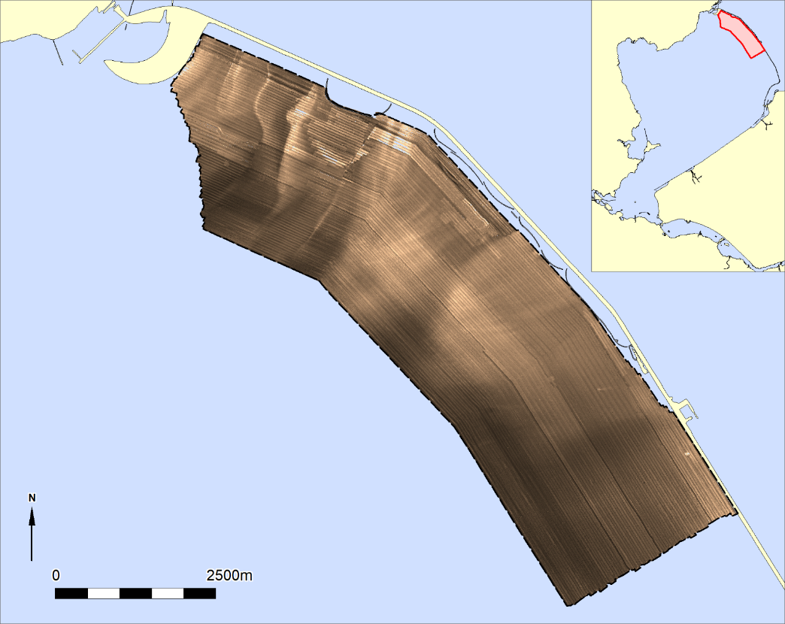
Archaeological survey Houtribdijk
28 km2
Goal:
Shipwrecks using side scan sonar
(Iron) debris using magnetometer

Slide 4
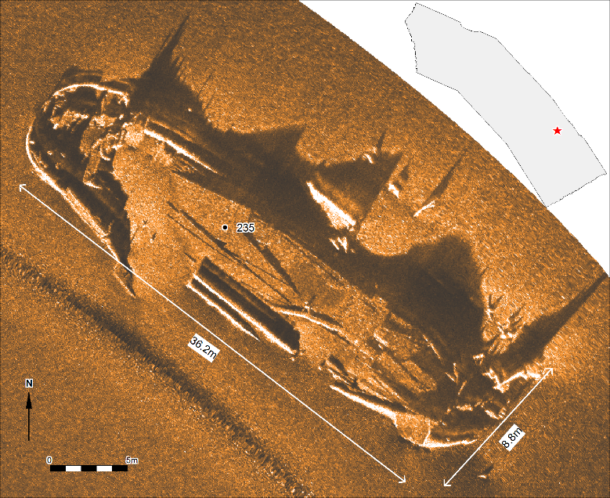
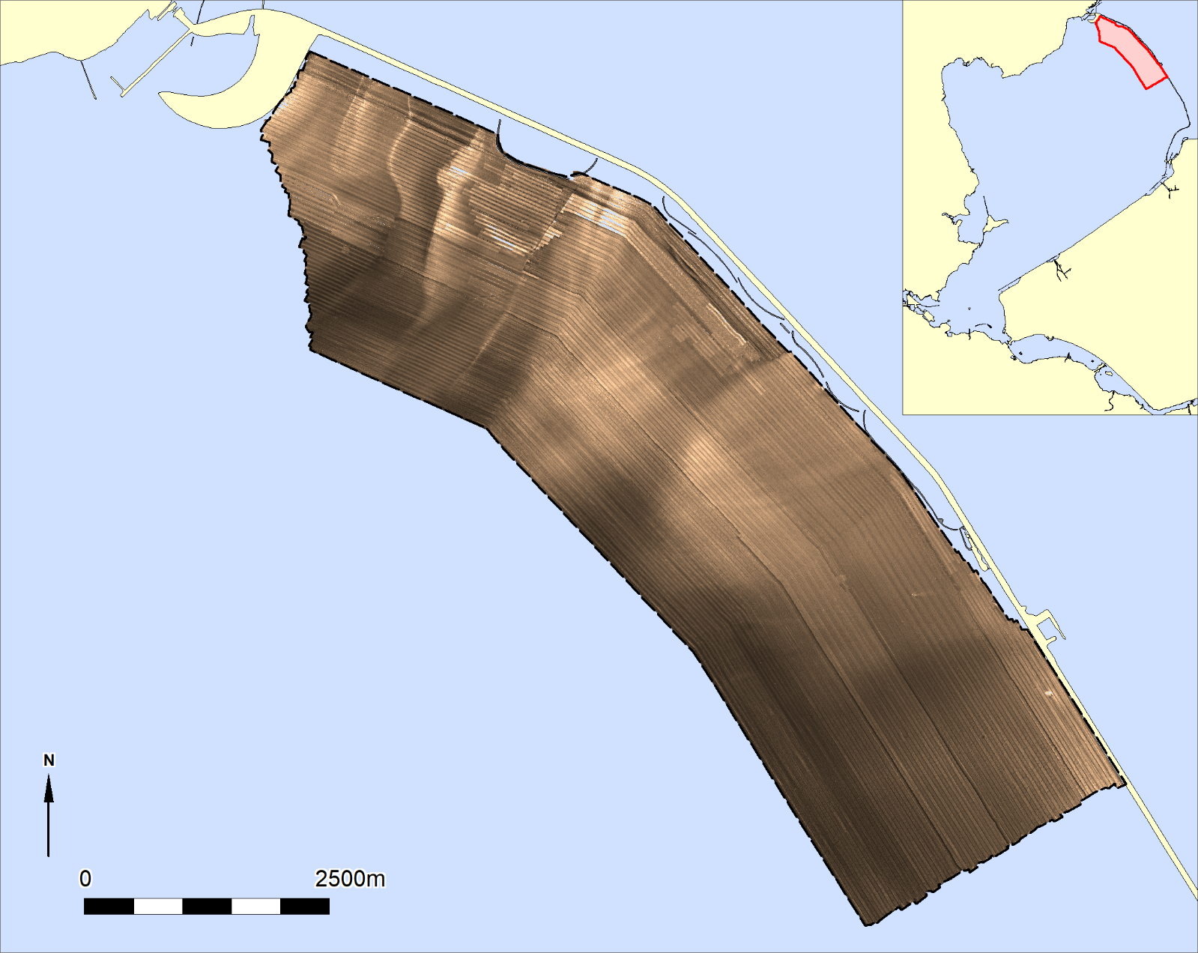
Archaeological survey Houtribdijk
Side scan sonar survey

Slide 5
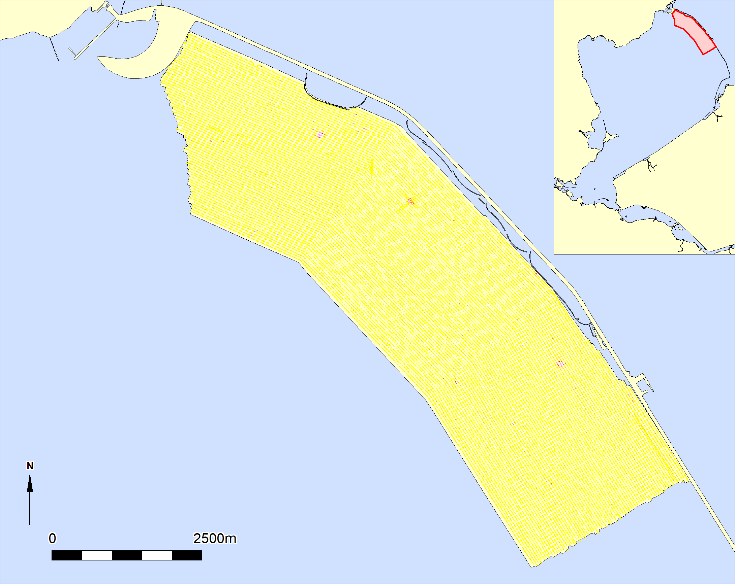
Magnetometer survey Houtribdijk
Magnetometer

Slide 6
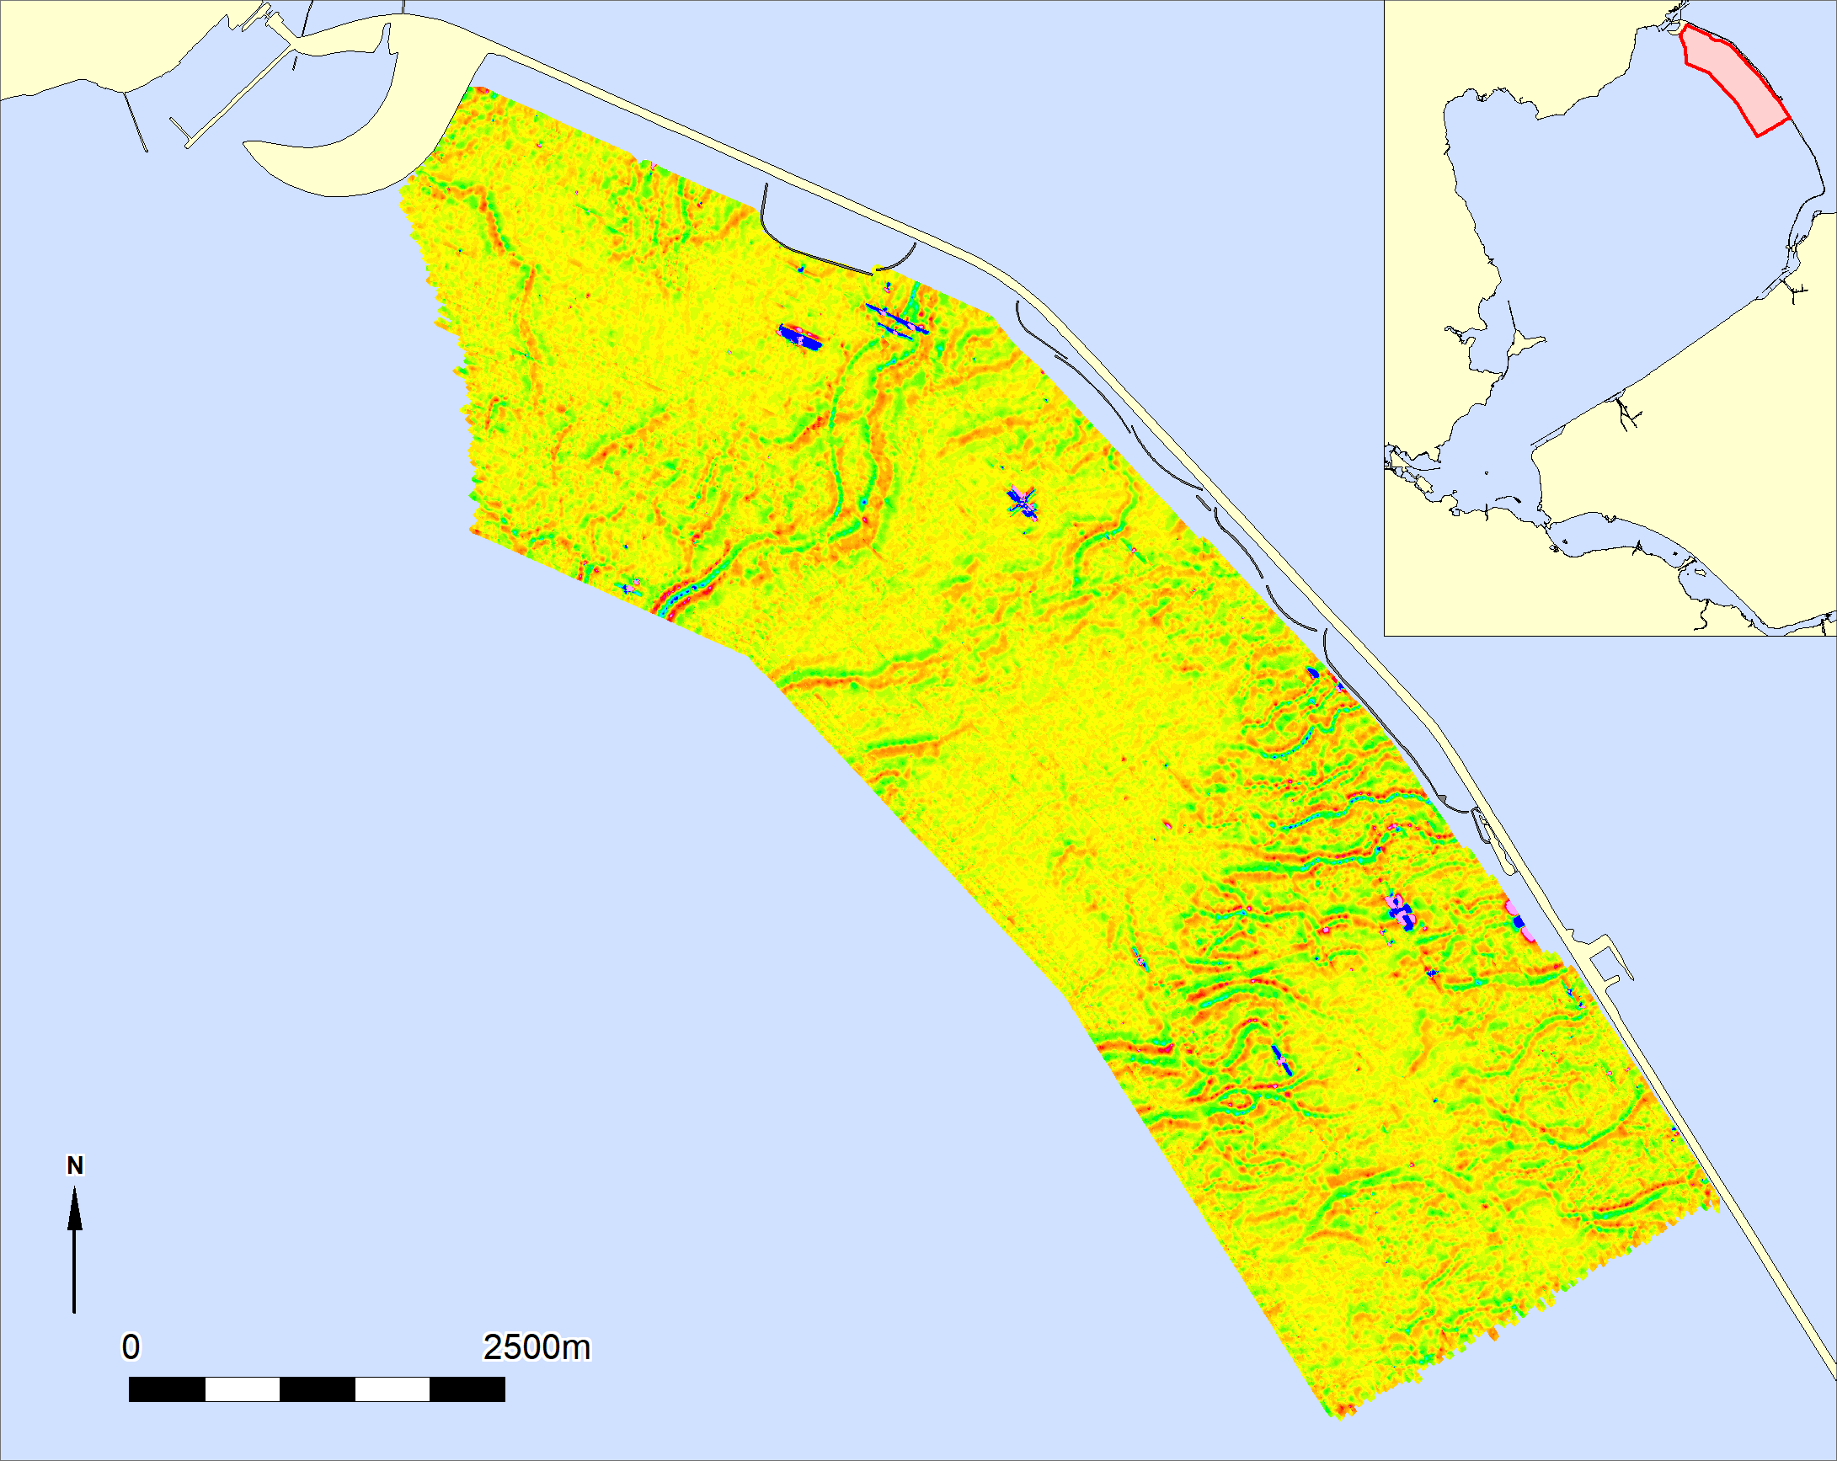
Magnetometer survey Houtribdijk
Amplifying background
Noise reveals patterns?

Slide 7
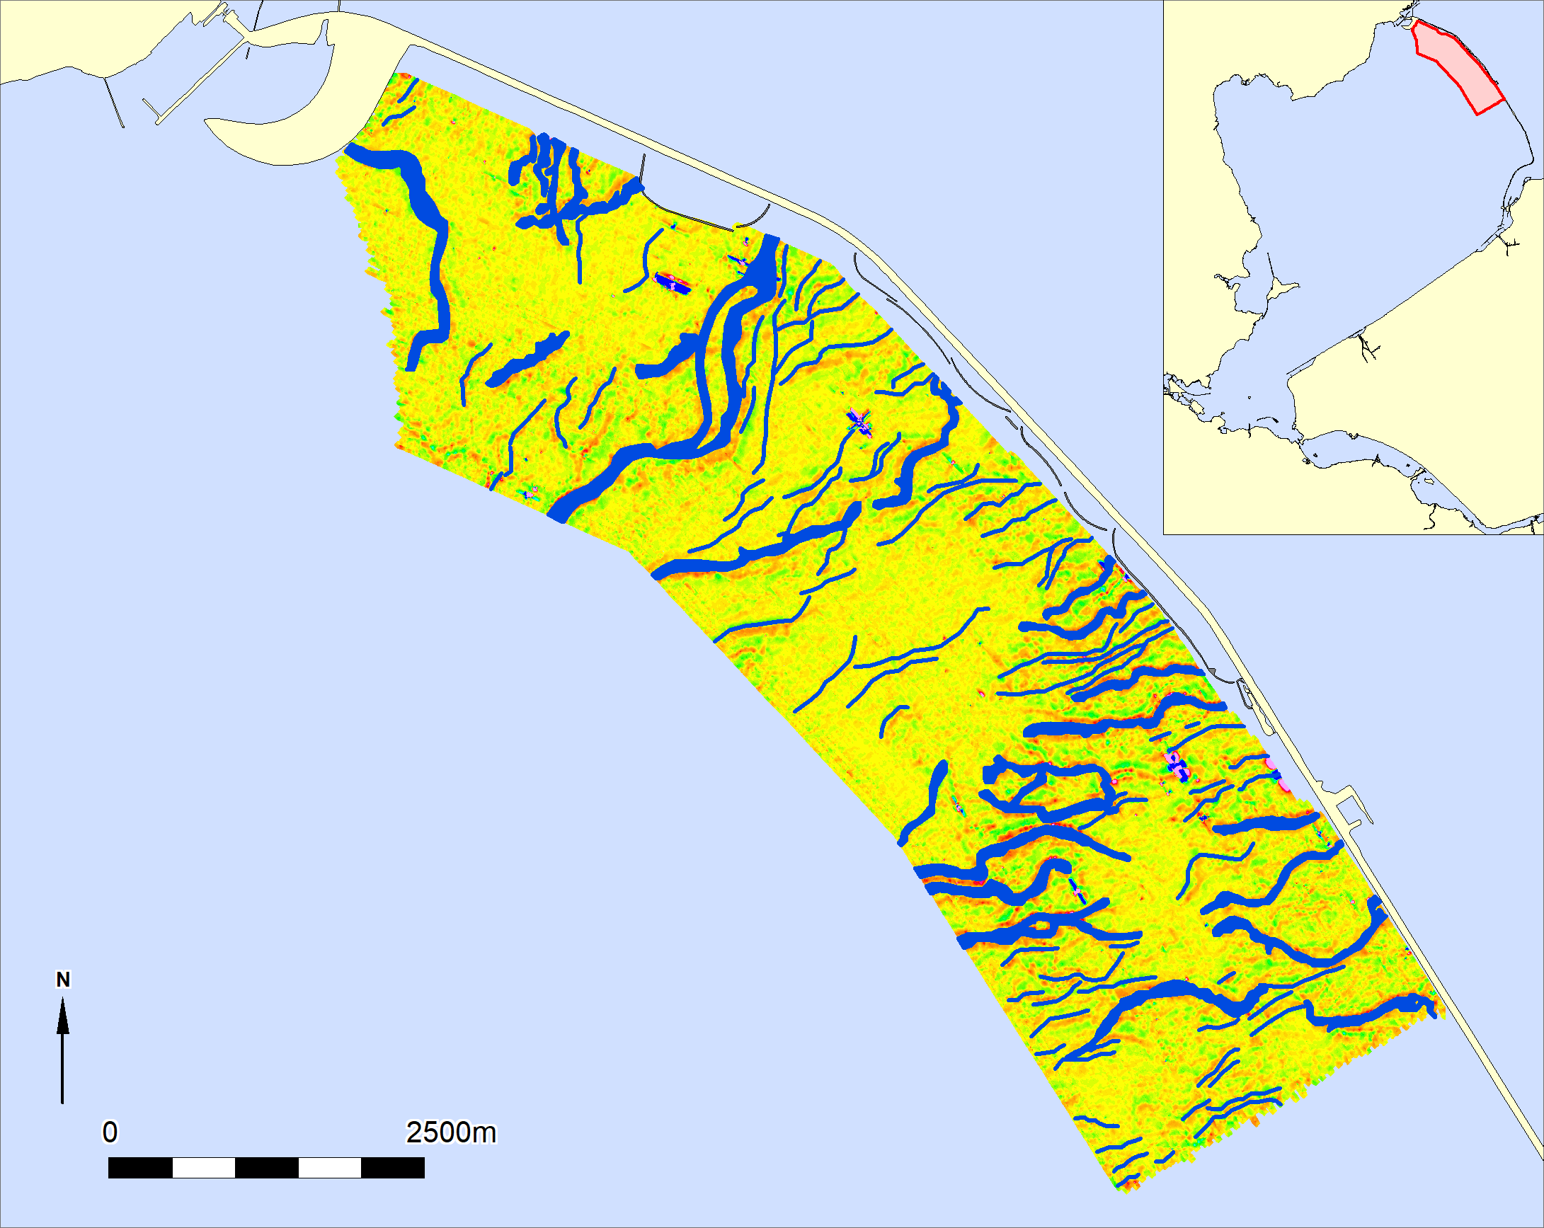
Magnetometer survey Houtribdijk
Amplifying background
Noise reveals patterns?

Slide 8
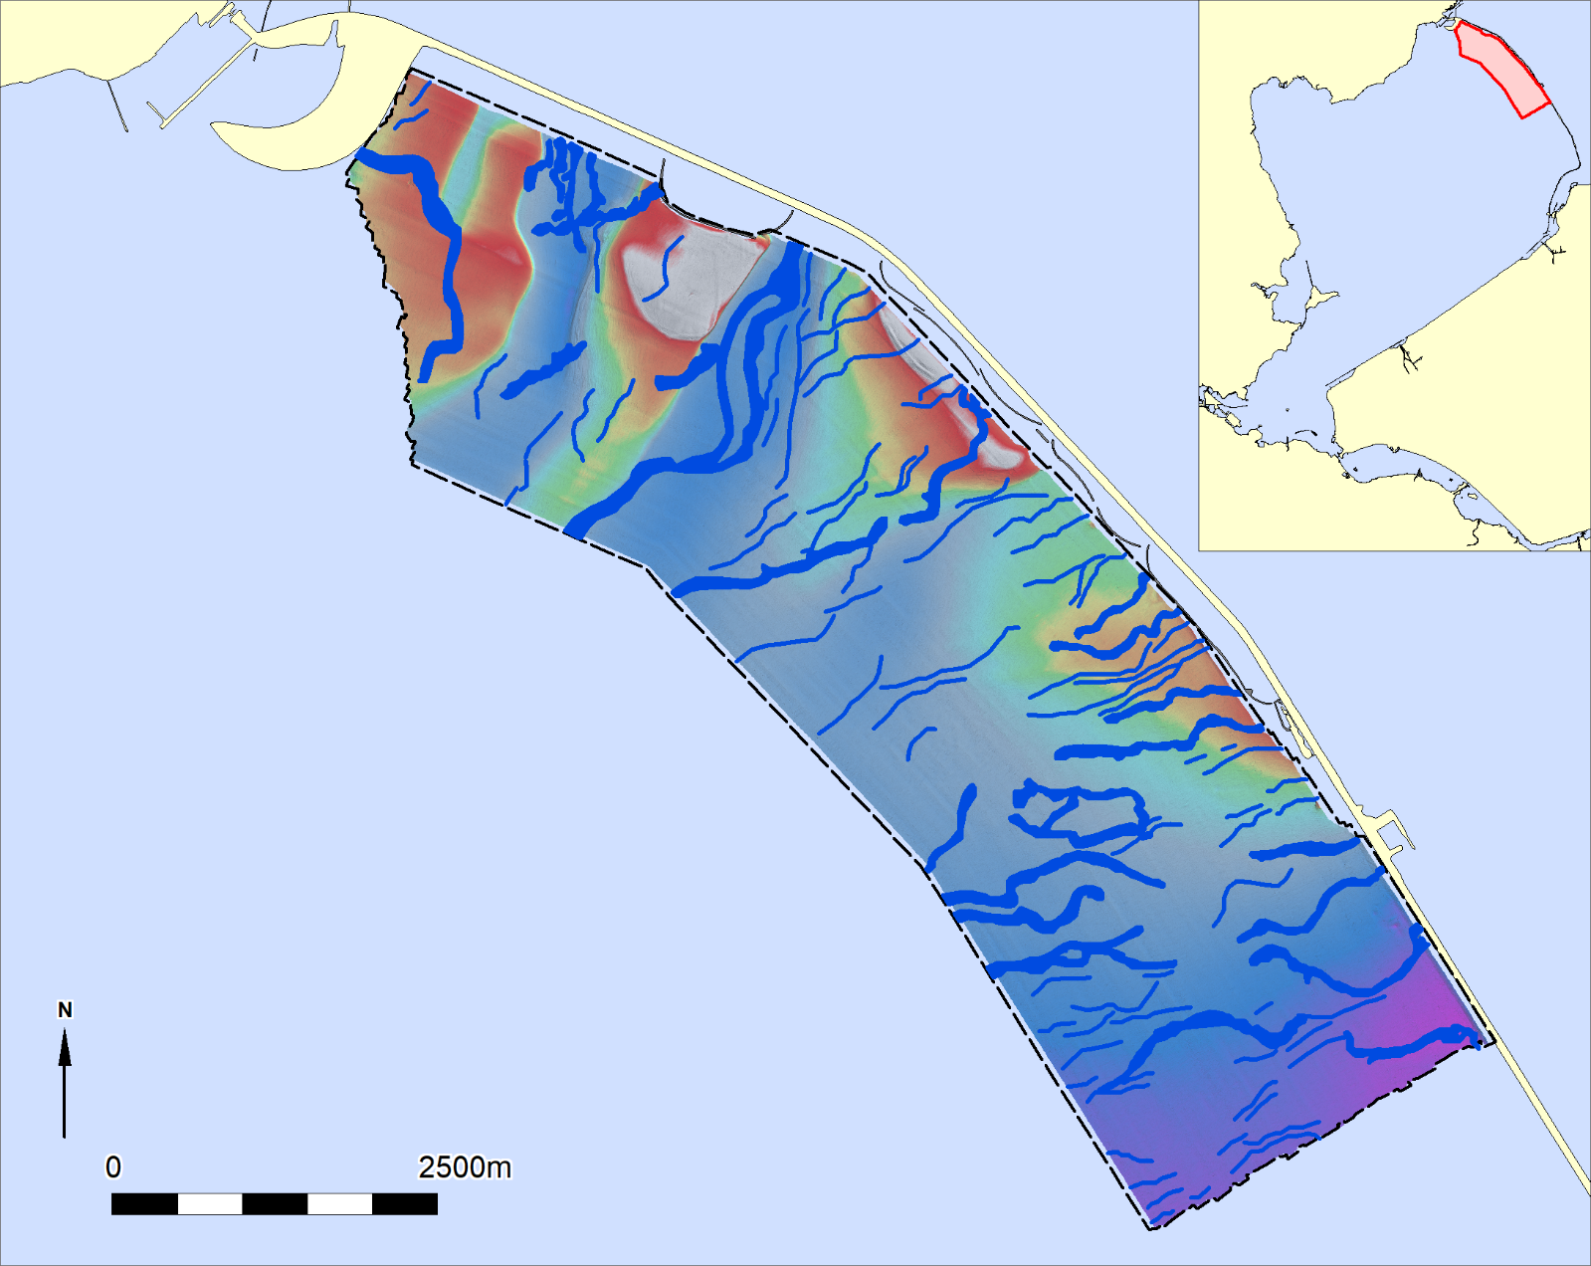
Magnetometer survey Houtribdijk
Check sea bed morphology
No match

Slide 9
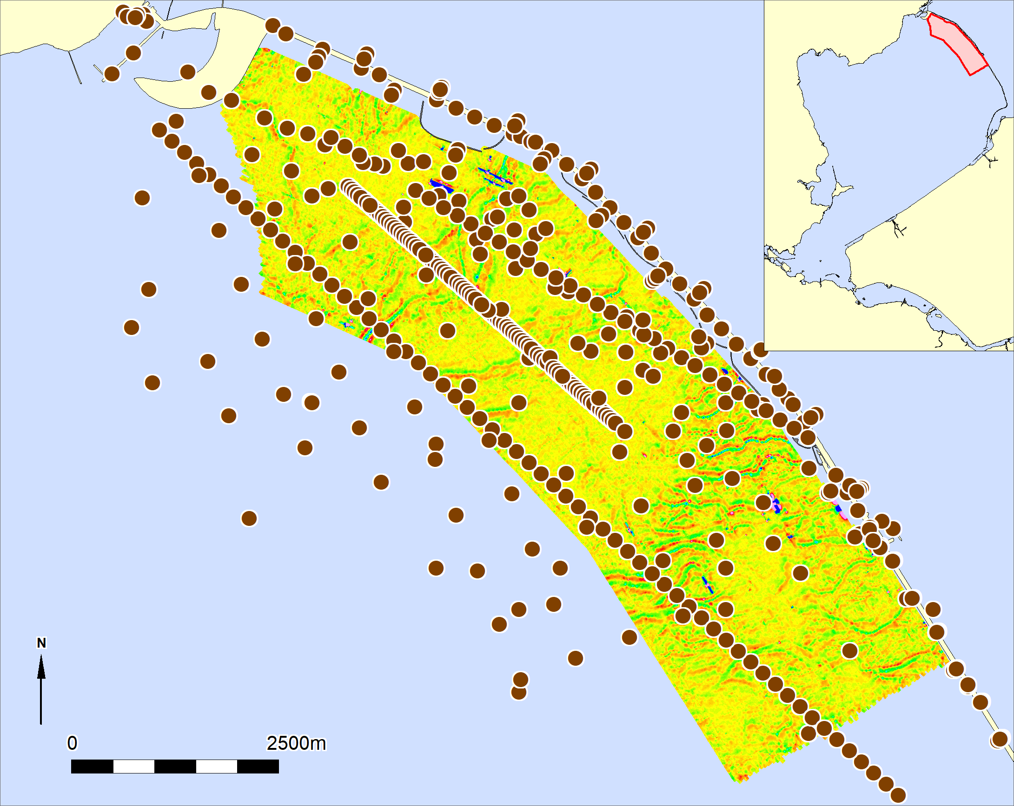
Magnetometer survey Houtribdijk
Check borehole data

Slide 10
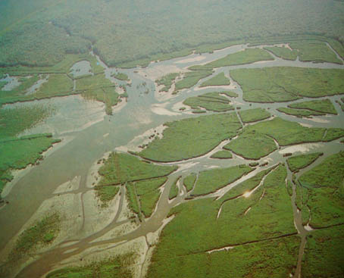
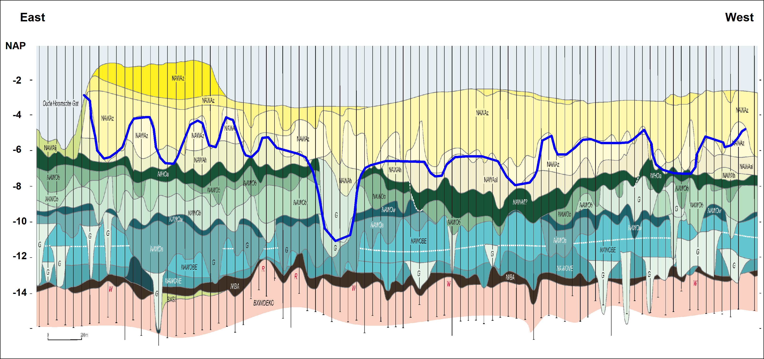
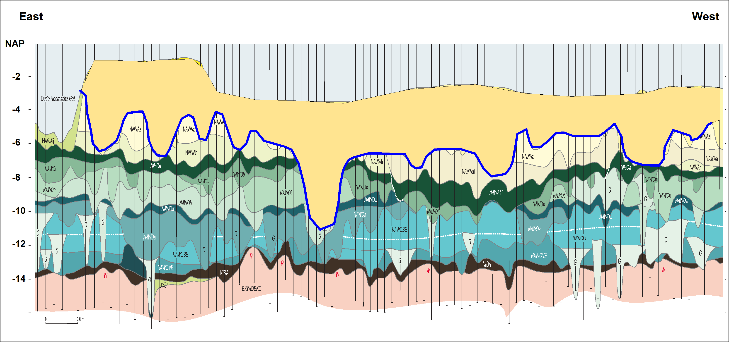
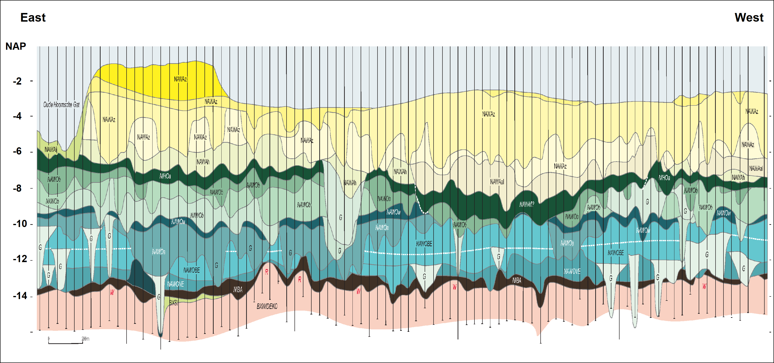
Geological profile
(construction by RAAP)
4000 BP
Sand 2 - 4 m

Slide 11
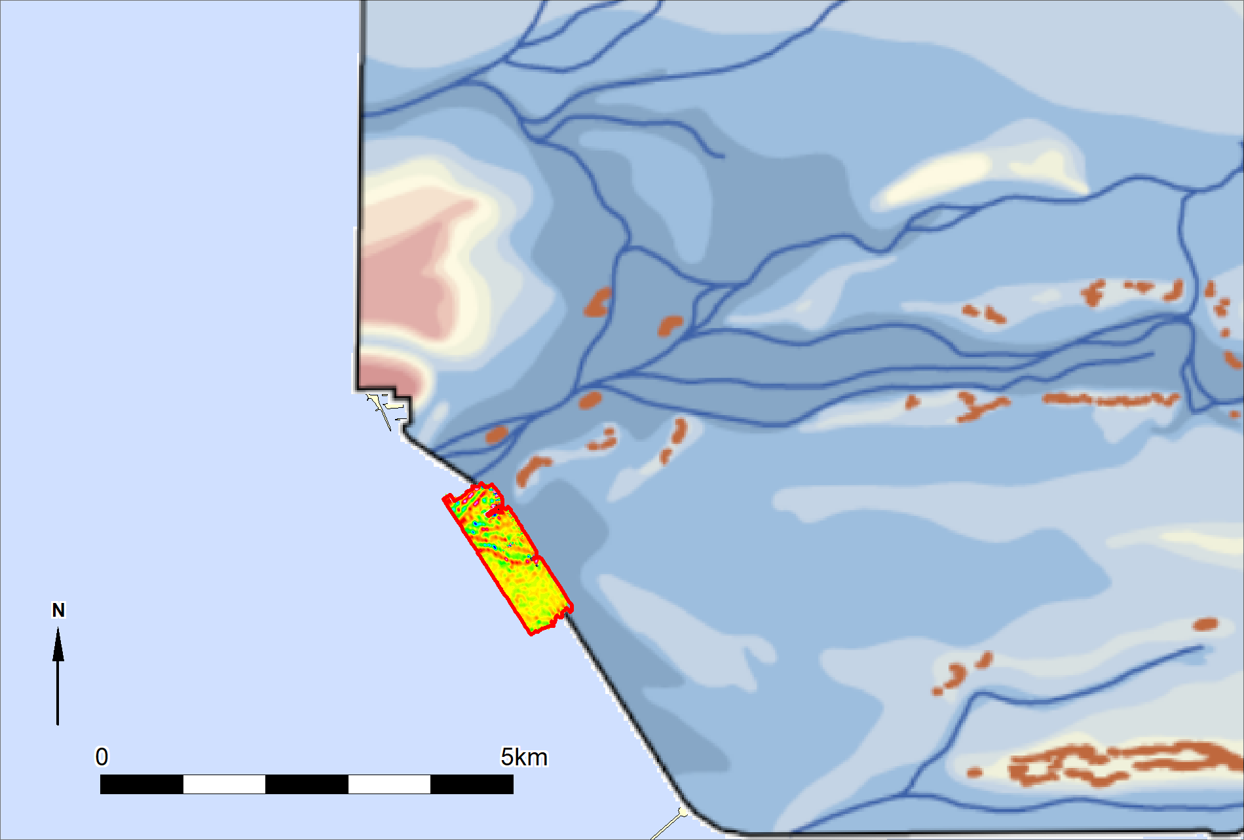
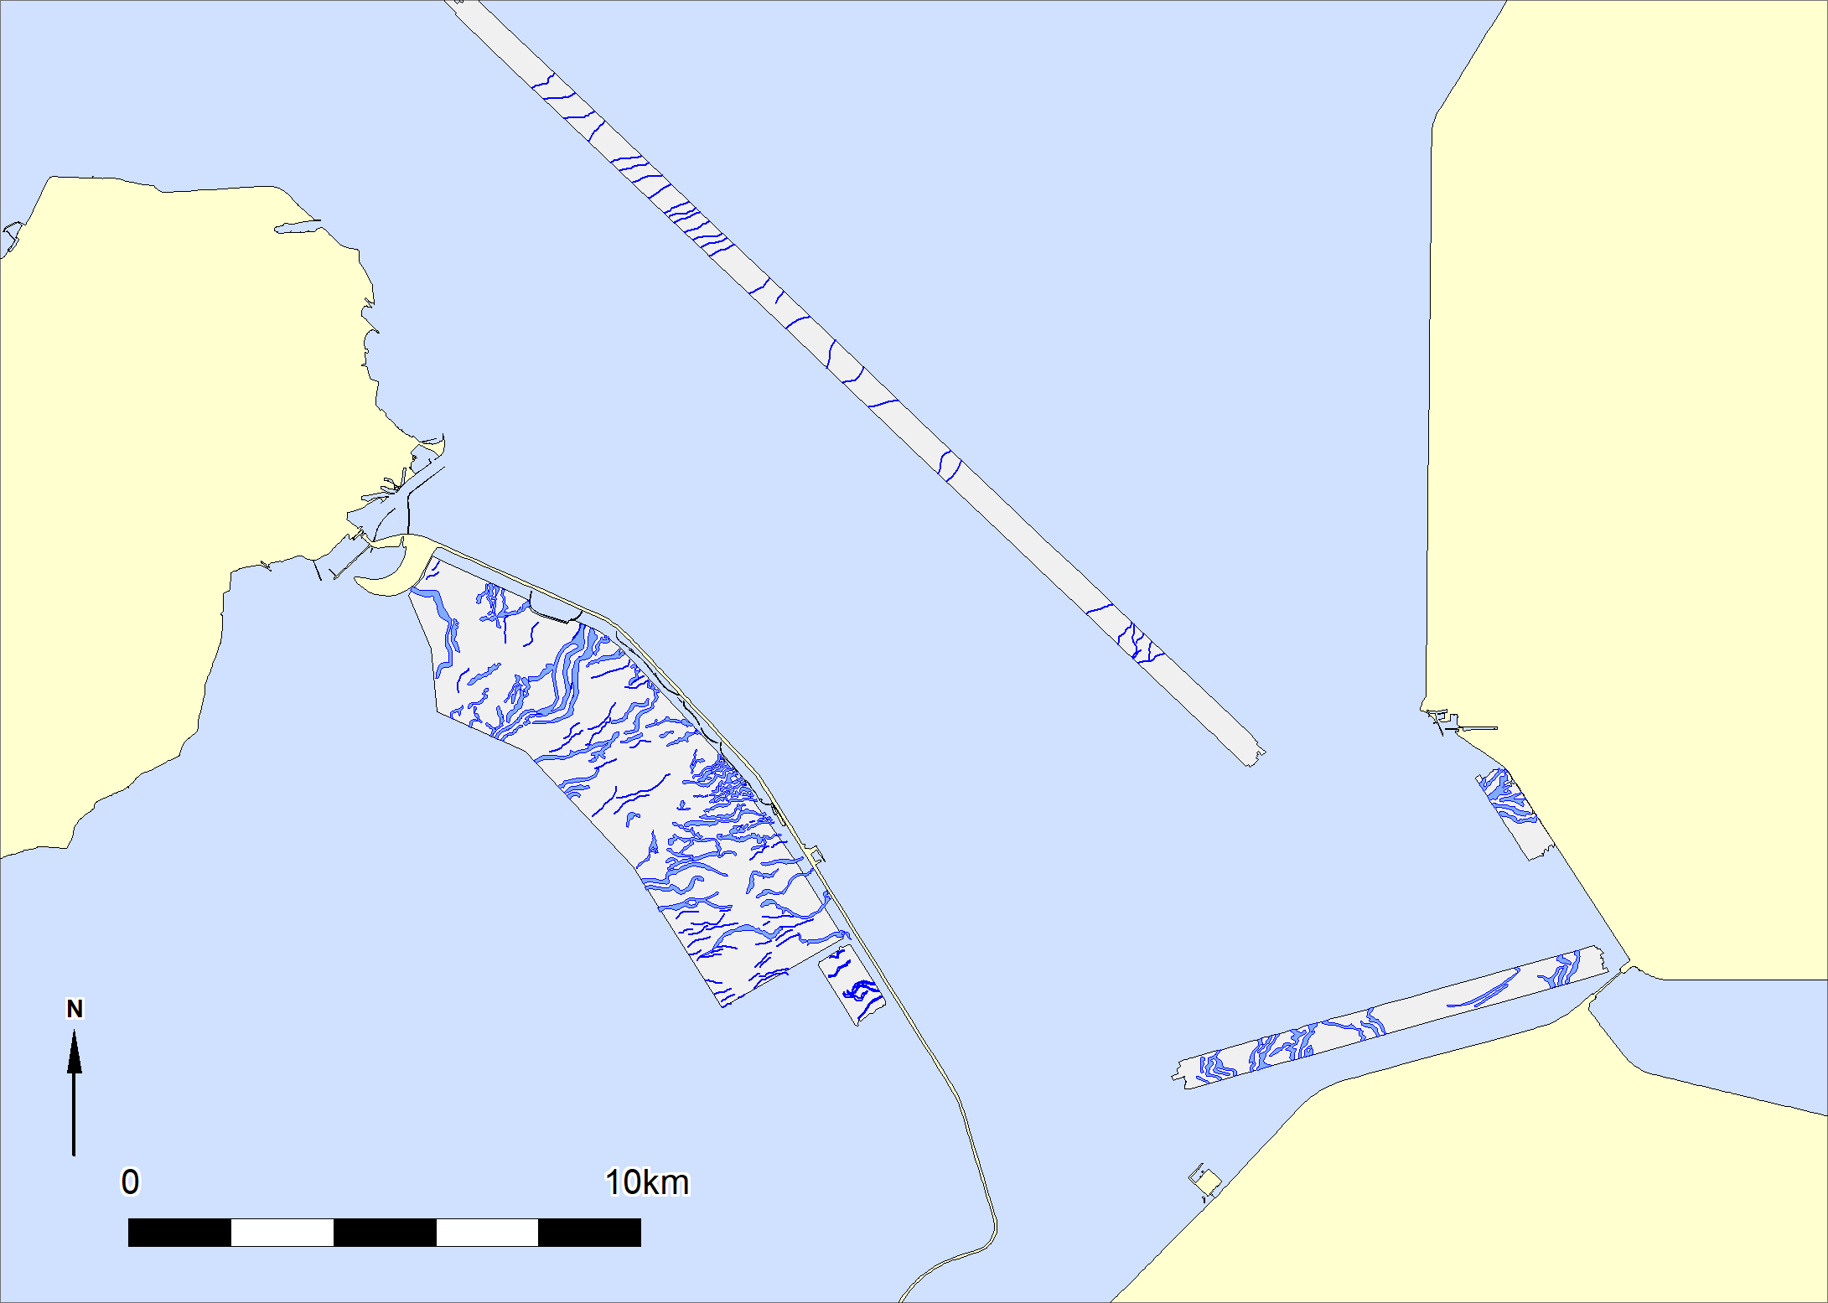
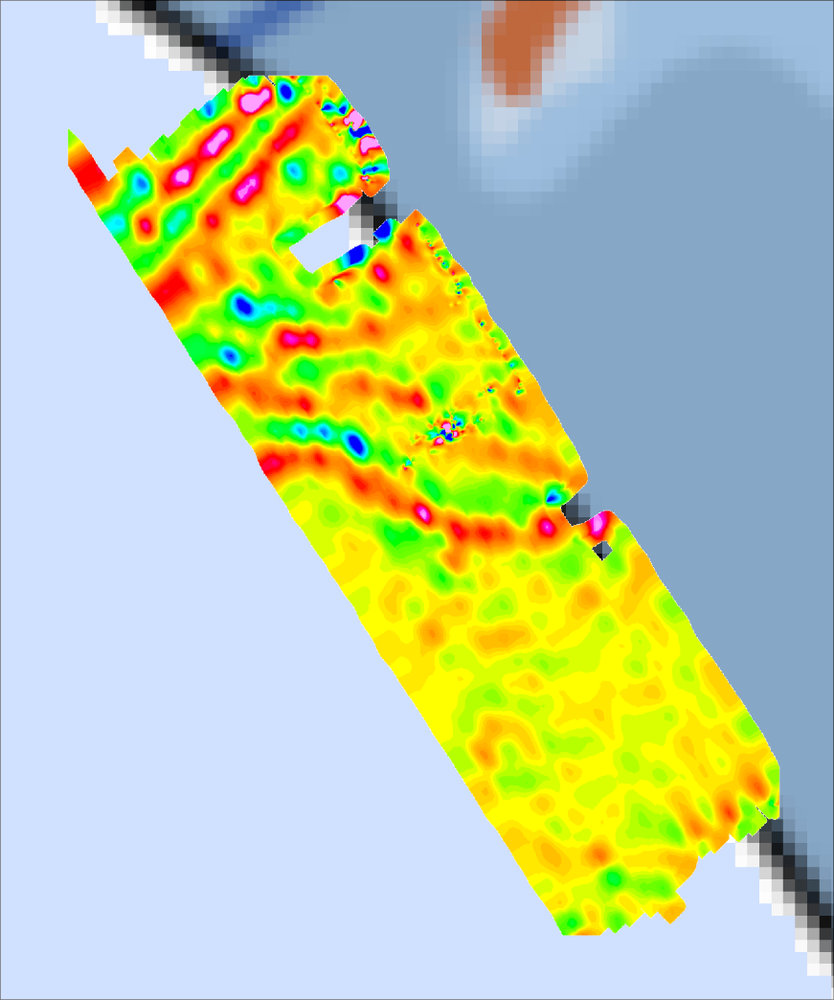
Other examples in vicinity
Urk
Houtribdijk

Slide 12
Technique is proven for IJsselmeer area
But………….
Does it also work on the North Sea?

Slide 13
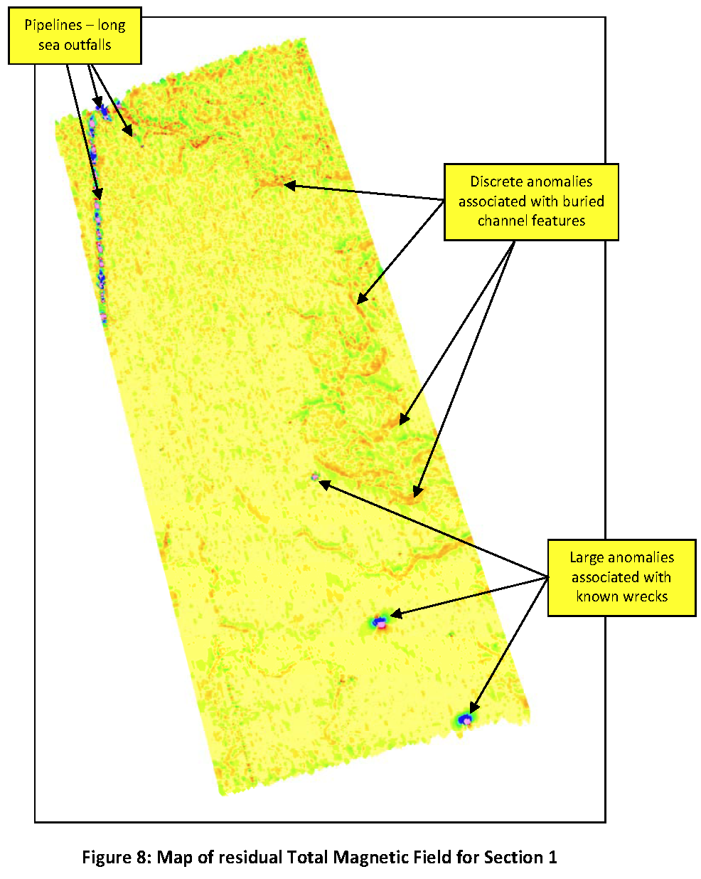
Osiris UK
Survey wind farm

Slide 14
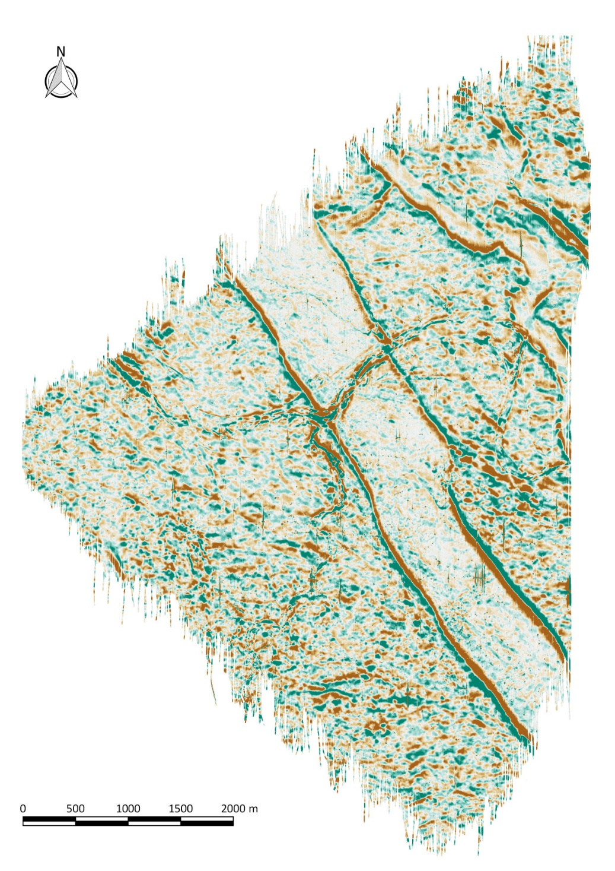
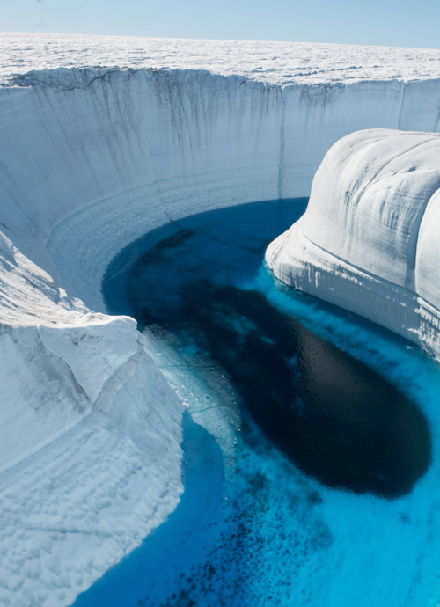
DEEP survey
German Bight
Melt water canyon

Slide 15
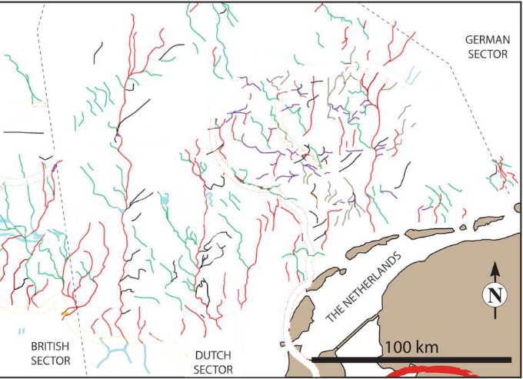
Known ice age Tunnel valleys North Sea

Slide 16
Conclusions
Magnetometer data can be used to map buried channels
Relative simple and cheap method
Offers opportunities for research prehistoric landscapes
Mapping shallow geology for future wind farm zones
Thank you for your attention

