Slide 1
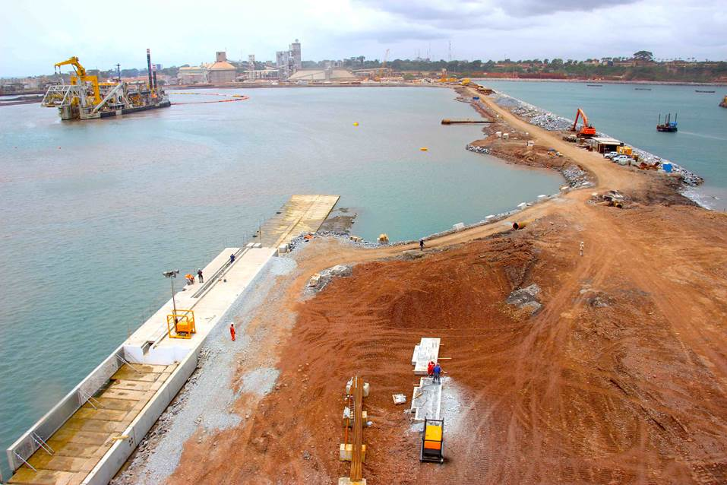
Port of takoradi infrastructure development project - Ghana
Providing (Hydrographic) Services to Marine Construction

Slide 2
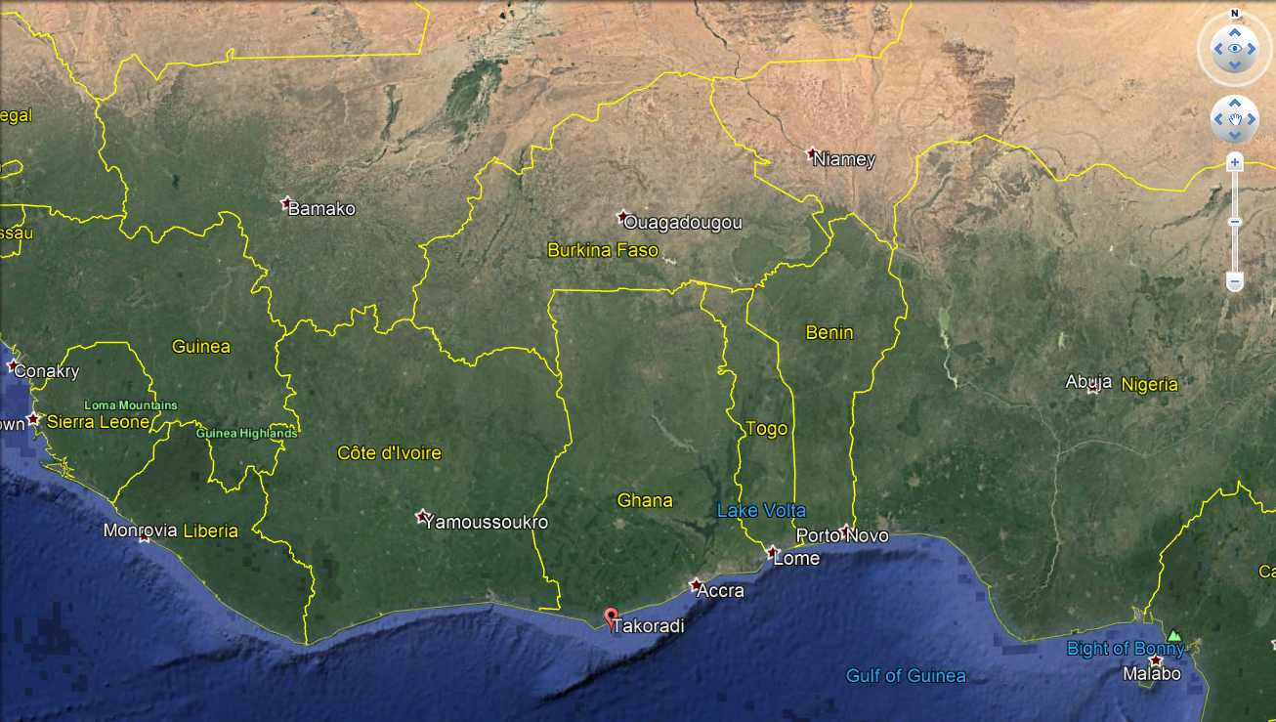
Port of takoradi infrastructure development project - Ghana
Project Location

Slide 3
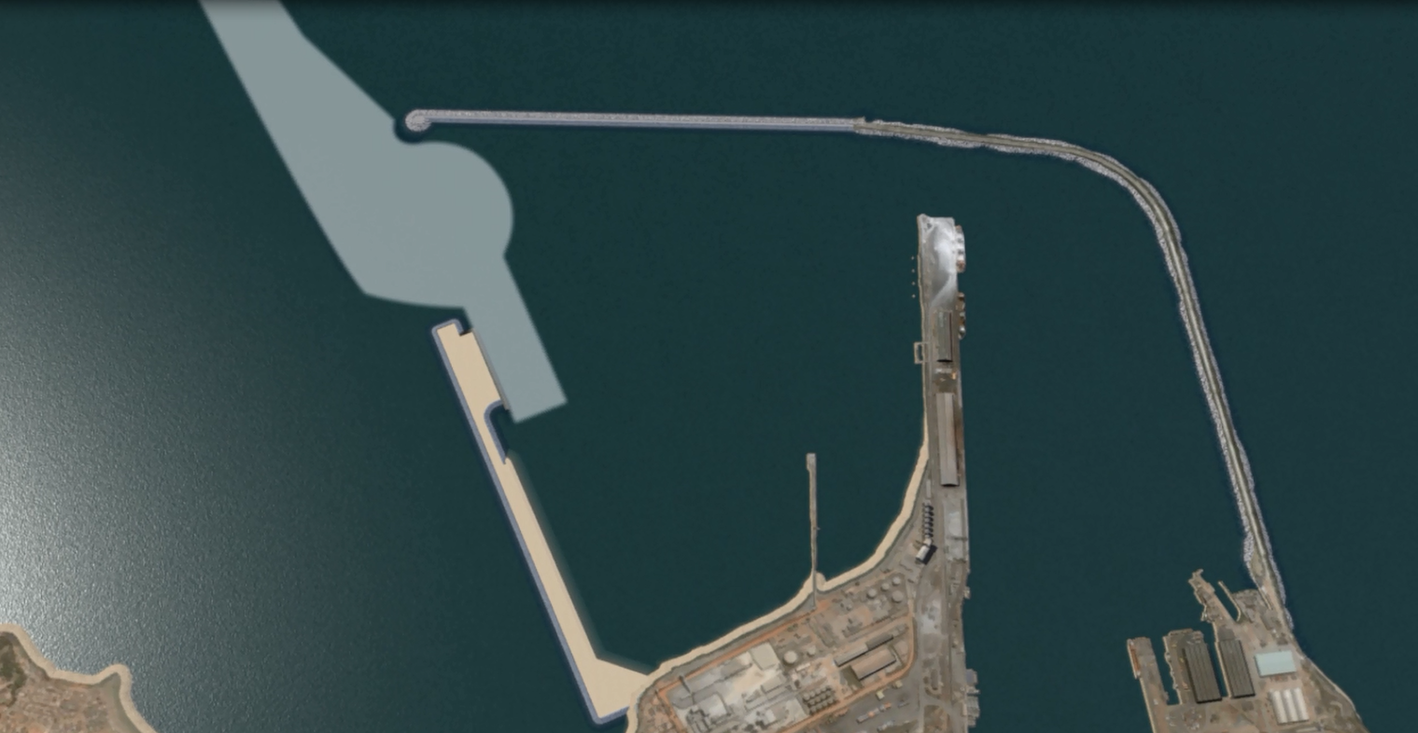
Port of takoradi infrastructure development project - Ghana
Project Description
Extension of the existing breakwater
Dredging of the Maritime Access Channel and creation of new turning basin
Construction of new quay wall
Reclamation and rock revetment
Notes:
1st Phase
Extension of the existing breakwater
Dredging of the Maritime Access Channel and creation of new turning basin
Construction of new 600m long quay wall
Reclamation and rock revetment
Jan De Nul Group is a leading expert in dredging and marine construction activities, as well as in specialized services for the offshore industry of oil, gas and renewable energy. These core marine activities are further enhanced by Jan De Nul Group’s in-house civil and environmental capabilities offering clients a complete package solution.

Slide 4
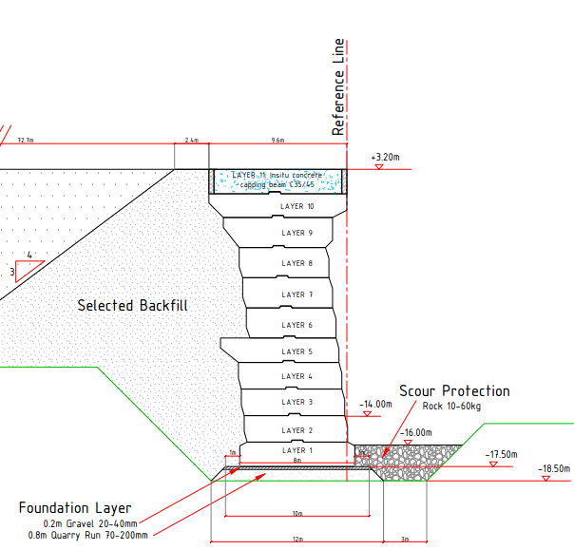
Port of takoradi infrastructure development project - Ghana
Project Description
Quay wall construction Practical
Notes:
In this picture you can see a typical section of the quay wall. The major steps in the construction of the quay wall are the removal of the unsuitable top layer, the installation of the foundation layer or gravel bed of approximately 1m and then the installation of 10 layers of concrete blocks to end up with the called capping beam
It’s obvious that the final result of the quay wall depends a lot on the correct placement of the gravel bed or foundation layer carrying the breakwater construction. To accomplish this, a custom made levelling tower has been built.

Slide 5
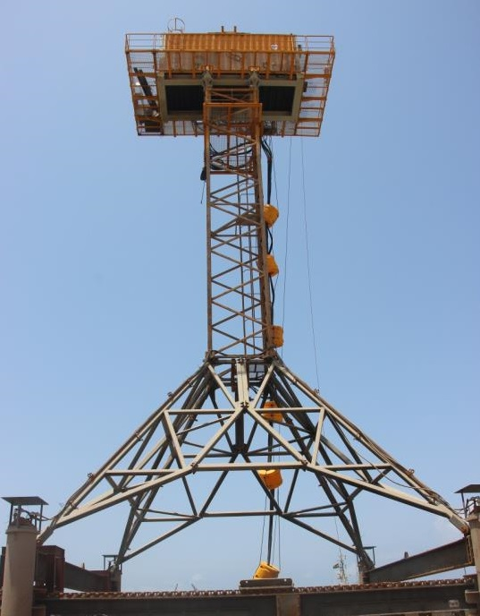
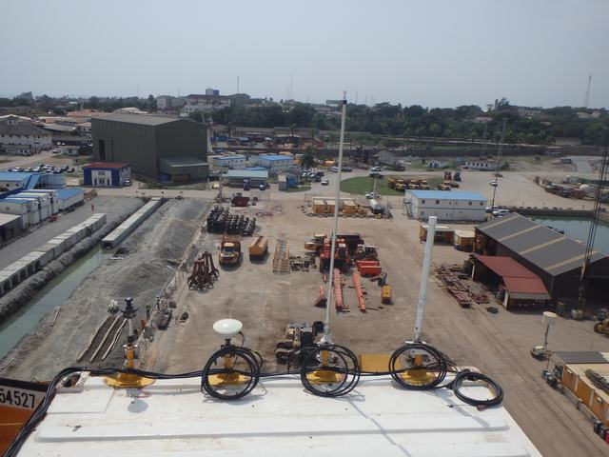
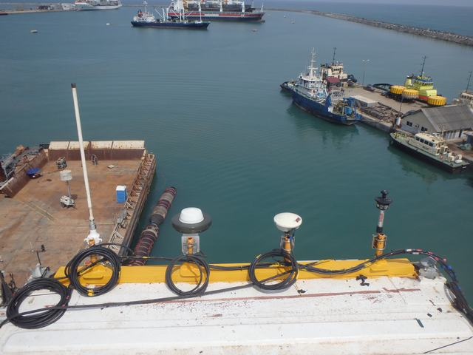
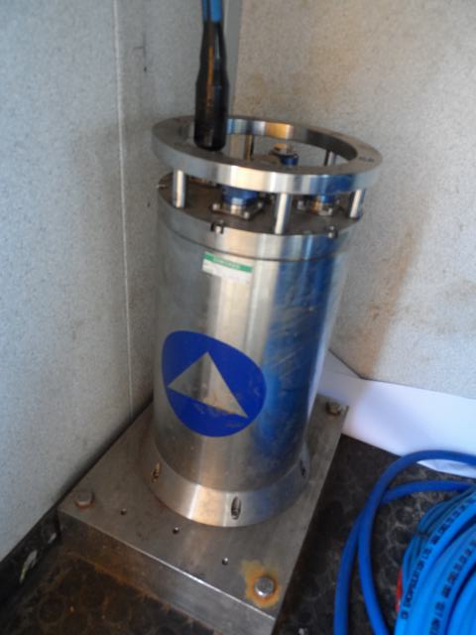
Port of takoradi infrastructure development project - Ghana
Gravel Bed Levelling – Levelling Tower
Levelling Tower - Installation
Antennas + prism (aft)
Antennas + prism (front)
Octans inside the container
Notes:
Levelling tower is 28m high structure with a hydraulic operated blade will moving back and forth between the legs of the tower.
On the top end of the tower we have the control room.
The complete structure is be positioned by GNSS or total station; the heading and the verticality of the structure is measured by a Octans fixed to the structure.
To adjust the level of the tower, the operator is able to control 4 pistons on the legs of the tower

Slide 6
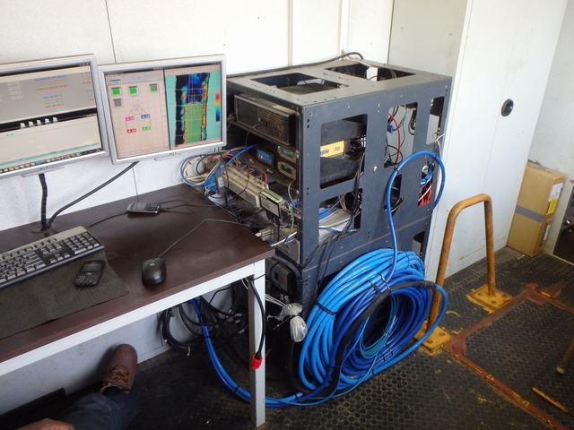
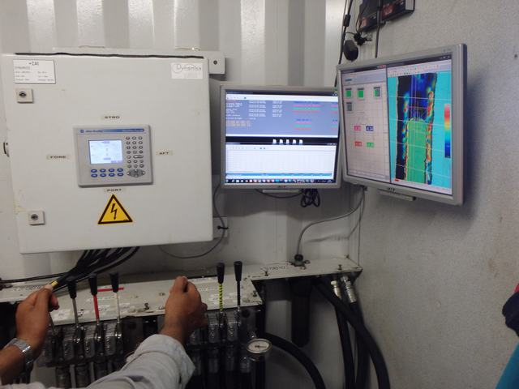
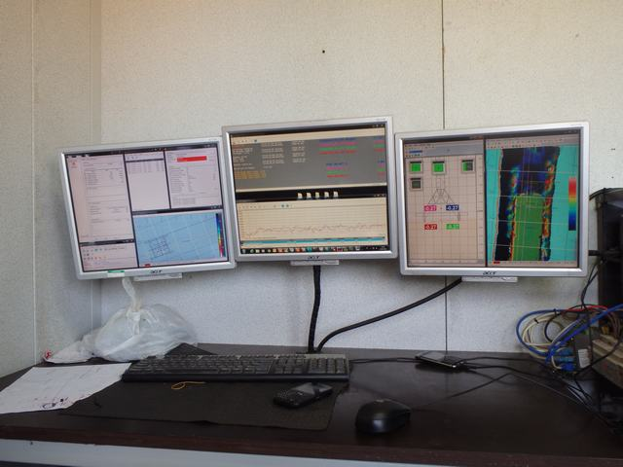
Port of takoradi infrastructure development project - Ghana
Gravel Bed Levelling – Levelling Tower
Levelling Tower - Installation
Survey desk
Operator’s desk
Notes:
Inside the control container we have the survey desk and the operator’s desk
Based on the info on the survey system, the operator is able to control 4 pistons on the legs of the tower to get it exactly level

Slide 7
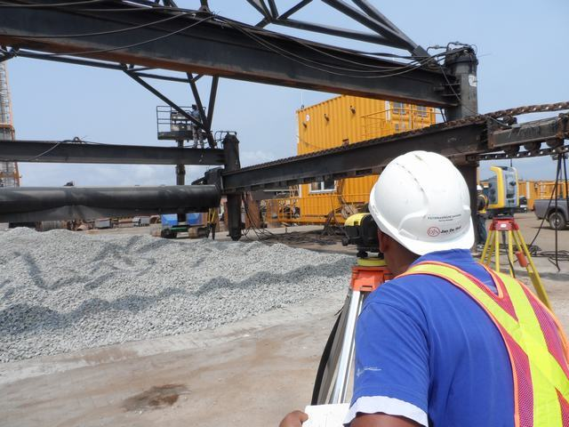
Port of takoradi infrastructure development project - Ghana
Gravel Bed Levelling – Levelling Tower
Levelling Tower - Calibration
Level blade after rectification (values in mm)
Notes:
All sensors and systems were first calibrated and aligned in the octans measurement frame in dry conditions by use of total stations and level instruments.
First the whole structure has been put level by means of a level instrument. Once the four positions of the rail points were at the same level, the bottom of the blade was measured. The correct level line was marked with white correction fluid over the complete length of the blade. This was done for easy reference to technical department to cut out the uneven part of the blade
After the rectification of the level blade, the same procedure was conducted to confirm the level of the blade.

Slide 8
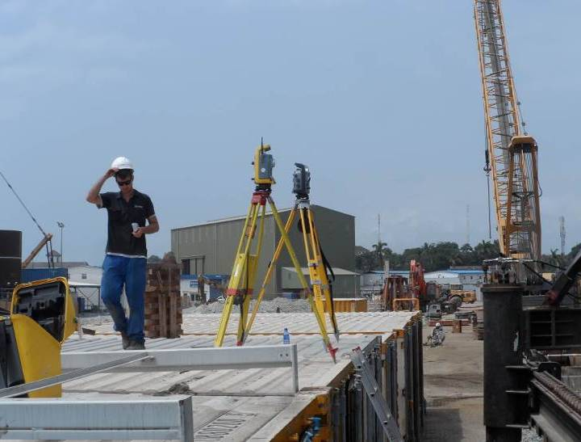
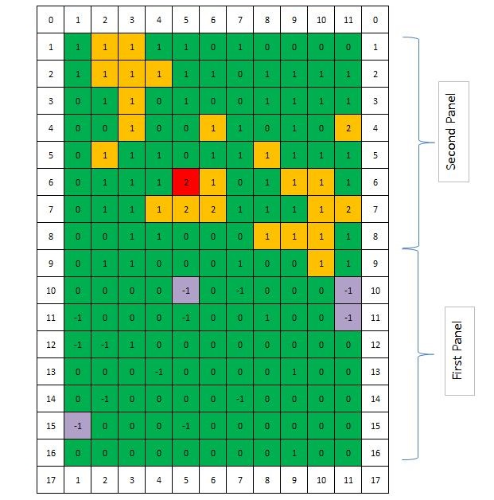
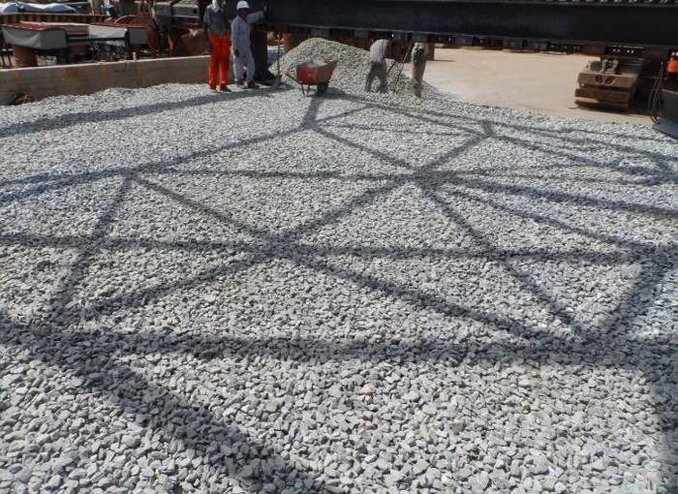
Port of takoradi infrastructure development project - Ghana
Gravel Bed Levelling – Levelling Tower
Levelling Tower – Dry Test
Result of Levelling
Notes:
To demonstrate the concept of levelling frame a dry test was performed and the levelled gravel bed was measured by total station and level instrument.
Based on results we were able to conclude that the gravel has been levelled within a 1 to 2 cm tolerance.
This dry test gave us the confidence that the

Slide 9
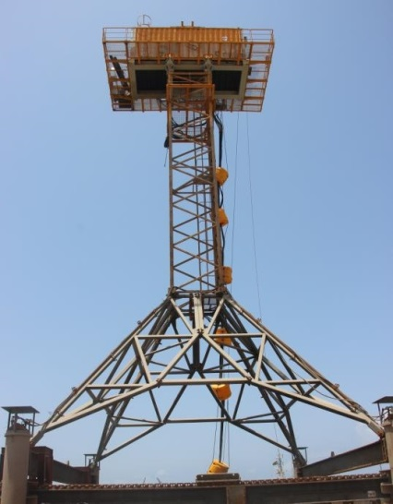
Port of takoradi infrastructure development project - Ghana
Gravel Bed Levelling – Levelling Tower
Levelling Tower – Survey Tool
Rotating MBE Transducer
Notes:
Common method= MBE mounted on survey vessel
Disadvantage:
only possible to survey the gravel bed after completion of the levelling and the levelling tower is removed from the area. If rectifications are needed? We have to reinstall the levelling tower and repeat the operation.
Accuracy: exclude motion parameters (heave, dynamic pitch/roll), smaller range
We came up with the idea of incorporating the measuring tool on the levelling tower itself. We installed a MBE transducer head in the centre of the frame on the axis of a hydraulic engine.
The MBE processor unit together with the survey computer is installed up and dry in the control container.
We had to reach high accurate and repetitive survey, that’s why we needed to exclude as much as possible th influence of sound velocity, motion and reducing distance to the bottom

Slide 10
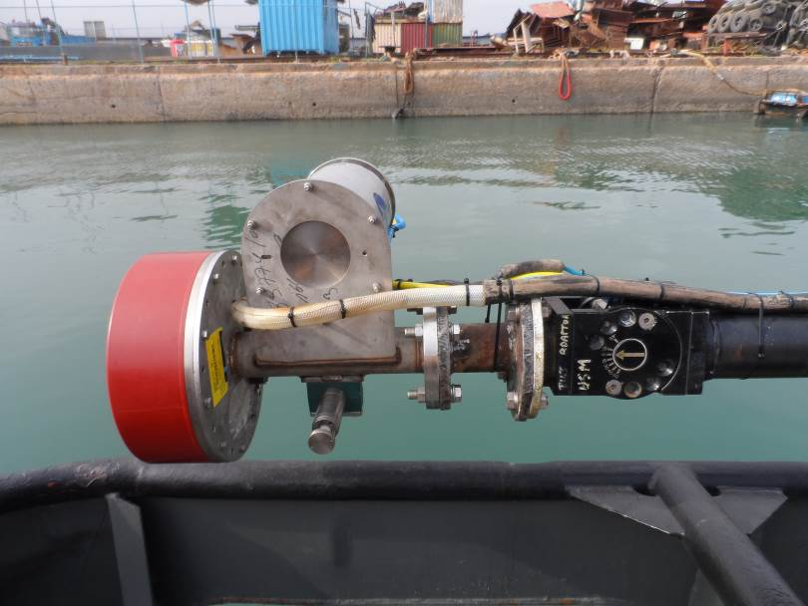
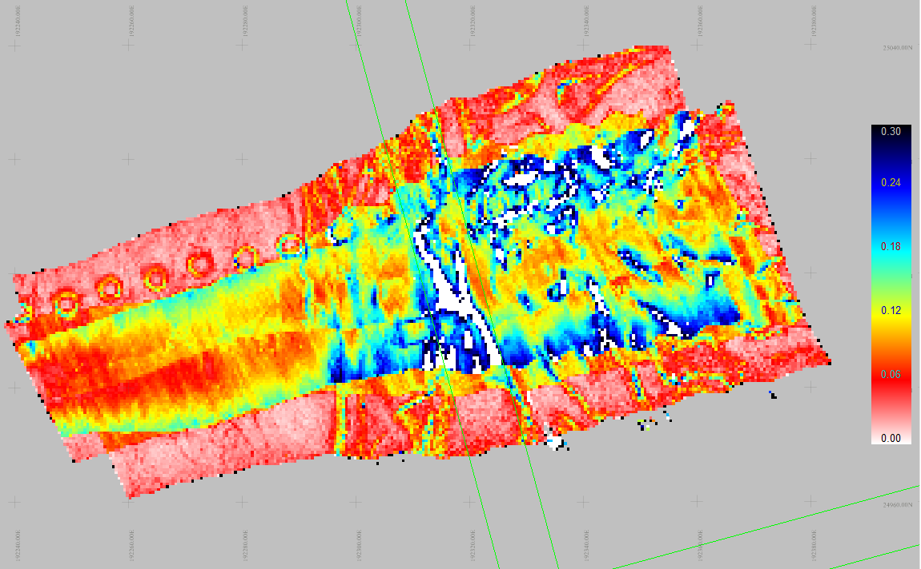
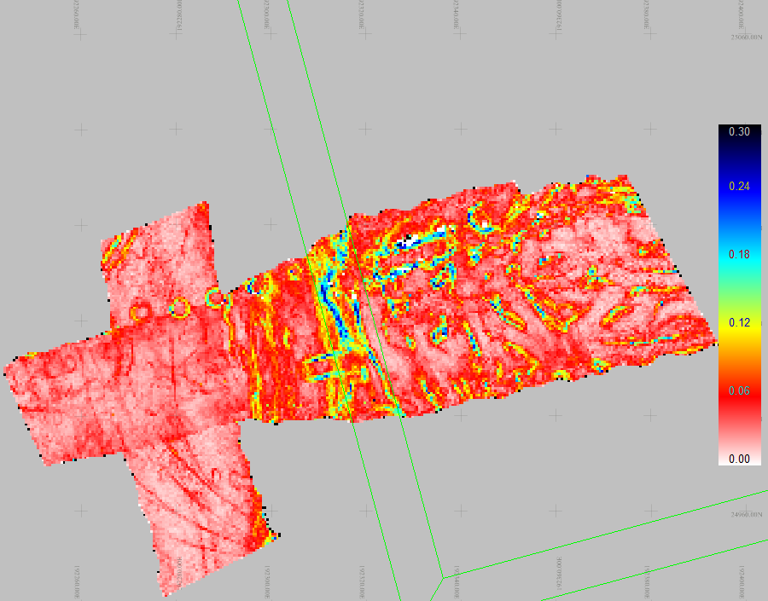
Port of takoradi infrastructure development project - Ghana
Gravel Bed Levelling – Levelling Tower
Levelling Tower – Survey Tool: Calibration
Stdev with mounting angles set to zero
MBE Frame Mounted on the USM Pole
Stdev with adjusted mounting angles
Notes:
Also the MBE setup had to be calibrated. For this, the complete frame was mounted on a survey pole on the survey vessel; Patch test was performed to obtain the Octans mounting misalignment and the MB mounting angles.
MBE and motion reference unit (here an Octans) are fixed mounted on the same frame, which means lever arms and angles which are pre-calibrated with the patch test will not change anymore during operations.

Slide 11
Port of takoradi infrastructure development project - Ghana
Gravel Bed Levelling – Levelling Tower
Levelling Tower – Survey Tool: Operation and acquisition

Slide 12
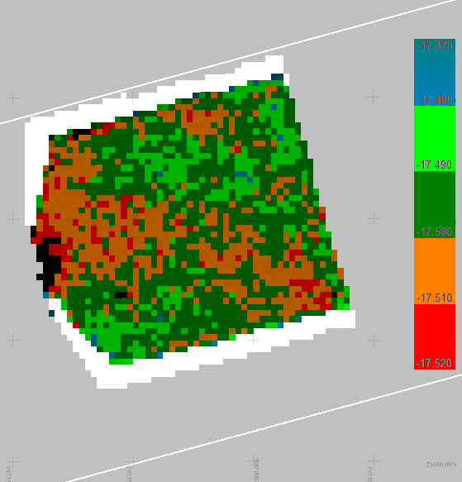
Port of takoradi infrastructure development project - Ghana
Gravel Bed Levelling – Levelling Tower
Levelling Tower – Survey Tool: 360° Rotating MBE Setup Result
Typical Result of levelling outsurvey
Notes:
Final levelling results were in general quite good, with 95% of the gravel bed (-17.50) +/- 2cm on a 0.25m grid.
As from the first day of levelling operations, it was observed that there was a discrepancy of 3 to 4 cm between the levelling height and the surveyed data height (see table below of 01/04/2015). This difference has been confirmed throughout the entire levelling of the gravel bed

Slide 13
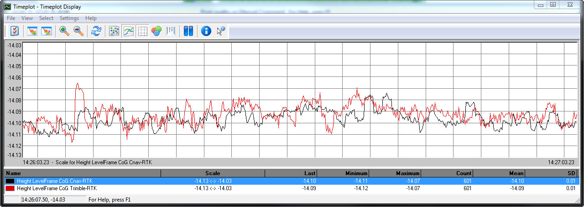
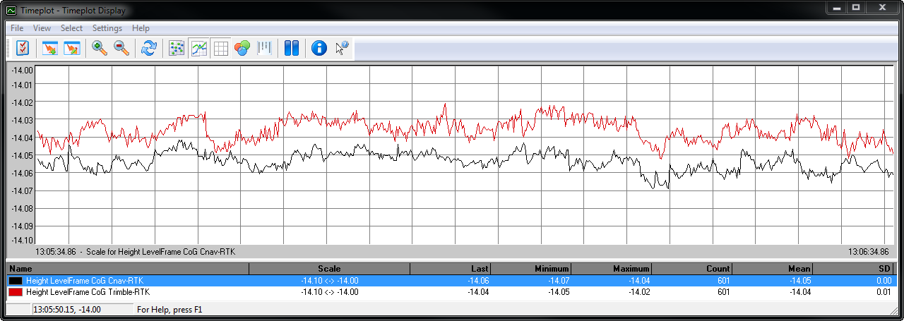
Port of takoradi infrastructure development project - Ghana
Gravel Bed Levelling – Levelling Tower
Levelling Tower – Survey Tool: RTK Height → Total station Height
Timeplot RTK height Trimble vs C-Nav
Notes:
The most important issue that came up during the levelling was the GNSS RTK height. Since the levelling had to be done within centimetre accuracy, the RTK height was not always accurate enough. There are three elements with regard to the RTK system.
Getting the blade on a desired height is difficult for the operator when RTK height is unstable
Uncertainty about the absolute levelling height because of RTK accuracy
Uncertainty about the survey results because of RTK accuracy
The below time plot (60 seconds) of the height of the LF COG (calculated by Trimble and C-Nav) illustrates the first point. Sometimes the RTK height is not stable on a centimetre level, which makes it difficult for the operator to get the cutting blade on a specific height.
Furthermore, one can never be sure about the correctness off the absolute RTK height on centimetre level. The two GNSS systems on board already differ by a few centimetre from time to time. The distance to the base station is within 2 km.

Slide 14
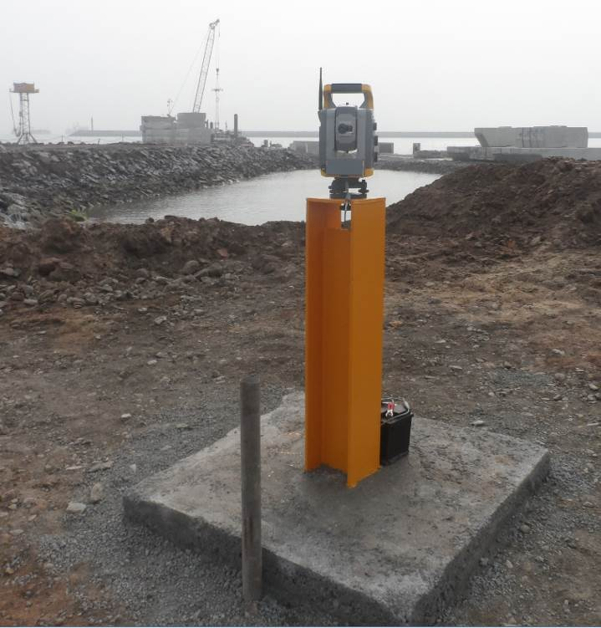
Port of takoradi infrastructure development project - Ghana
Gravel Bed Levelling – Levelling Tower
Levelling Tower – Survey Tool: RTK Height → Total station Height
Positioning the levelling tower by total station in automatic tracking mode to obtain more reliable height

Slide 15
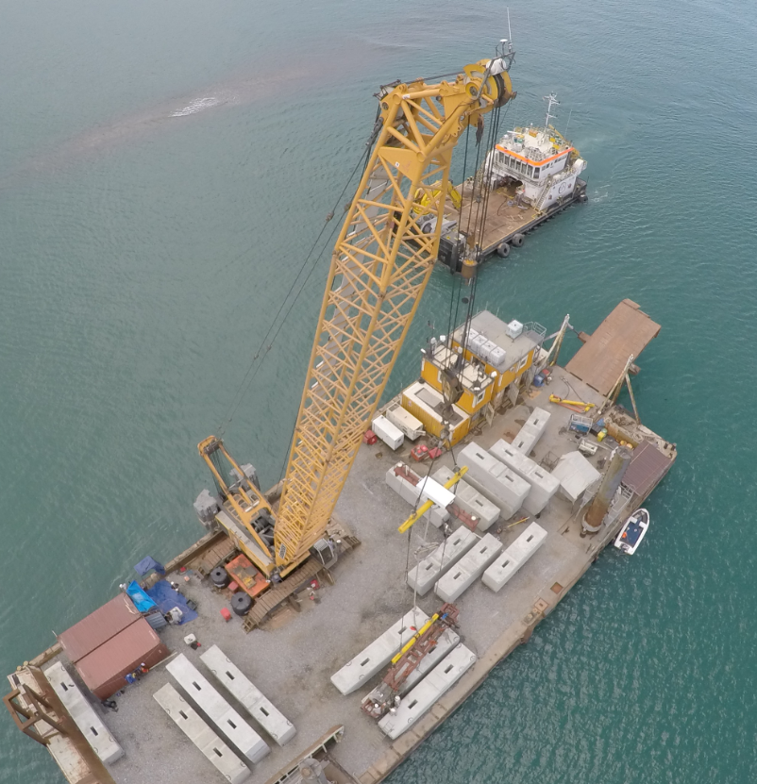
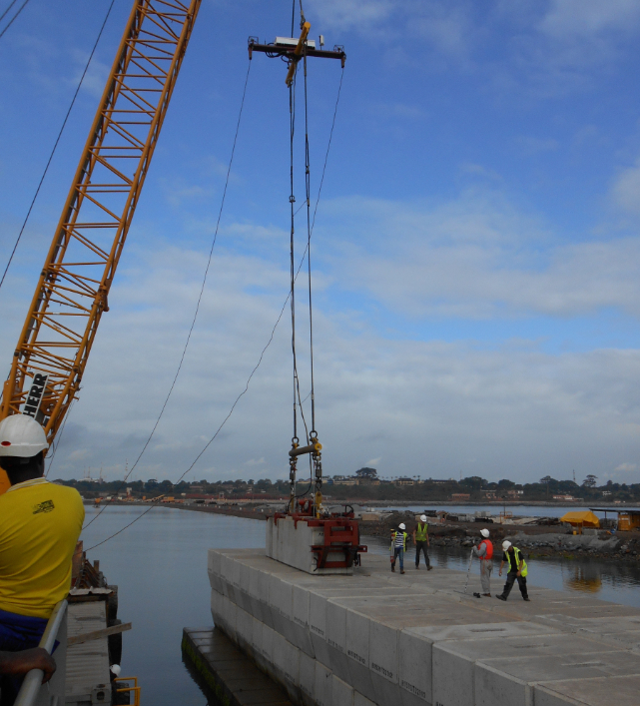
Port of takoradi infrastructure development project - Ghana
Block Placement
Block Placement: Block Placement Frame
Notes:
The quay wall was constructed by placing blocks next to each other starting from the levelled gravel foundation. The blocks were installed layer by layer. Once the first layer (layer 1) blocks were installed correctly in line, the proceeding layers were installed.
Because the correct placement of first block is really important for the position of the remaining part of the quay wall, the first block has been installed with a special rigid block placement frame positioned by means of RTK and Ixsea octans motion sensor. This frame extended above the water in order to have constant RTK reception. The frame which you can see on the pictures is the one used for the remaining part of the blocks.
To reduce the constant need for divers during the installation, 3 real-time cameras (including lights) and an iXsea GIV subsea motion sensor were installed on the block placement frame itself
On the spreader beam you we have the control box containing the camera interface, RTK receiver and WiFi and radio communication to broadcast all data to the control room and the crane cabin.

Slide 16
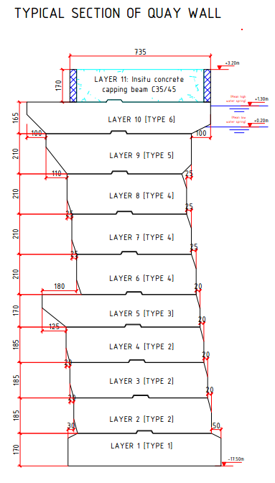
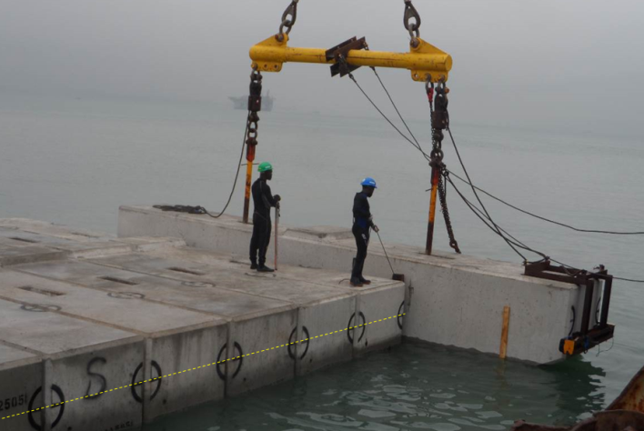
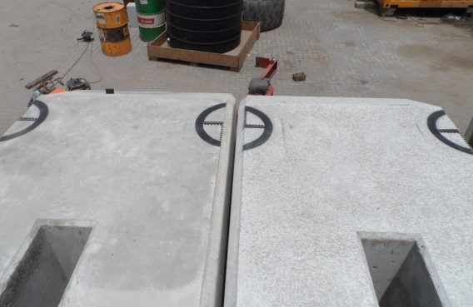
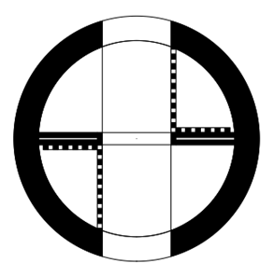
Port of takoradi infrastructure development project - Ghana
Block Placement
Block Placement: Visual Aids
10 types of individual block layers with on top the capping beam
100% aligned symbol
Notes:
Prior to the installation, half circular symbols were painted on the blocks to be able to align them under water based on the camera images. The black circle was demarcated in centimetre divisions, like that, the operator was is to see the misalignment at centimetre level.
With the cameras focused exactly on these symbols and a live link of all camera feeds into the operator cabin, the new block could be lowered and aligned exactly relative to the previous one.

Slide 17
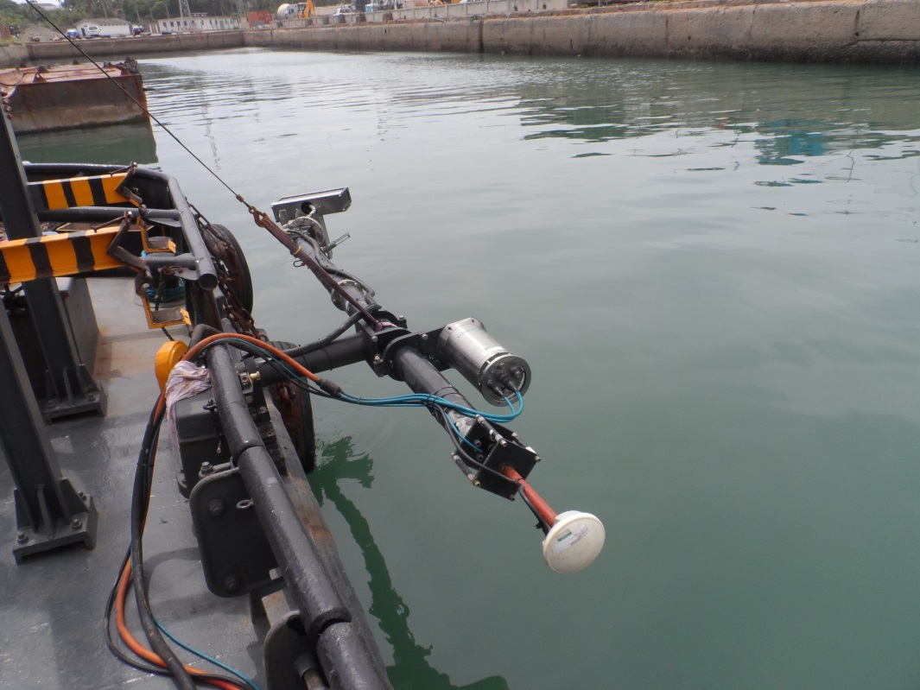
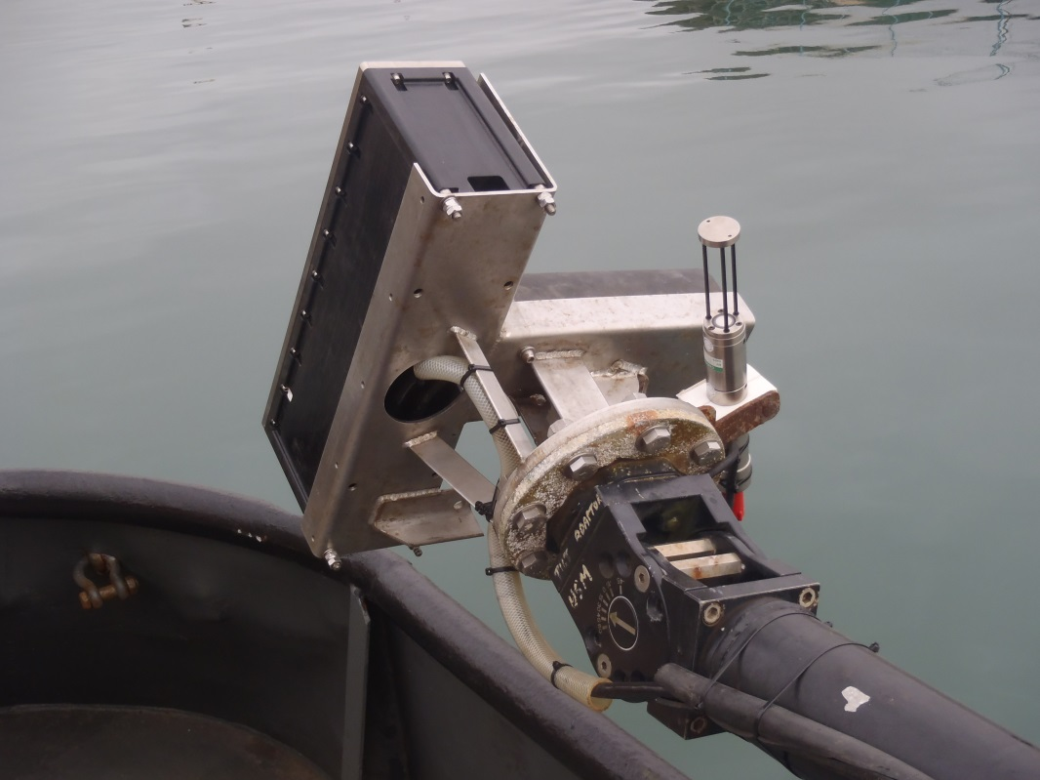
Port of takoradi infrastructure development project - Ghana
Block Placement
Block Placement: MBE Survey of the blocks
Notes:
Surveys were performed using our standard Jan De Nul MBE setup: all sensors in one pole to avoid misallignement errors when redeploying the frame.
For this particular application of monitoring the block placement operations we choose to have to multibeam head mounted under an angle of 30 deg.

Slide 18
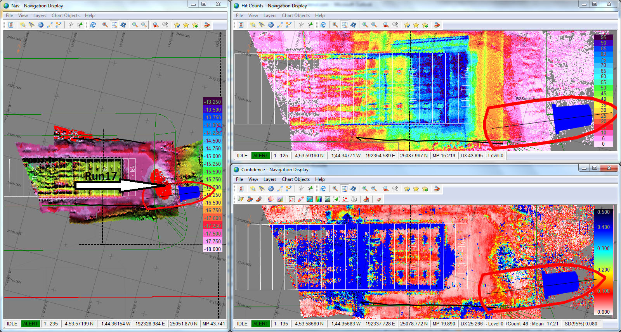
Port of takoradi infrastructure development project - Ghana
Block Placement
Block Placement: MBE Survey of the blocks
Surveying of blocks from different angles to capture as much as possible data on different faces
Notes:
For a typical block survey we will aim to capture a big amount of data, as much as possible on the different visible planes on the block.
To do so we will run predefined lines from different angles and focus the MBE beam on the part of the block we are interested in.
After about 17 passes we will have on top of the block about 80 hits per cell of 0.1m.
The display in the right bottom shows the standard deviation per cell.

Slide 19
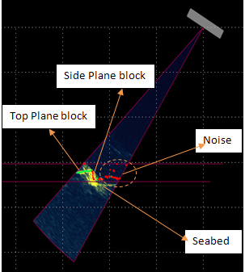
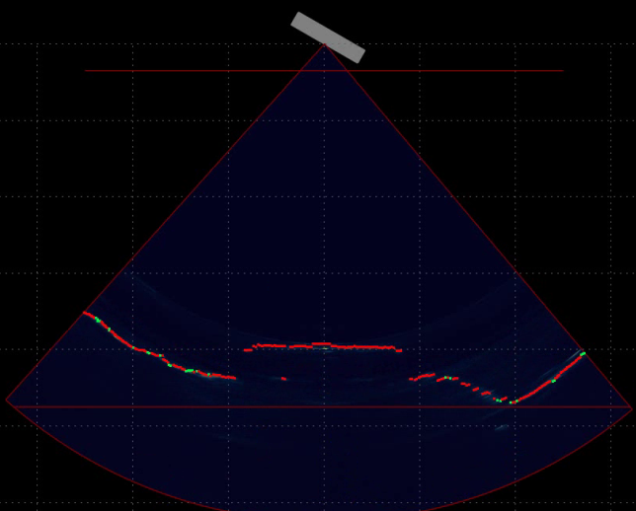
Port of takoradi infrastructure development project - Ghana
Block Placement
Block Placement: MBES Survey of the blocks
Notes:
Here is a good example of how we could survey with high tide until the top layer.
For this specific application, the possibility to focus the beams and the 0.5degree system seemed to be indispensible

Slide 20
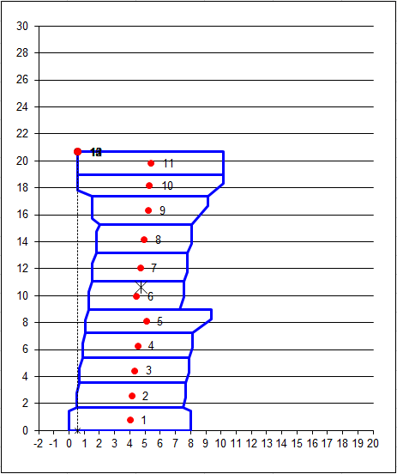
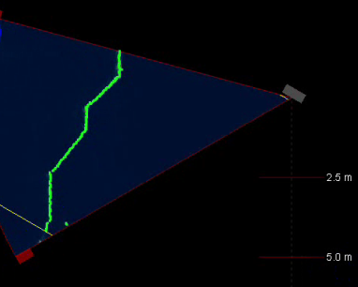
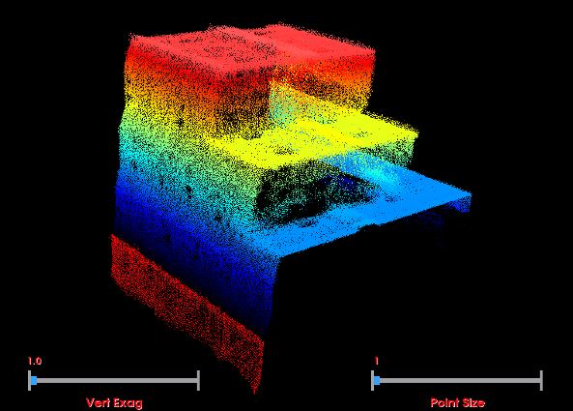
Port of takoradi infrastructure development project - Ghana
Block Placement
Block Placement: MBES Survey of the blocks
Notes:
These images show that with the Reson 8125 H multibeam system we were able to obtain high resolution and high accurate point clouds.

Slide 21
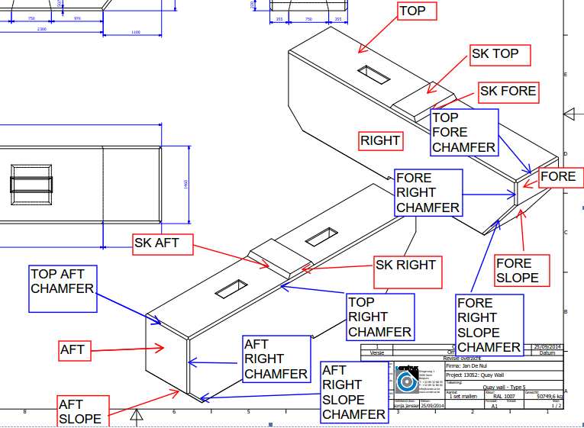
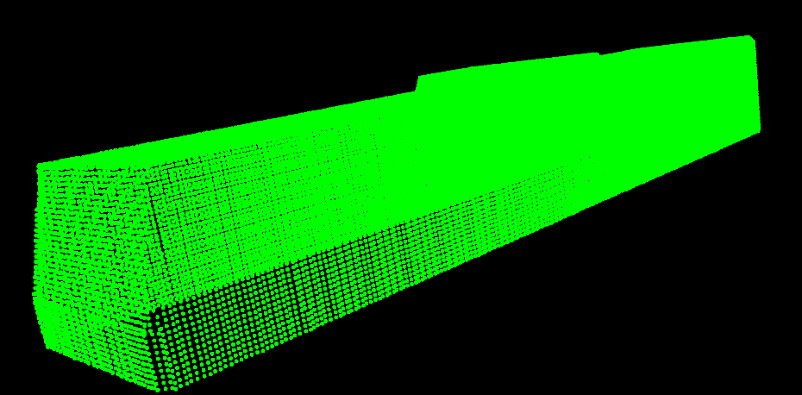
Port of takoradi infrastructure development project - Ghana
Block Placement
Block Placement: Block Detection
Definitions of the faces
Definitions of the faces
Notes:
To determine the as built position and orientation of the block, JDN developed a block detection software in cooperation with Beamworx.
Based on a theoretical block shape, the software searches for a “best fit solution” in the point cloud “as surveyed”

Slide 22
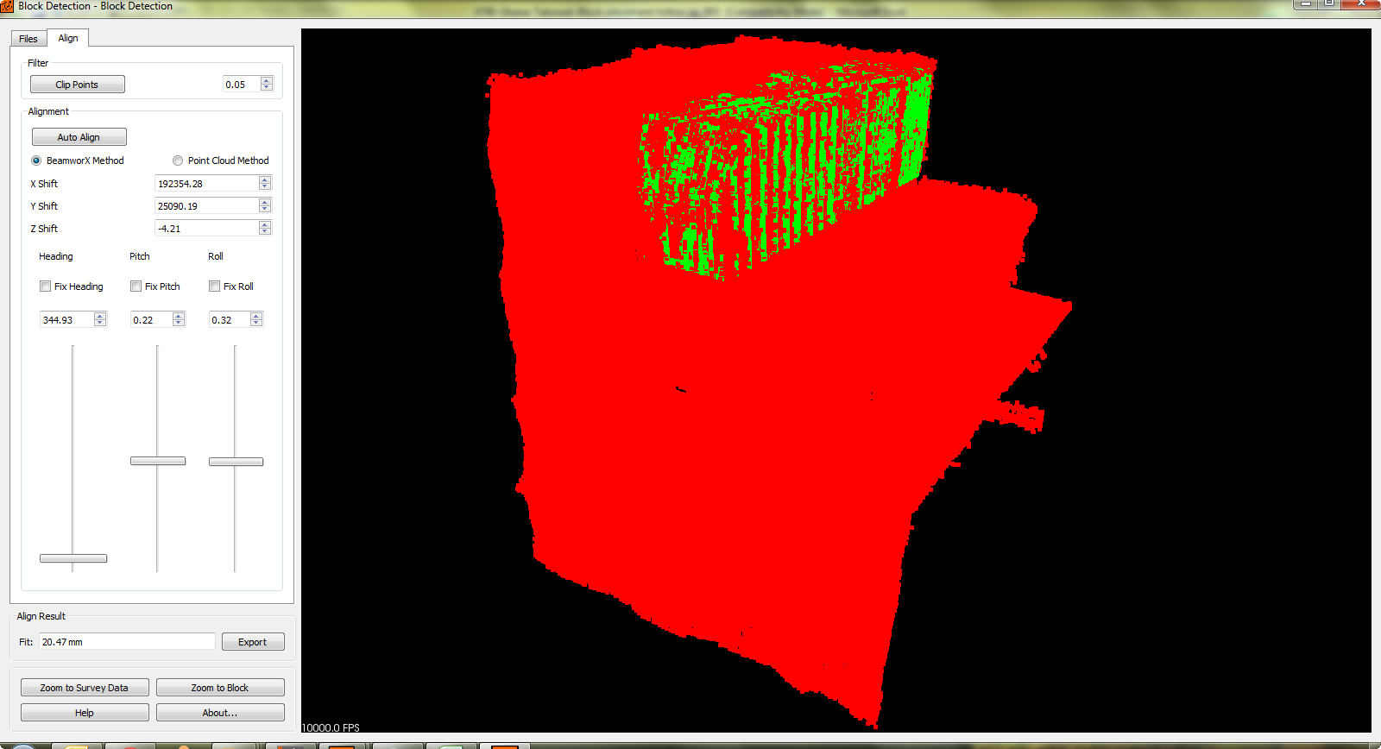
Port of takoradi infrastructure development project - Ghana
Block Placement
Block Placement: Block Detection
Block detection software will search for the best fit solution to fit the theoretical block within the multi beam data
Notes:
Block detection software will search for the best fit solution to fit the theoretical block within the MBE data.

Slide 23
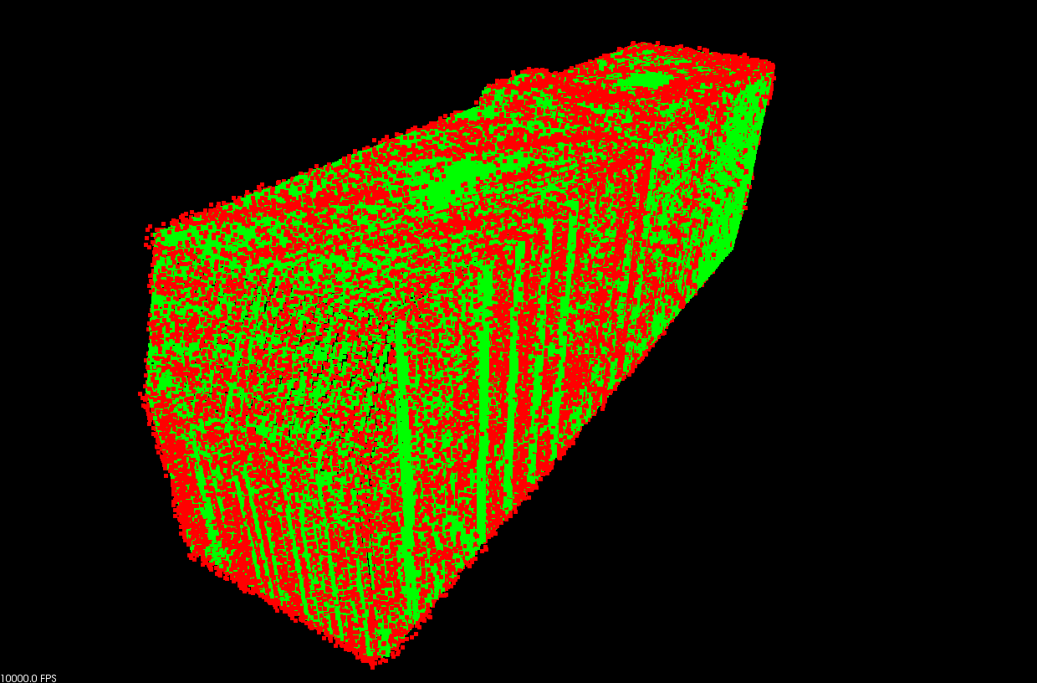
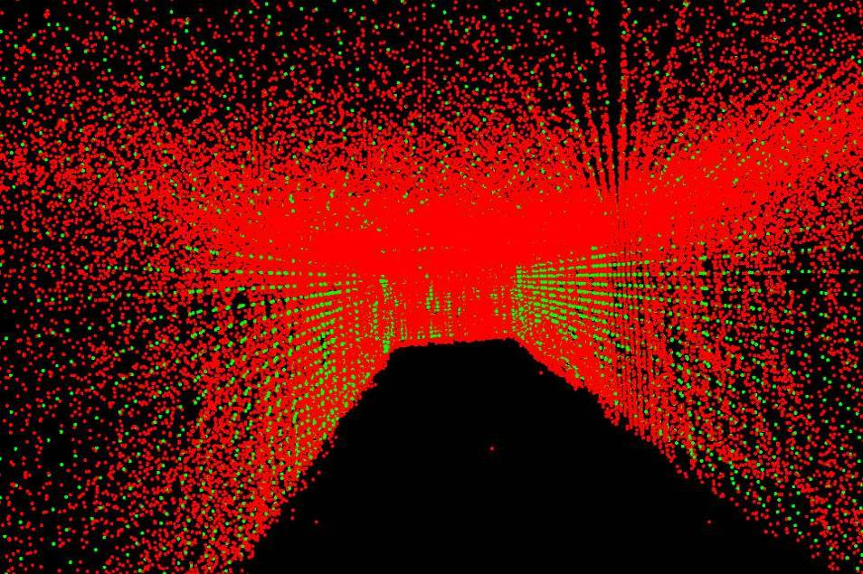
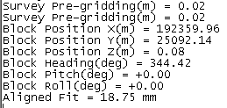
Port of takoradi infrastructure development project - Ghana
Block Placement
Block Placement: Block Detection
After clipping the multi beam data around the positioned theoretical block
Aligned multi beam data (inside block)
Sample of report from block detection tool
Notes:
Once roughly positioned, the data will be clipped around the theoretical block in a certain boundary and a fine calculation can be done.
The result will give an precise centre point coordinate and the roll, pitch and heading of the block.

Slide 24
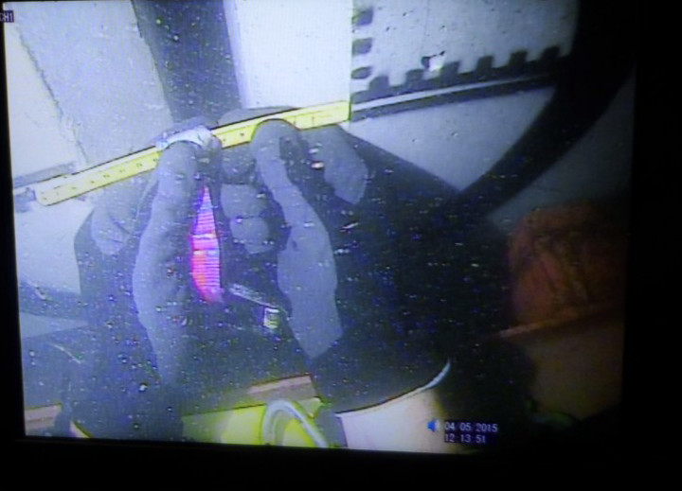
Port of takoradi infrastructure development project - Ghana
Block Placement
Block Placement: Block Measurement
Divers measuring the alignments
Notes:
Jan De Nul had three different ways to interpret the results of the block placement
The Octans, installed on the block frame, gave pitch, roll and heading of every installed block.
Hydrosurvey, using the block detection tool, can supply pitch, roll, heading and position of the outer blocks.
The divers manually measured the correct alignment of the blocks

Slide 25
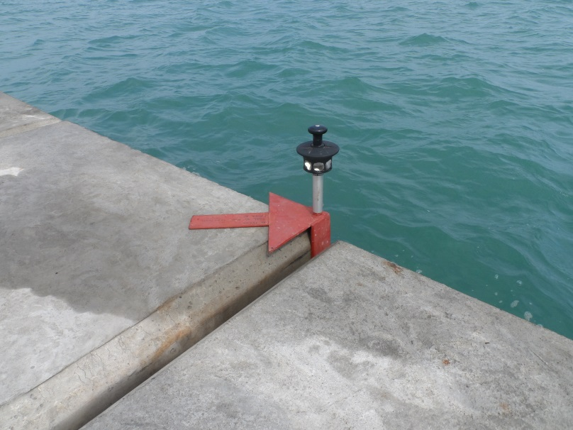
Port of takoradi infrastructure development project - Ghana
Block Placement
Block Placement: Topographical verification
Alignment of the blocks precisely measured by total station and compared with the MBE results
Notes:
We can now measure the position of the blocks by total station and compare with the position calculated by the block detection software based on the MBE survey.
The results are beyond expectations!

Slide 26
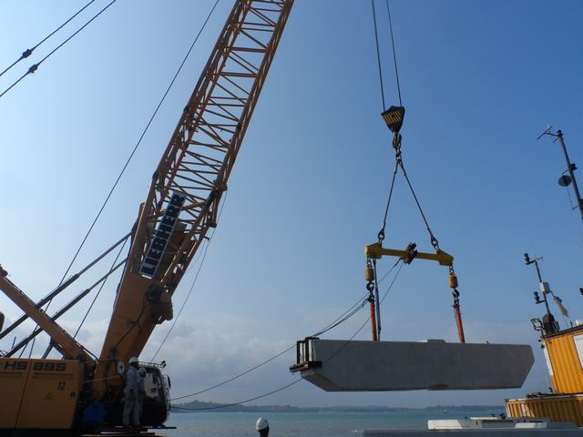
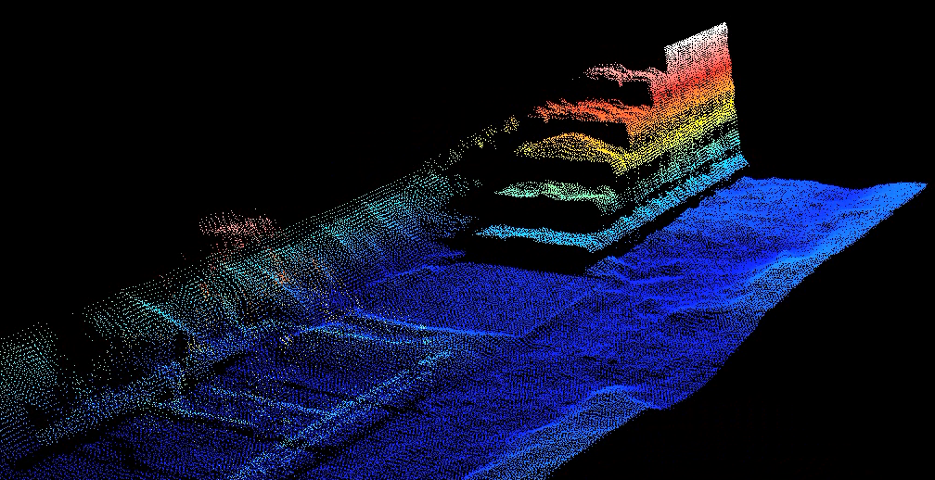
Port of takoradi infrastructure development project - Ghana
Block Placement
Conclusion
Improved effeciency
Notes:
Improved efficiency by thinking out of the box and using traditional survey techniques in a non traditional way

Slide 27
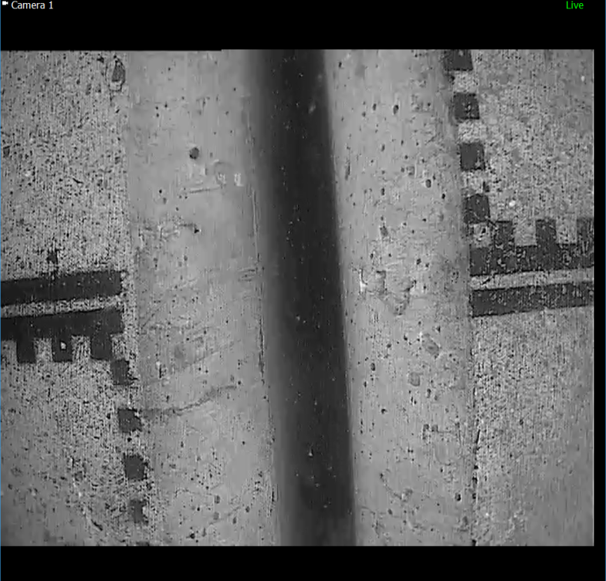
Port of takoradi infrastructure development project - Ghana
Block Placement
Conclusion
Improved effeciency
Improved safety

Slide 28
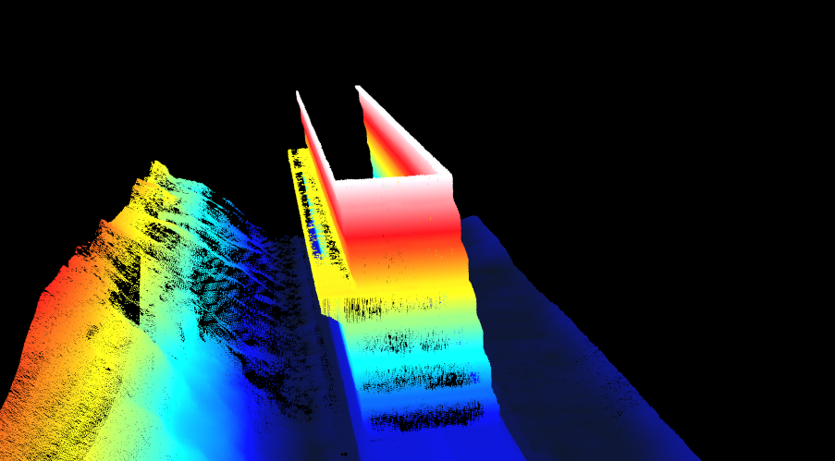
Port of takoradi infrastructure development project - Ghana
Block Placement
Conclusion
Improved effeciency
Improved safety
Proof that bathymetric survey can be applied for jobs requiring high accuracies

