Slide 1
HYDRO 17 Conference
Rotterdam 13th – 16th November 2017
Optimizing Surveys
for
Breakwater Construction Projects
By: Barry Grinker

Slide 2
Background
Lia Engineering & Surveying Ltd. is conducting hydrographic surveys in support of the Mifratz Port construction project in Haifa Israel.
The project began in 2015 and should be completed in 2020.
The project involves:
Extension of the Main Breakwater (900m) and construction of a
Lee Breakwater (1,600m)
Construction of a Caissons Revetment (19 Caissons)
Dredging
Reclamation – 860,000 square meters

Slide 3
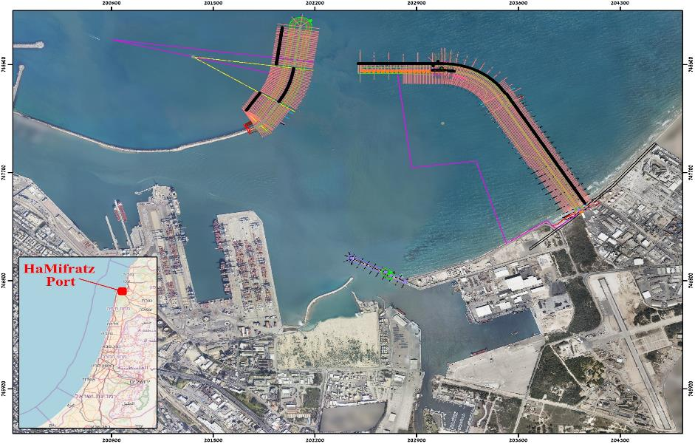
Background
19 Caissons
MBW – 900 m
LBW – 1600 m
Reclamation – 860,000 m²

Slide 4
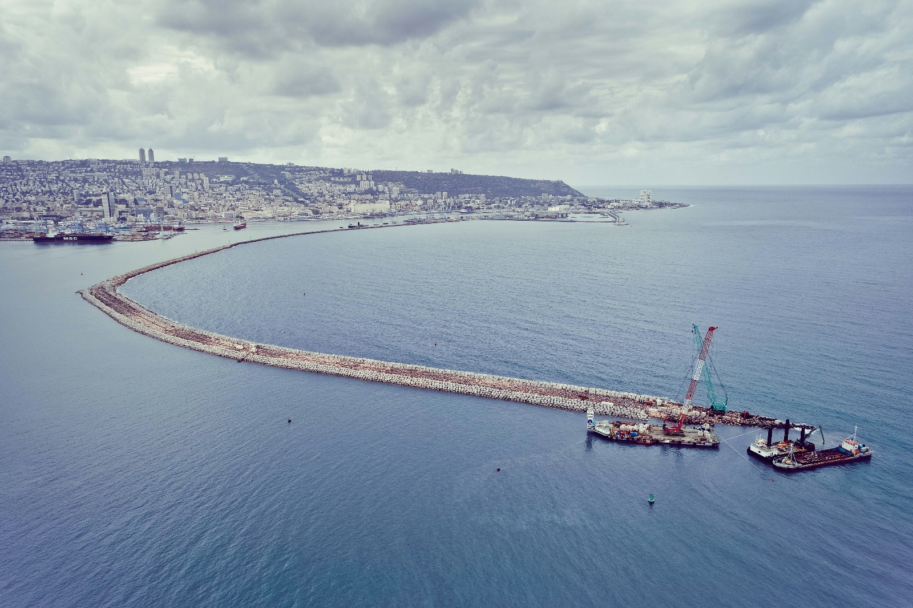
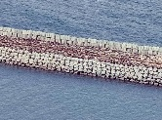
Main Breakwater Extension
ANTIFERS

Slide 5
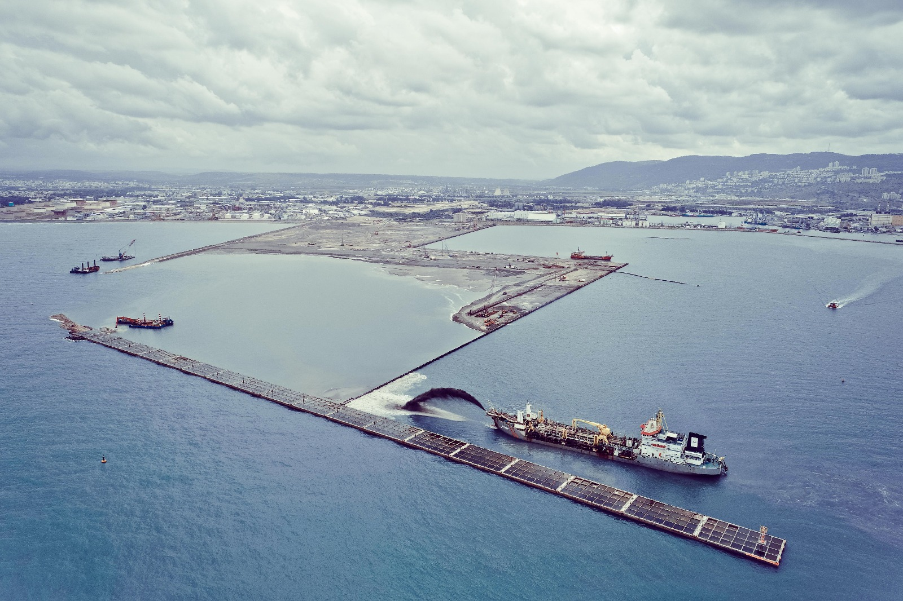
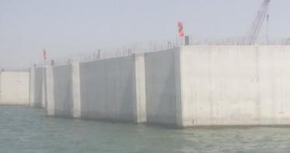
Lee Breakwater
Reclamation
Caissons

Slide 6
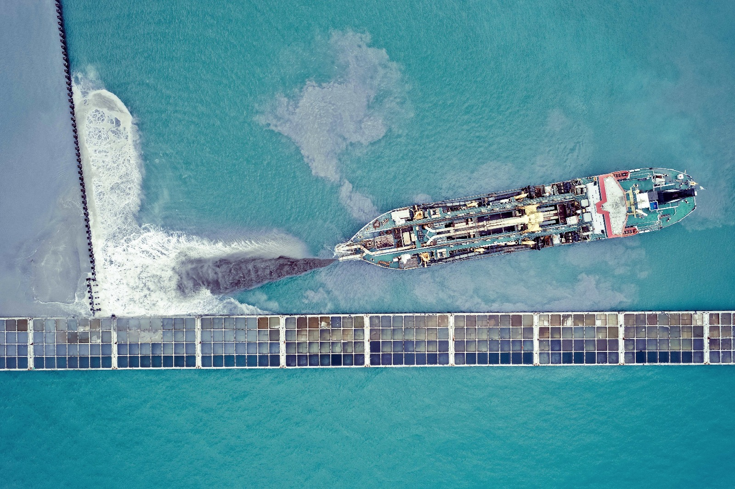

Slide 7
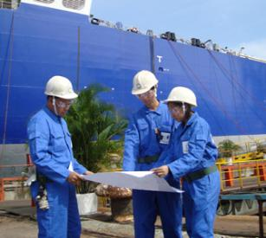

Project Survey Requirements
The surveys serve various purposes including:
Checking construction progress according to engineering plans and predefined tolerances
Daily work planning and control
Volume calculations for payment
etc.

Slide 8
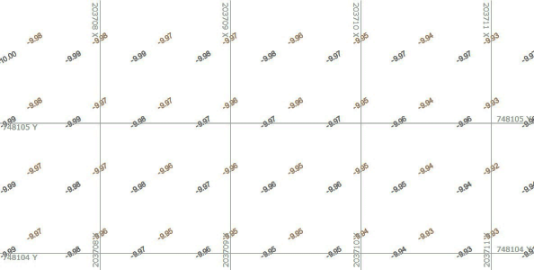
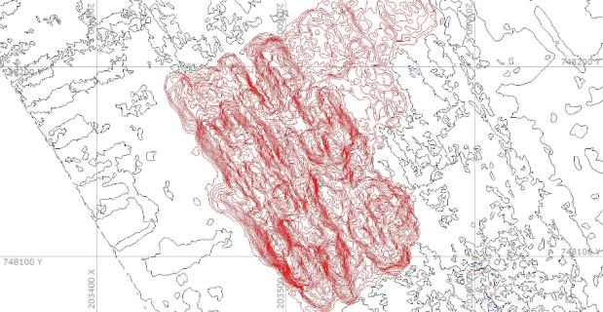
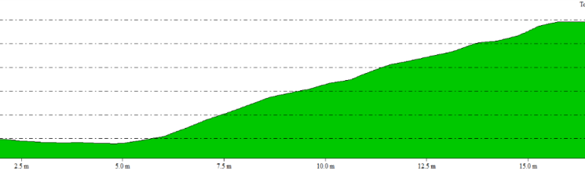
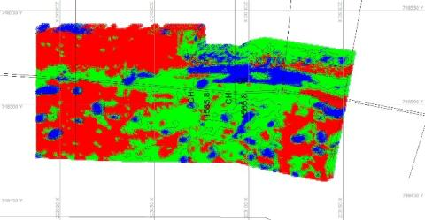
Survey Outputs
Gridded data - X,Y,Z - DTMs at 0.5m X 0.5m
Contour maps - 0.5m contour interval
Cross sections
Tolerance maps

Slide 9
Initial Survey Techniques
Initially the surveys along the breakwaters were conducted, according to project specs, as follows:
* Multi Beam Hydrographic Surveys to -3m depth, limited by swath
* Sounding Ball measurements down to -5m (2m overlap with MB)
* Land Survey GPS RTK measurements above water and in the
shallow areas along the breakwater

Slide 10
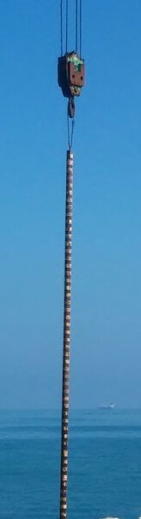
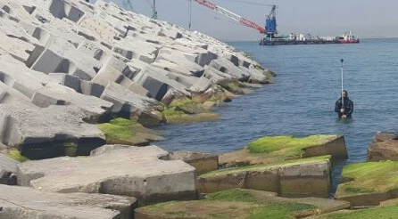


Initial Survey Techniques
+6m
0m Chart Datum
-1m
-3m
-5m

Slide 11
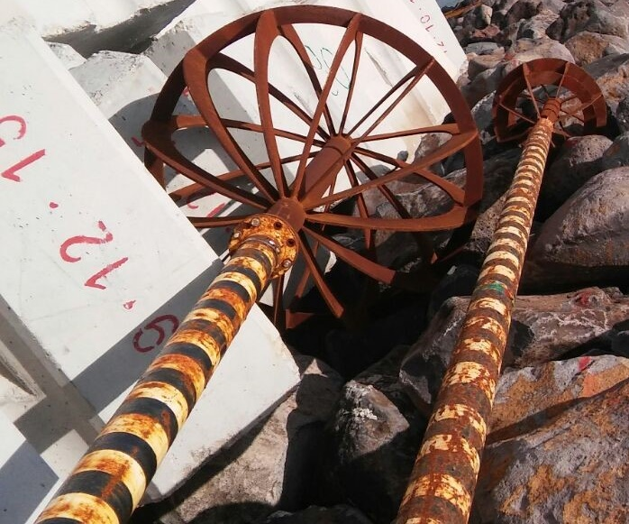
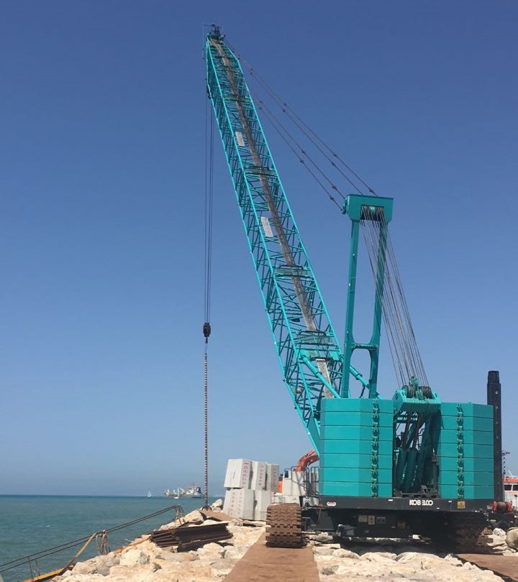
Sounding Ball

Slide 12
Drawbacks
Sounding Ball surveys are time consuming and not very
accurate - is the position measured above the ball with GPS
exactly vertically above where the sounding ball is lodged?
Sounding Ball and RTK measurements are taken only at discrete points at a relatively low resolution
Much interpolation in the cross sections
Poor feature depiction (antifers, rocks etc.)

Slide 13
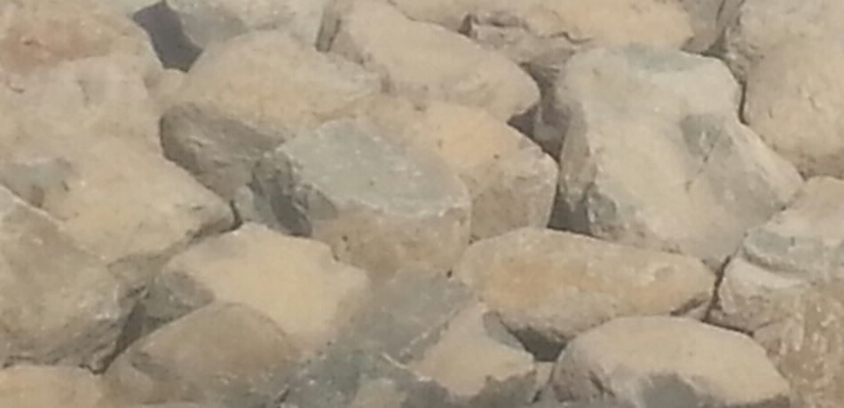
Sounding Ball on Rocky Breakwater
Where is the Ball Placed?
Measured surface
Sounding Ball Error
Actual surface

Slide 14
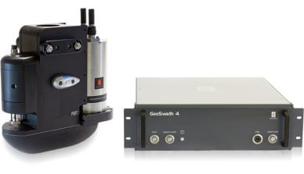
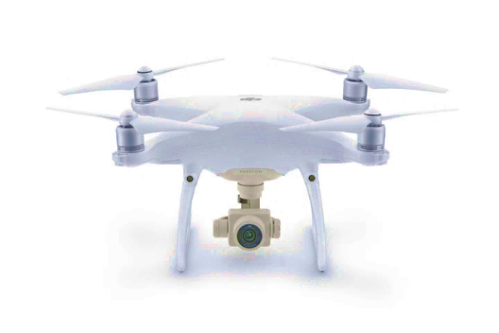
Solution
Lia Engineering & Surveying purchased equipment:
GeoSwath 250 KHz Interferometric Multi Beam system
240° swath range (right up to the water surface)
b. Phantom 4 Pro Drone with Sensor - CMOS, 20 Mega
Byte Effective pixels

Slide 15
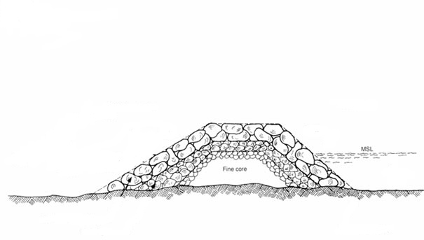
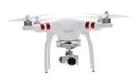
Solution
Interferometric MB with Drone survey
Area not Measured
Can be measured further
from the breakwater
-1 m
≈ 95 % 0f break water measured with high resolution

Slide 16
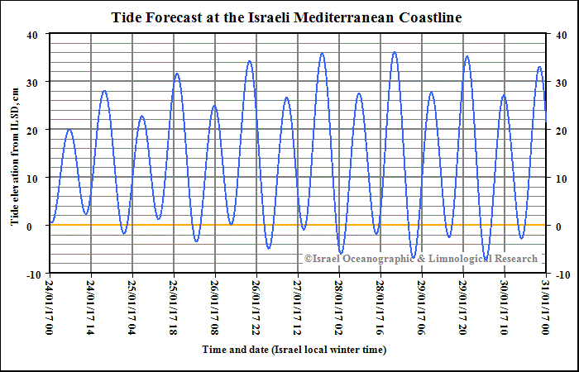
Test Cases
Hydrographic and Drone Photogrammetry surveys were conducted in conjunction with the Sounding Ball and RTK Surveys in various areas for comparison and evaluation
The GeoSwath data was processed up to -1m depth along the breakwaters
(below this depth air-water interface noise corrupted the data)
The Drone Photogrammetric surveys were from the water level (0m according to the tide at the time) and up
Maximum daily Tidal Range in the area ± 50 cm

Slide 17
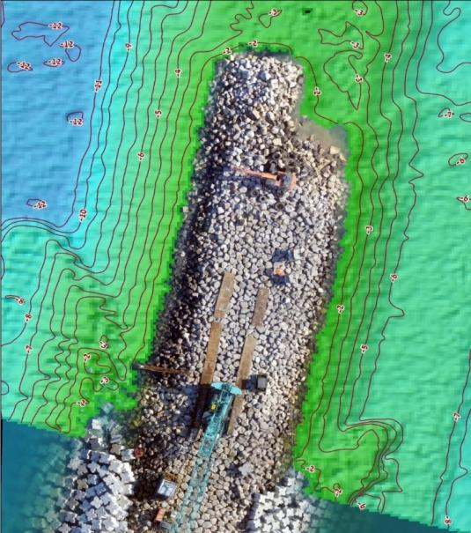
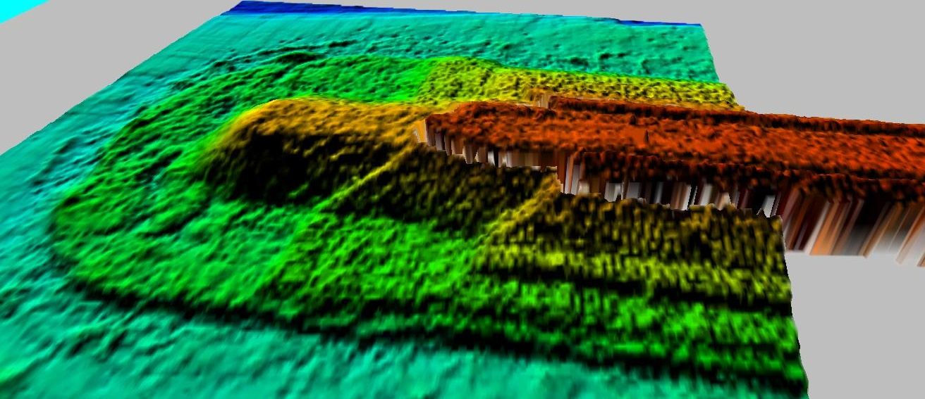
Combined Survey Data
Below Water MB Above Water Drone
Small Gap

Slide 18
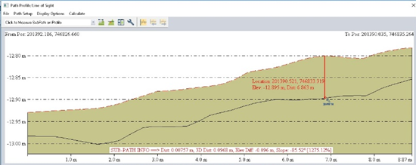
Results
Comparison between profiles derived from RTK - Sounding Ball – Multi Beam measurements and those derived from Interferometer - Drone surveys showed differences at the discreet points on the order of 1 to 2 decimeters.

Slide 19
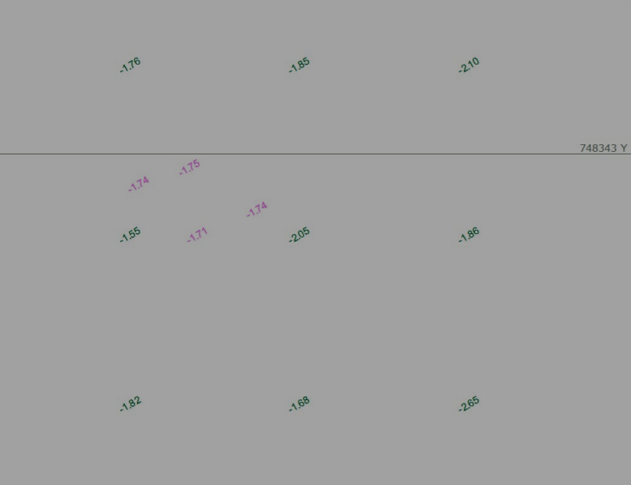
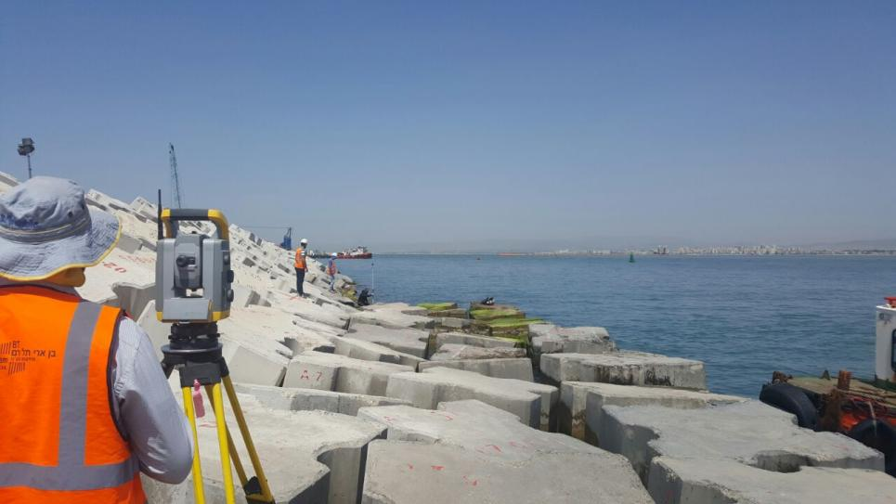
Results
On the submerged antifers, using the Weighted Mean interpolation method to determine point depths within the grid, resulted in differences on the order of a few centimeters.
Green = MB grid
Purple = RTK points

Slide 20
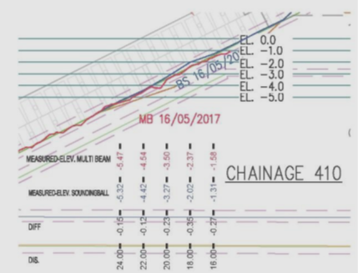
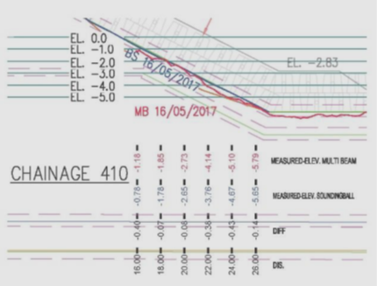
Typical Cross Section
Blue Line = Sounding Ball Red Line = Multi Beam

Slide 21
Cross Section on Antifer Surface

Slide 22
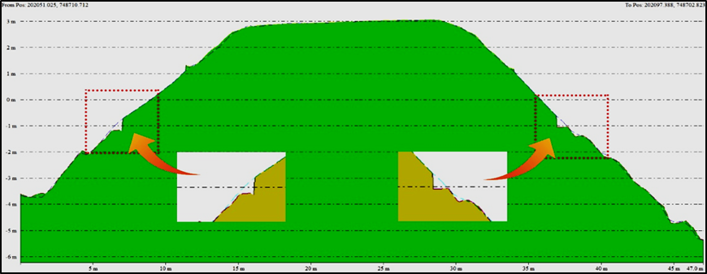
Actual Measurement VS Interpolation

Slide 23
Conclusions
Using the Interferometric Multi Beam System in conjunction with the Drone
Photogrammetry, provides an accurate, high resolution continuous data
base with a small gap between 0m and -1m.
The survey method provides quick, efficient and improved data for the engineers.
Ideally the Multi Beam survey would be conducted at high tide and the Drone survey at low tide to reduce the data gap.

Slide 24
A Typical Work Day on Site
07:00 - Commence Multi Beam survey (change of shifts on barges working in the area)
08:30 - Commence Drone survey (optimal sunlight conditions)
09:30 - End of Multi Beam survey
10:30 - End of Drone survey
10:00 - 11:30 - Multi Beam data processing
11:00 - 12:30 - Drone Survey data processing
12:30 - 13:00 - Lunchbreak
13:00 - 14:00 - Data quality assessment, survey report and data release
14:00 - 15:30 - Cross sections, contour maps and tolerance maps preparation
16:00 - Status presentation to the Engineer and work planning for the night….

Slide 25
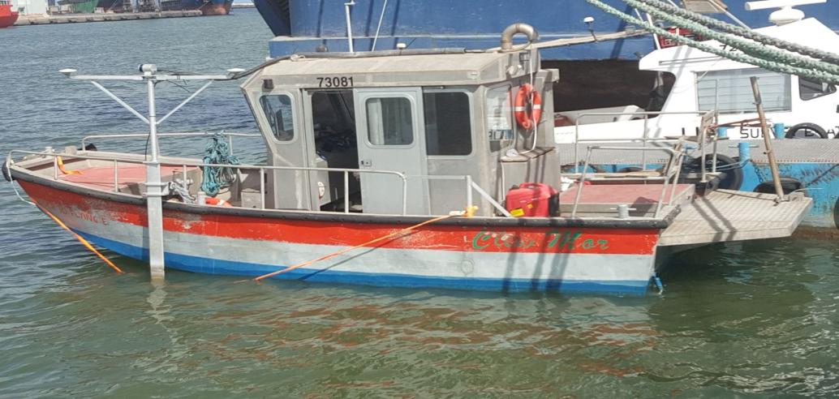
What Next ?
We have recently purchased a second Multi Beam system (Norbit iWMBS) with a 220° swath and 200 KHz – 700 KHz frequency range.
In addition the system includes a horizontal Lazer Scanner, mounted on the Multi Beam pole, facilitating horizontal LIDAR measurements of breakwaters, piers, sea walls etc.
The latest challenge we are dealing with is closing the 1m data gap between the sea surface and the -1m level.

Slide 26
Thank You
Questions?

