Slide 1
Proactive dredging in the Dutch Wadden Sea
Hydro17 conference
Rotterdam 15 November 2017 Mattijn van Hoek

Slide 2
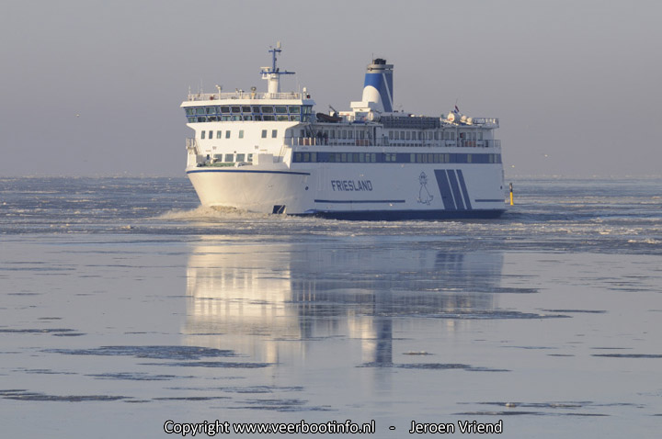
Objective
Maintain the navigable waterways and harbours in the Dutch Waddensea by dredging:
Reactive maintenance:
dredging on current bottlenecks
Proactive maintenance:
anticipate on forecasted bottlenecks
Notes:
Maintenancework can be reactie or proactive. Reactive maintenance is dredging on current bottlenecks. In proactive maintenance you anticipate on forecasted bottlenecks. Het doel van deze analyses is het identificeren en voorspellen van knelpunten door het inschatten van sedimentinvang in de geulen en havens.

Slide 3
Consortium
Client
Dutch Department of Waterways and Public Works (RWS)
Contractor
Gebroeders van der Lee
Sediment & Ecology specialist
Tijhuis Ingenieurs
Data management & Forecasting
HKV Consultants
MMS 1.0
MMS 1.1
MMS 1.2
MMS 2.0
2016
(Sep)
2017
2018
2021

Slide 4
Outline
Study Area
Materials & Data
Methods
Results
Conclusion

Slide 5
Study area
Area of the Dutch Waddensea: ~10.000km²
UNESCO World heritage
Protected nature reserve, high recreational value
Many cable and pipelines (850km)
Data and telecom, electricity, gas and liquid

Slide 6
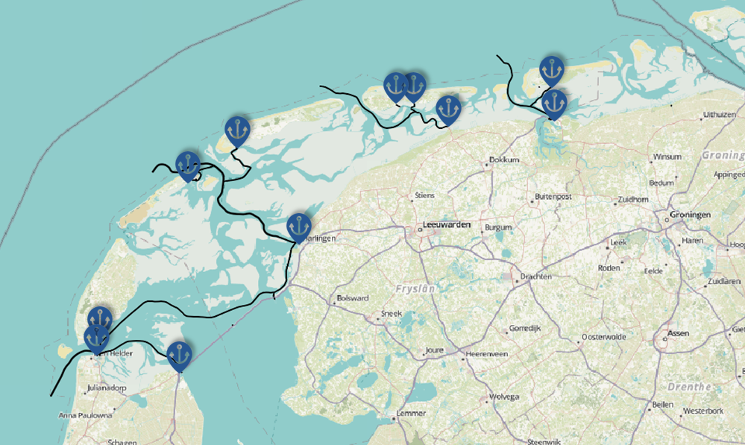
Study area
11 harbours
5 primary waterways
Total ca.350 km navigation channels
100 dredge fields
40 dumping locations

Slide 7
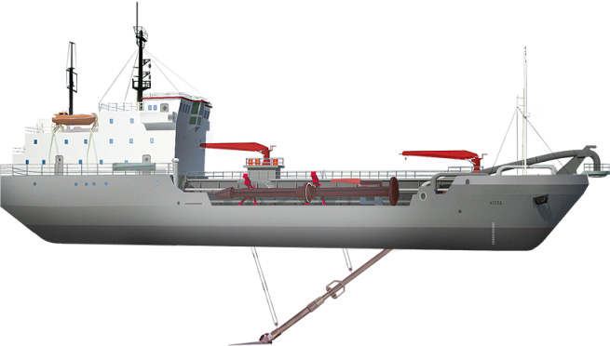
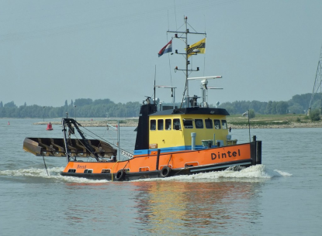
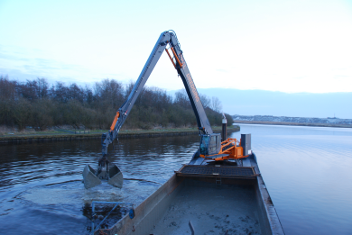
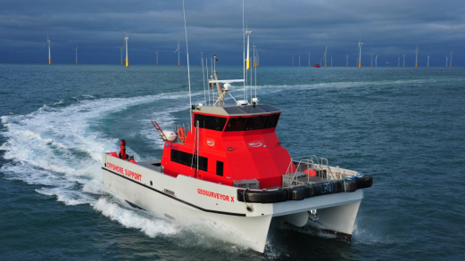
Materials
Multiple vessels in use:
2 dredge vessels
2 trailing suction hopper dredger
1 plough vessel
1 water injection vessel
1 survey vessel

Slide 8
Data
Soil and water quality permit
Dredge field permits
Dump location permits
Declared minimal and maximal depth
All having different period of validity

Slide 9
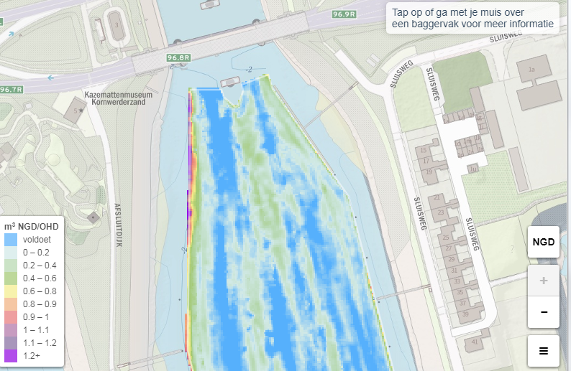
Data
Bed-level data (QA/QC passed)
Source: multi-beam echo sounders (survey vessel)
Spatial resolution: 1 x 1 meter
Temporal resolution: depends on survey frequency:
Mostly weekly, biweekly, monthly or biannual

Slide 10
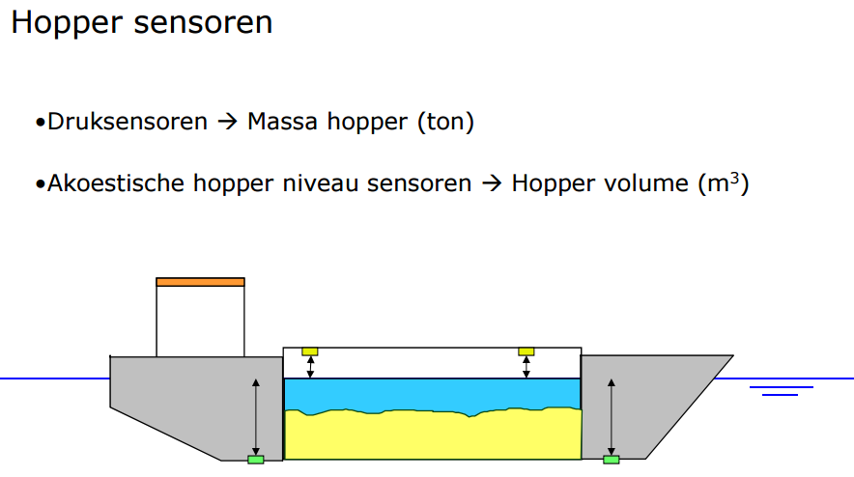
Data
Tons Dry Solids (TDS)
Source: Monitoring And Registration System (MARS)
Spatial resolution:
Dredge fields (dredged volumes)
Dumping locations (dispersed volumes)
Temporal resolution: every trip
Notes:
Automated for TSHD-vessel by MARS
Semi-automated for dredge vessels (via excel-plugin)

Slide 11
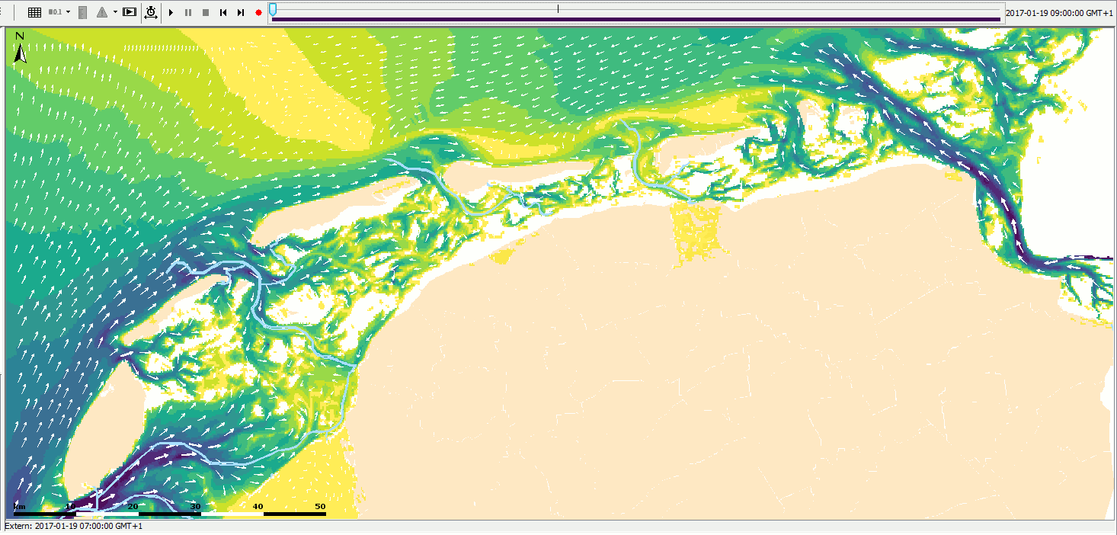
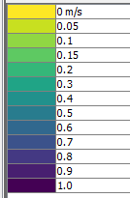
Data
Water- and windvelocity/direction
Source: MATROOS/WATERBASE
Spatial resolution:
Watervelocity/direction: 400 x 400 meter
Windspeed/direction: 6 sites (1D)
Temporal resolution:
Watervelocity/direction: 5 day ahead, timestep 10 min
Windspeed/direction: 5 day ahead, timestep 10 m

Slide 12
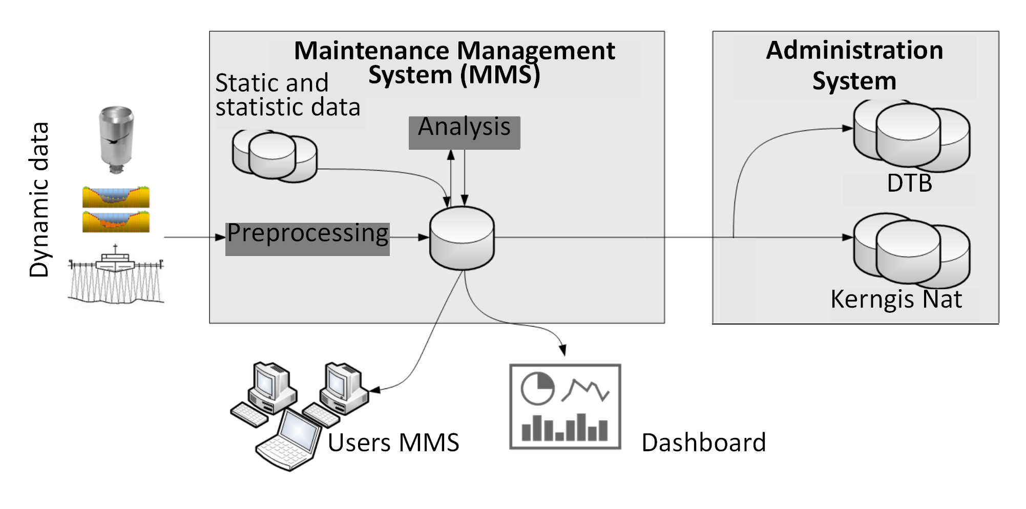
Method
Notes:
Preprocessing = processing
Analyse = analysis/forecasting

Slide 13
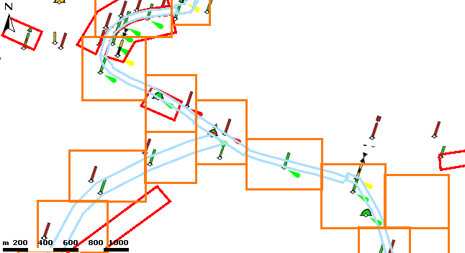
Method
Project bedlevel survey observations to custom tiling-scheme
Tiling scheme follows navigation channels with buffer of at least 50meter (‘standard’ width channel ~100m)
1 tile ~ 500x500pixels x 4 byte => 1MB/day/tile
Notes:
Small shifts in navigation channels is ok
Float32

Slide 14
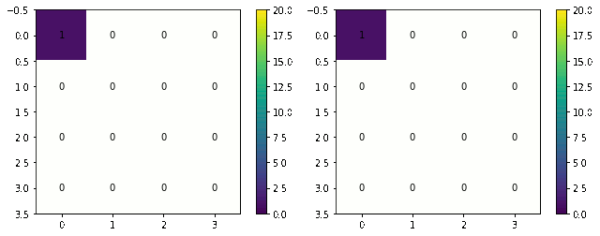
Method
Actual bed level computation
Daily process of creating a complete coverage of changes in last 30 days, with starting point the situation of 30 days ago.
In other words: daily process that retroactively considers changes in the last 30 days.
Observed bed level
Computed Actual bed level

Slide 15
Method
 | Area | Volume | Pct.
Cut r.t. NGD | parameter 1 | parameter 2 | parameter 3
Cut r.t MD | parameter 3 | parameter 4 | parameter 6
Fill r.t MD | parameter 7 | parameter 8 | parameter 9
Fill r.t NGD | parameter 10 | parameter 11 | parameter 12
mNAP
NGD
Declared minimal depth (nautical guaranteed depth)
-3.0
Declared maximum depth (maintenance depth)
-3.5
MD

Slide 16
Method
Sand
Mud
Wind conditions
Wave conditions
Tidal and wind influence
Statistical analysis
Mud-model
Trends
Bed levels
Historical dredged volumes
Sediment concentration
Trend analysis
Sediment deposition

Slide 17
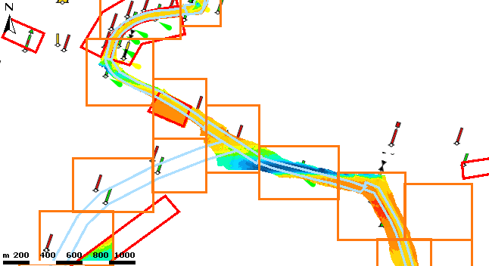
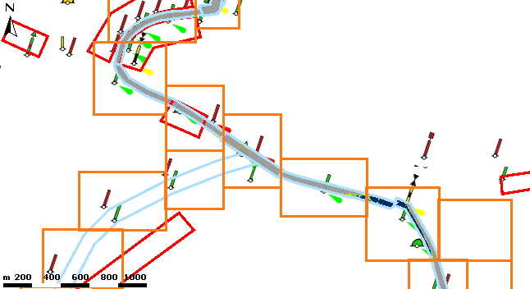
Results
Custom tiling scheme
Bedlevel observations projected to tiles
Derivate parameter computed for dredge fields (stored in tiles)

Slide 18
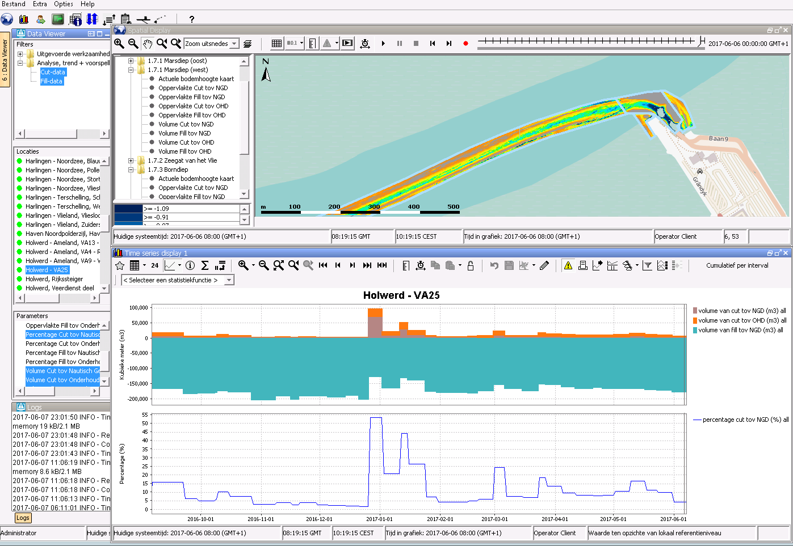
Results
Transformation of tiles to dredge fields and dumping location timeseries (1D)

Slide 19
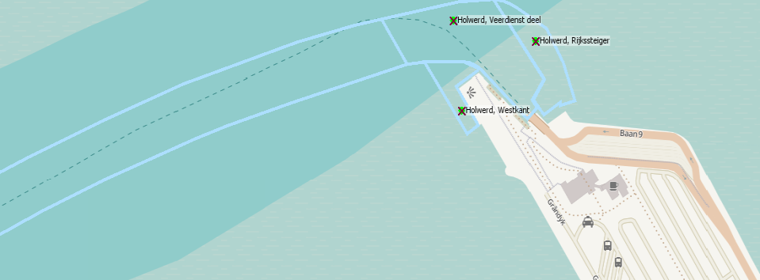
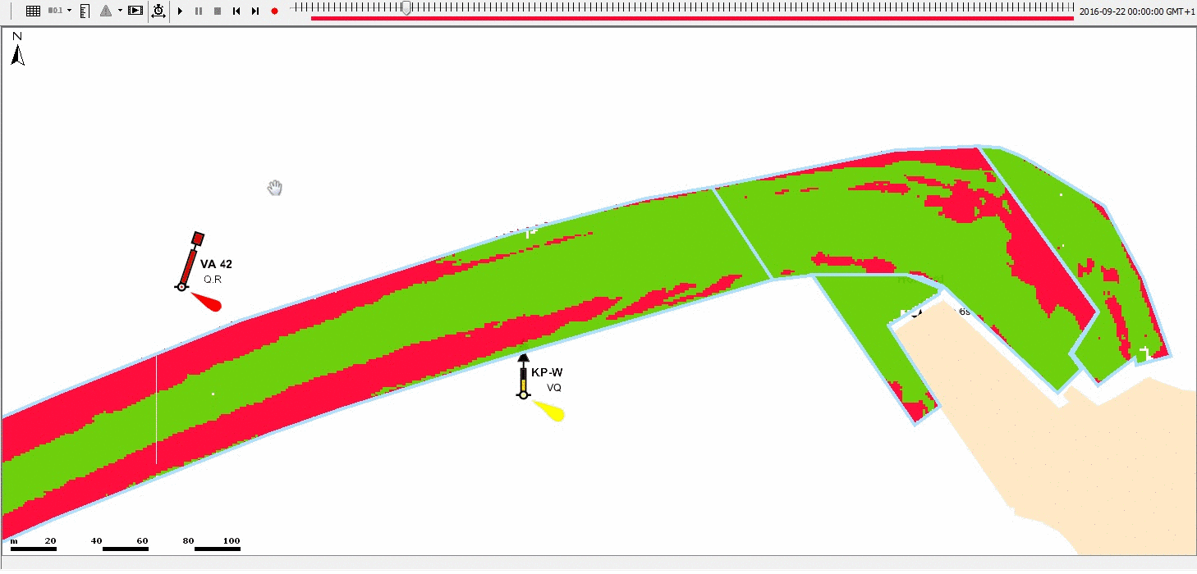
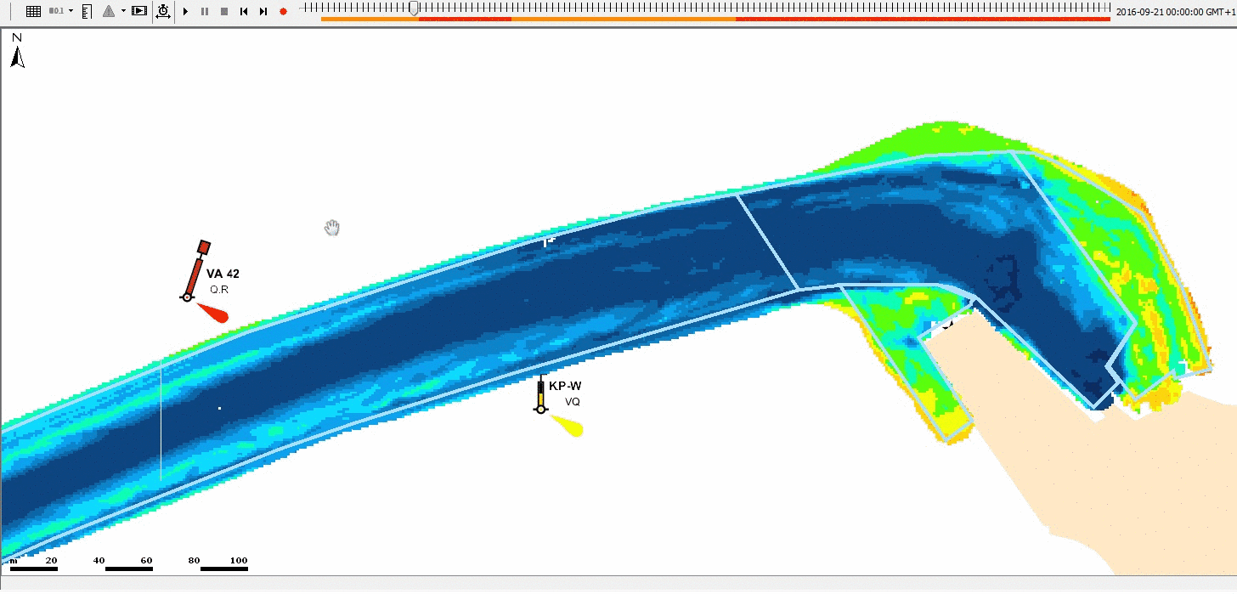
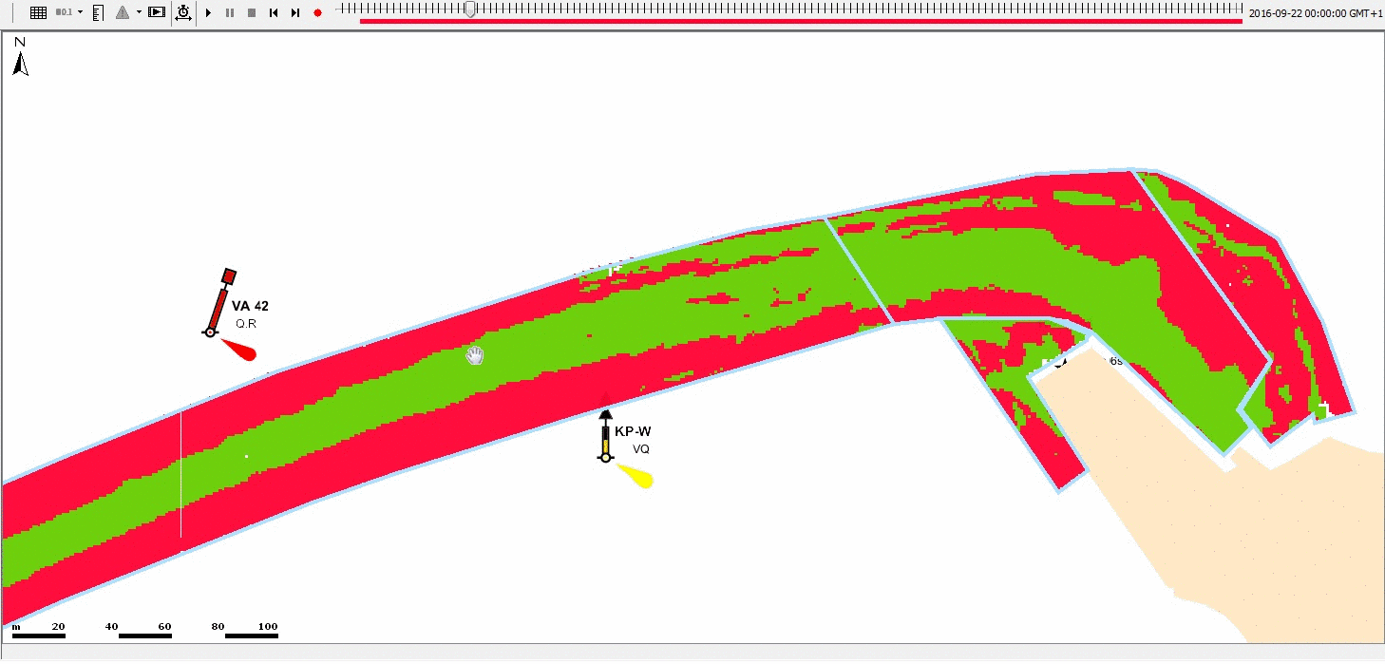
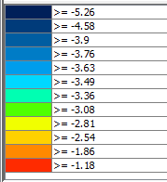
Results
NGD: -3.8 / MD: -4.0mNAP
Area cut rt. NGD
NGD: -2.5 / MD: -3.0mNAP
Good
Not good
Actual bed level
Area cut rt. MD
mNAP
Good
Not good

Slide 20
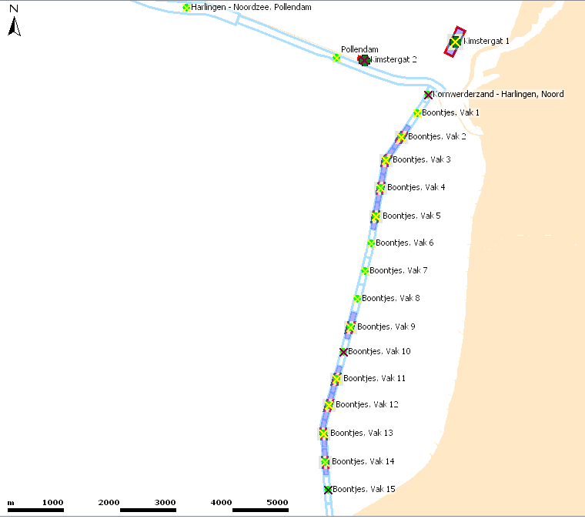
Monitoring dredged + dispersed volumes
Vlieland /
Terschelling
Harlingen
Dumpinglocation:
Kimstergat 1
Dredgingfields:
Boontjes Vak 1-15
Den Helder

Slide 21
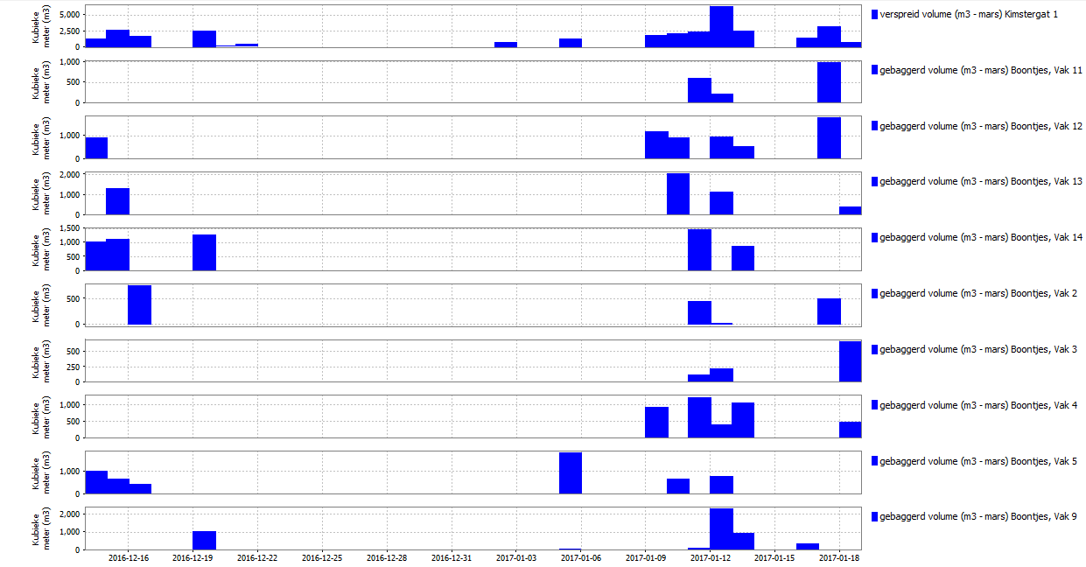
Monitoring dredged + dispersed volumes

Slide 22
Results
For each wind direction, set-up a relation between sedimentation deposition speed and wind velocity with a linear regression: SDS=𝑎∗WV+𝑏
Where:
SDS=sedimentation deposition speed (m/day]
WV=95th percentile wind velocity (m/s)
𝑎=slope [s/day]
𝑏=constant[m/day]

Slide 23
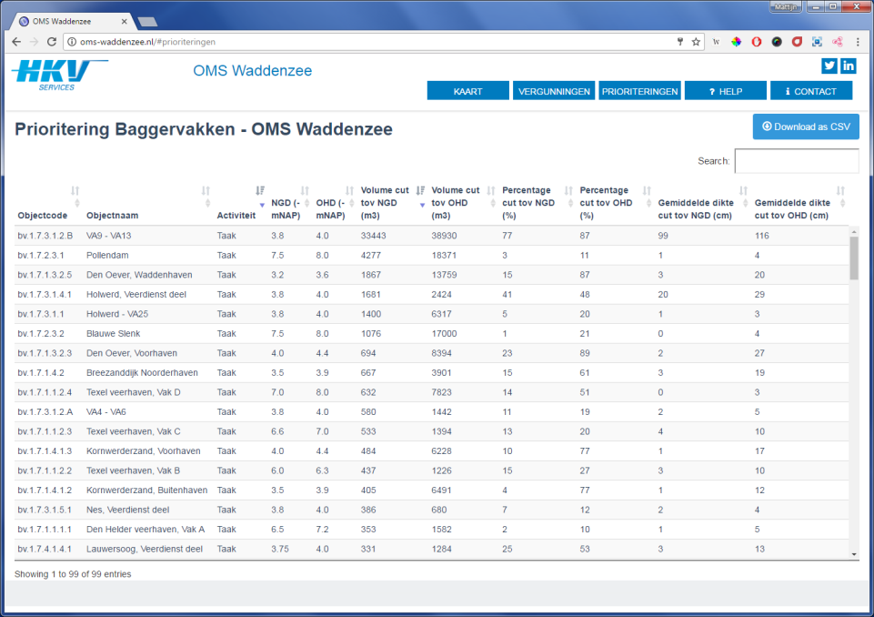
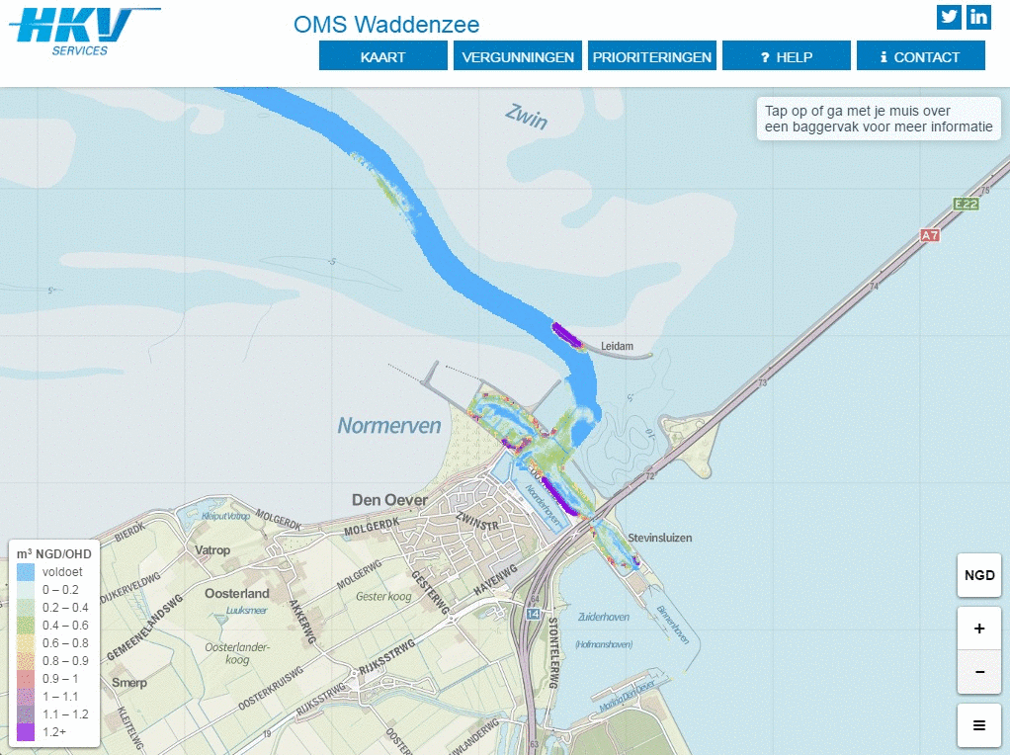
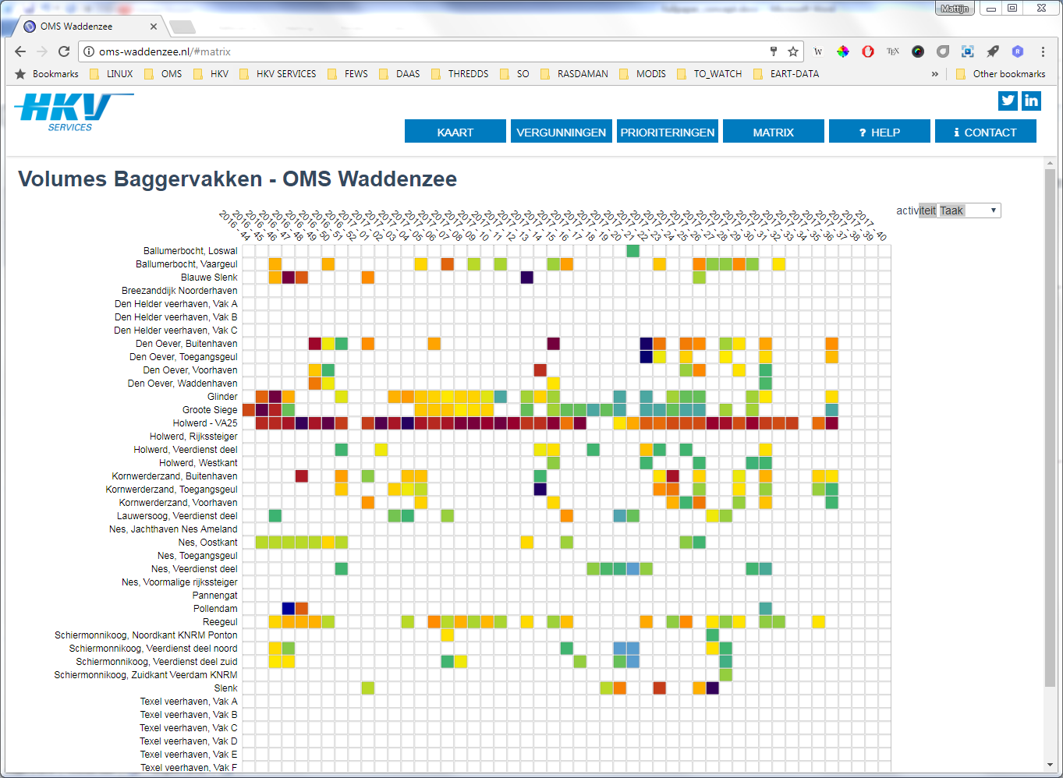
Results
Viewer with actual bedlevel
Daily updated priority table
weekly dredged volumes for each dredge field

Slide 24
Conclusion
Benefits of MMS (so far):
Relocation of navigation channels is easy, since algorithms are based on tile-scheme
Automatic emails and PDF map (A0) creation is a big time-saver for contractor
Web-based insight in interactive maps / weekly priorities / and expiry dates of permits is very convenient

Slide 25
Conclusion
Difficulties in MMS so far:
Forecasting is difficult
relation between bed levels and dredged volumes is related, but relationship is not natural (and contractor dependent)
Wind is most dominant factor
Maybe include Remote Sensing?
Maybe adopt Artificial Intelligence?

Slide 26
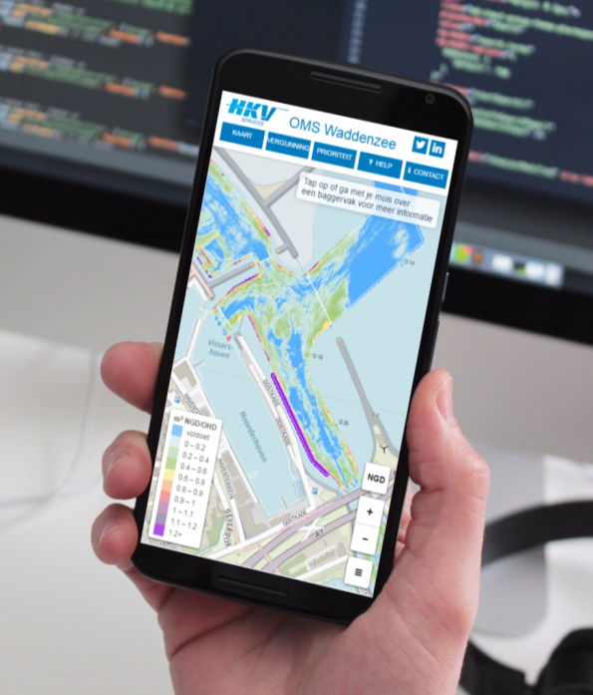
Proactive dredging in the
Dutch Waddensea
Questions?
Contact information:
Mattijn van Hoek
hoek@hkv.nl
+316 35 11 97 62

