Slide 1
A continuum of knowledge from measurements to modelling to explore the future of our seabed resources,
Belgian part of the North Sea
Nathan Terseleer*, Vasilis Hademenos, Tine Missiaen, Jan Stafleu, Dries Van den Eynde, Vera R.M. Van Lancker
*nterseleer@naturalsciences.be
Hydro17 – Connecting 4D Future
16th November 2017

Slide 2
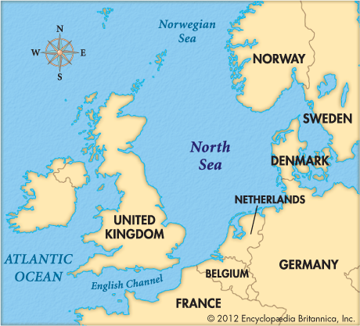
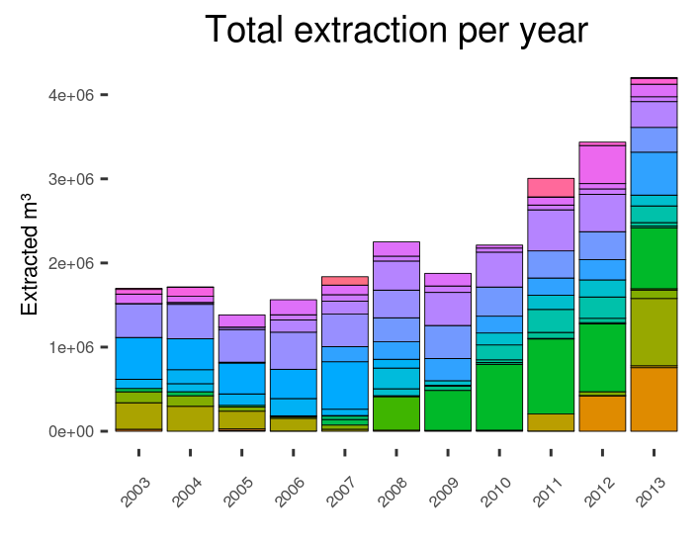
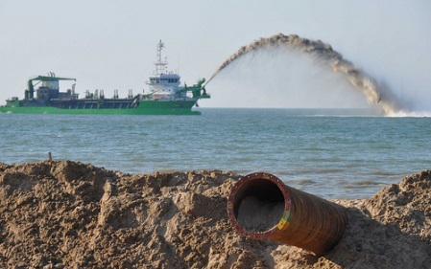
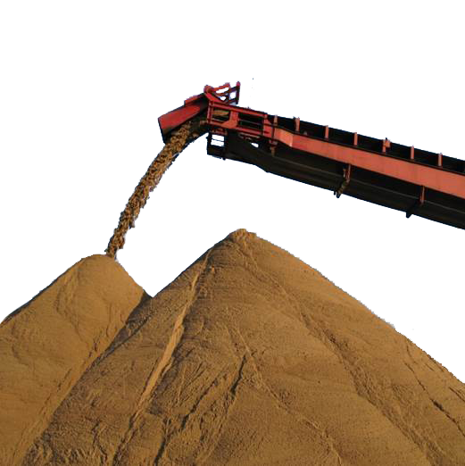
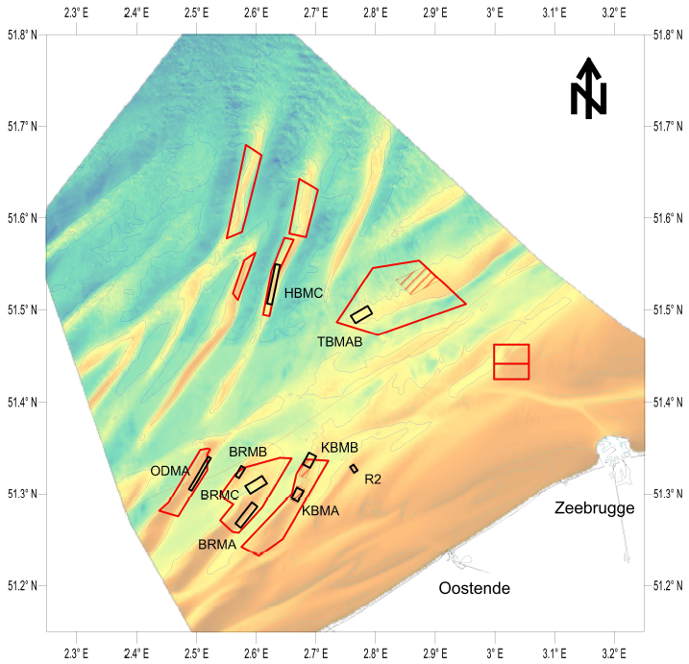
Introduction
From data…
… to model (3D)
… to model (4D)
Concl. & Perspectives
Marine aggregate extraction in the BCS
Started in 1976 (~30x10³ m³/yr → >1.7x10⁶ m³/yr in the ‘90s)
Sand exploited for the industry and beach nourishment
extraction areas
monitoring areas
Extent and sustainability of the resource?
Effects of extraction on the system?
3D geological model of the resource
link to environmental impact models
→ 4D Decision Support System

Slide 3
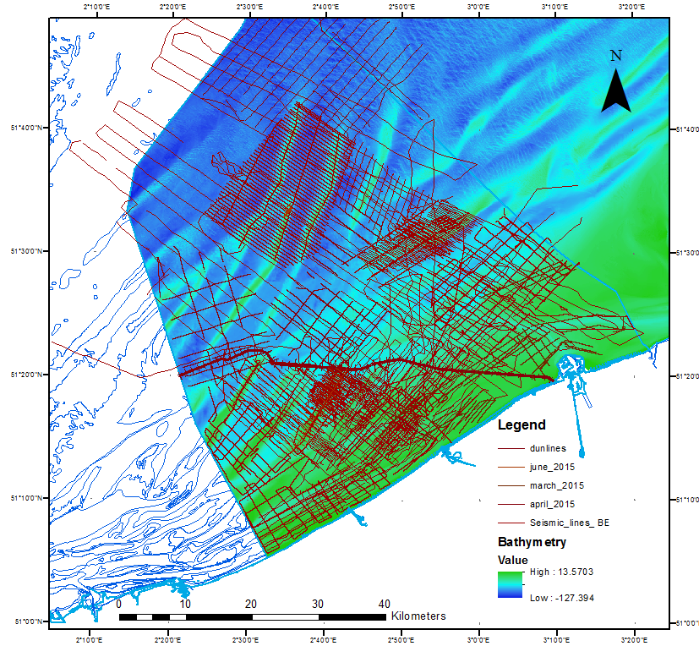
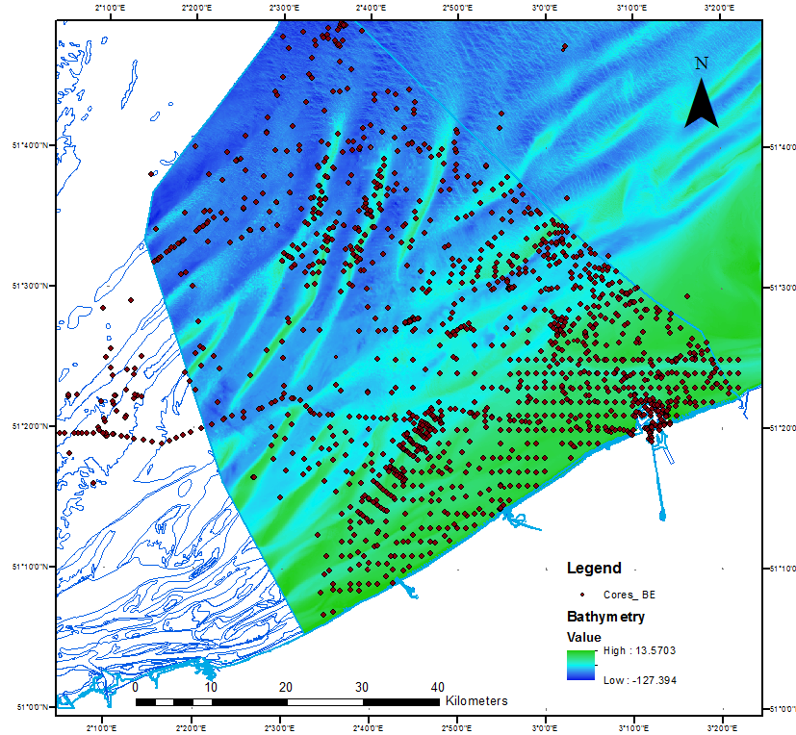
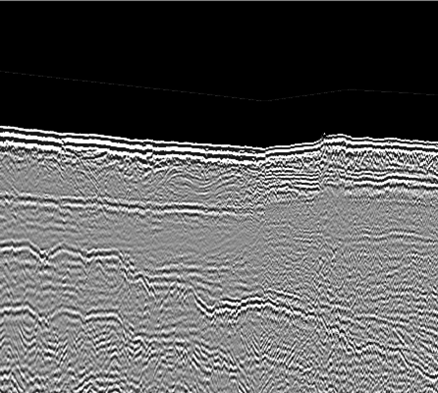
Introduction
From data…
… to model (3D)
… to model (4D)
Concl. & Perspectives
From measuring…
Seismic profiles
Cores
Holocene
Velocity model: time → depth
Boundaries between
geological units
Pleistocene
Tertiary

Slide 4
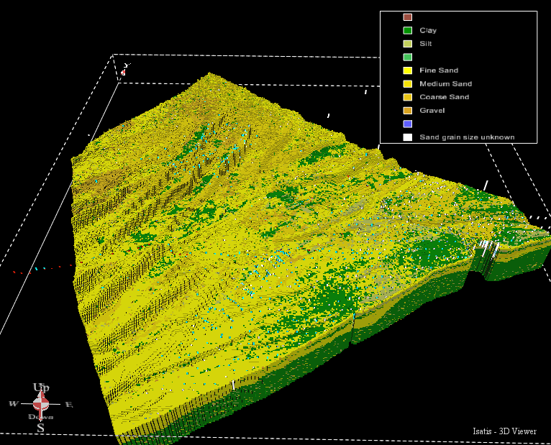
Introduction
From data…
… to model (3D)
… to model (4D)
Concl. & Perspectives
From measuring… to modelling: the VOXEL model
lithological classification
2D lithostratigraphical units
3D interpolation
Stafleu et al., 2011
3D geological model of the resource
Blocks of information (~200x200x1 m):
lithology
uncertainty
sediment properties
possibly any relevant info
(ecology, chemistry, …)
spatial analysis
(volume calculations, …)

Slide 5
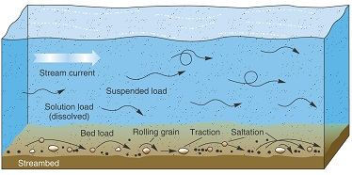
Introduction
From data…
… to model (3D)
… to model (4D)
Concl. & Perspectives
From measuring… to modelling: COHERENS
Hydrodynamics
Sediment Transport
Seabed Morphology
SUSPENDED LOAD
for different sediment fractions
TOTAL LOAD
particle diameter
BED LOAD
f
settling velocity
critical shear stress
EROSION-DEPOSITION → seabed changes…
particle density
Challenges:
sedimentological resolution → classes, properties
initial conditions (concentrations, available stock vs limitless quantities)

Slide 6
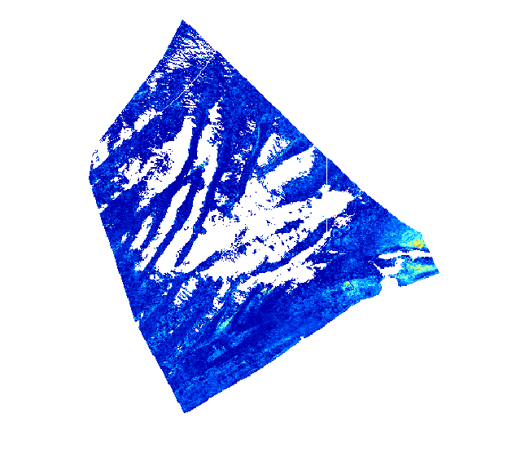
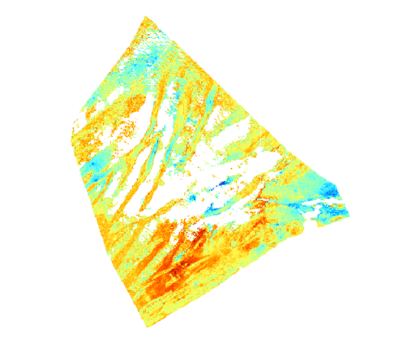
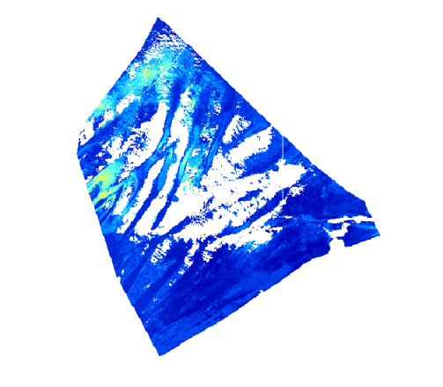
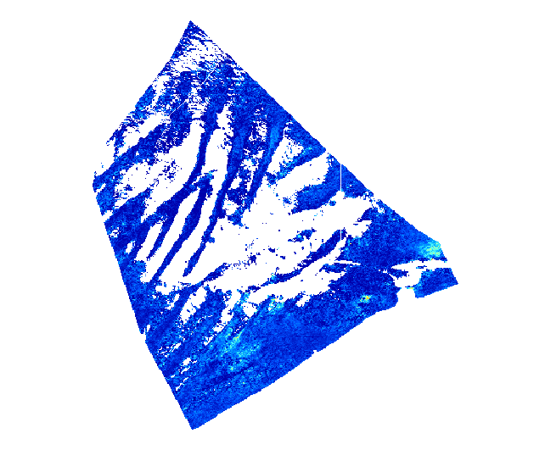
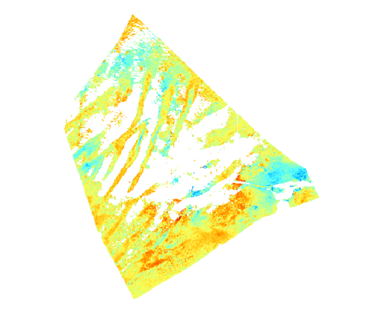
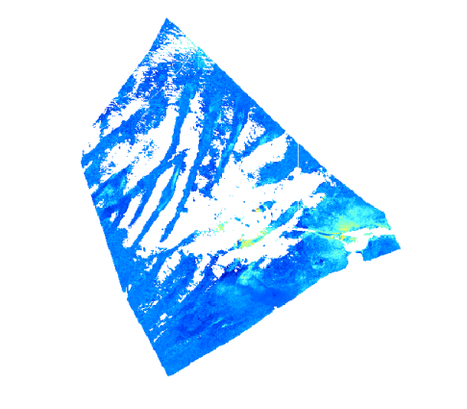
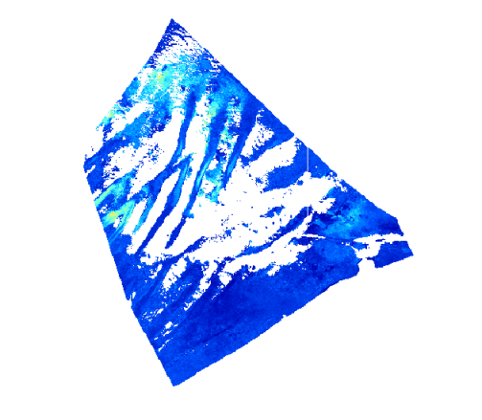
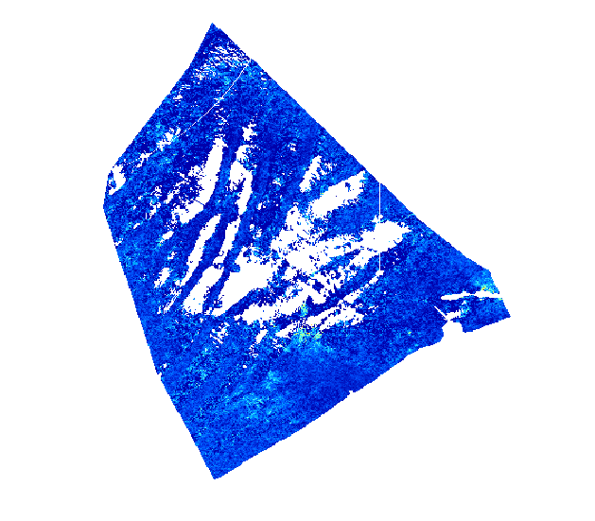
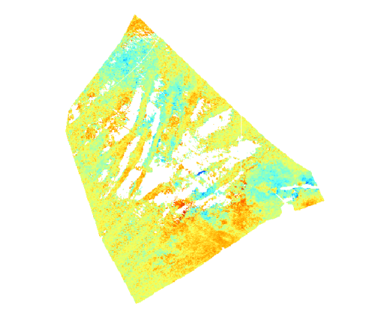
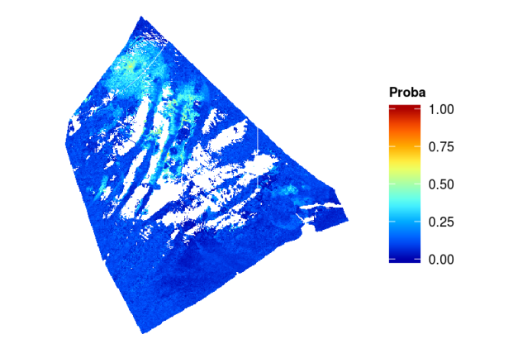
Introduction
From data…
… to model (3D)
… to model (4D)
Concl. & Perspectives
From measuring… to modelling: VOXEL → COHERENS
The VOXEL model is translated into COHERENS-readable information
Fraction 1
(Clay + Silt)
Fraction 2
(Fine Sand)
Fraction 3
(Medium Sand)
Fraction 4
(Coarse Sand + Gravel)
Layer 1
Layer 2
Layer 3

Slide 7
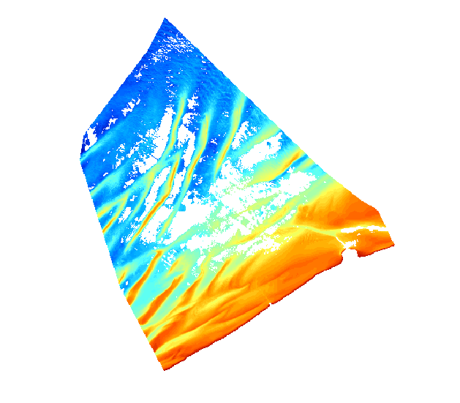
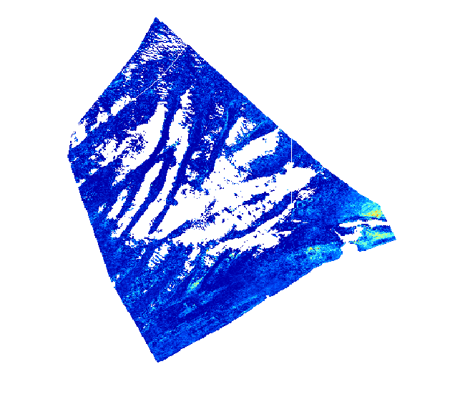
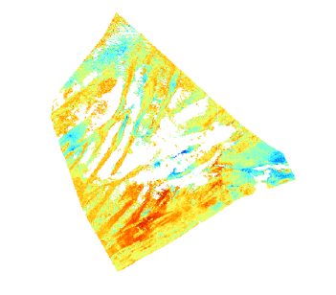
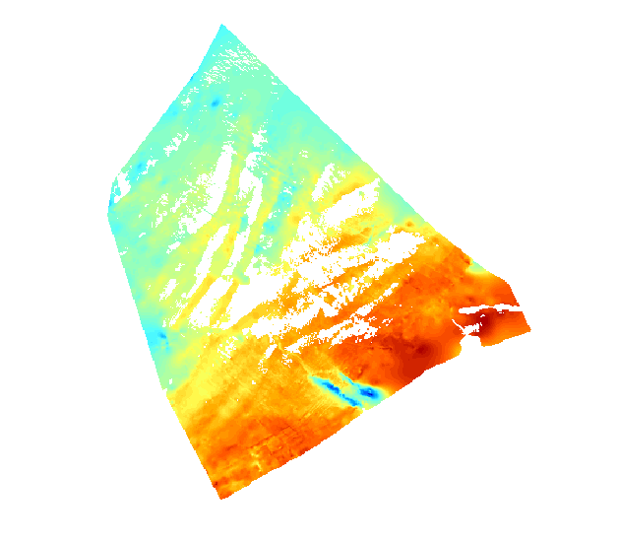
Introduction
From data…
… to model (3D)
… to model (4D)
Concl. & Perspectives
COHERENS - VOXEL coupling
water surface
water column
erosion
deposition
Bathymetry
BATHYMETRY
FRACTIONS
& PROPERTIES (d_{p}, ρ)
THICKNESS
TERTIARY
Fixed layer

Slide 8
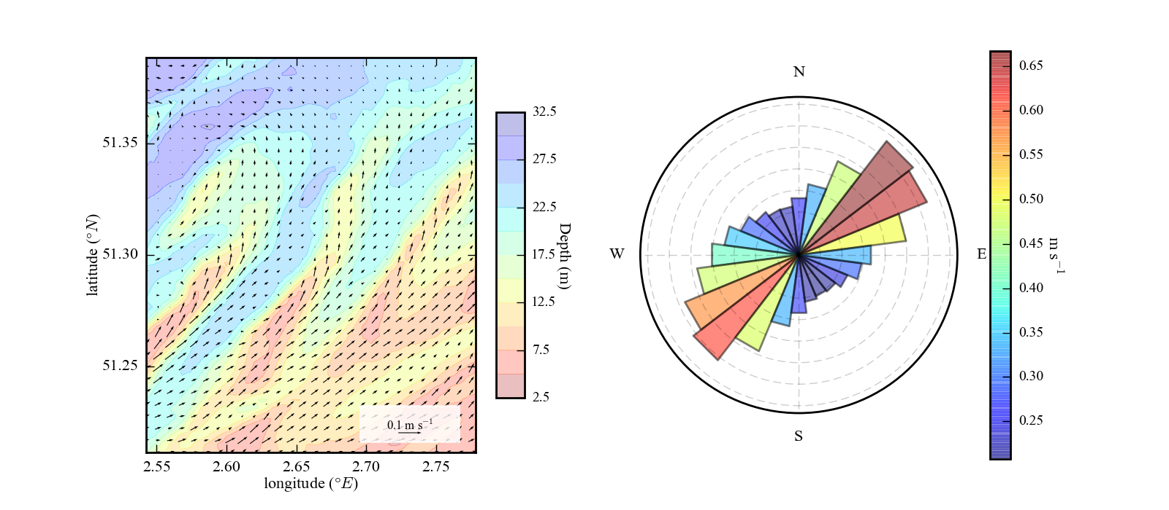
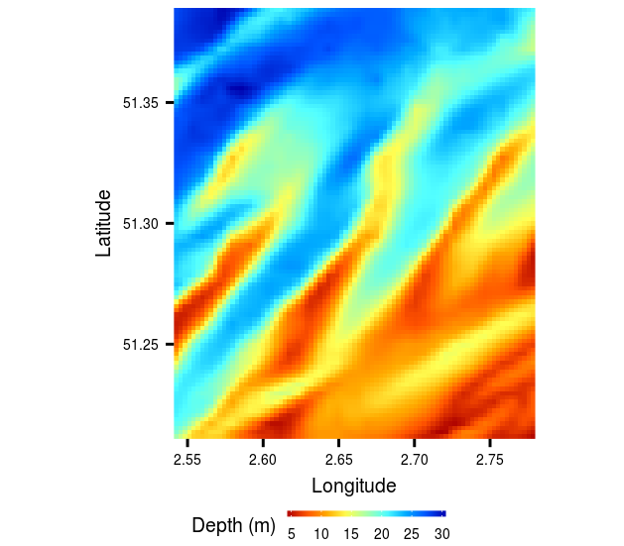
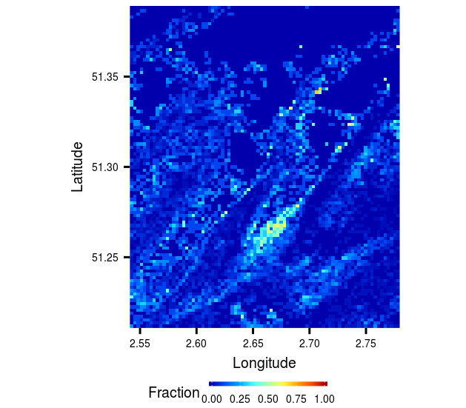
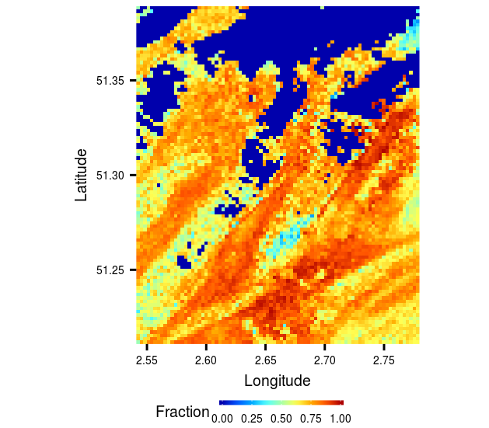
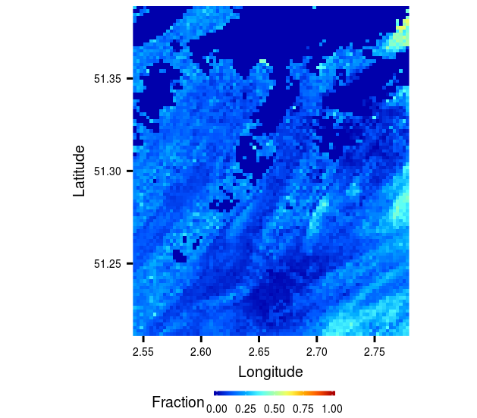
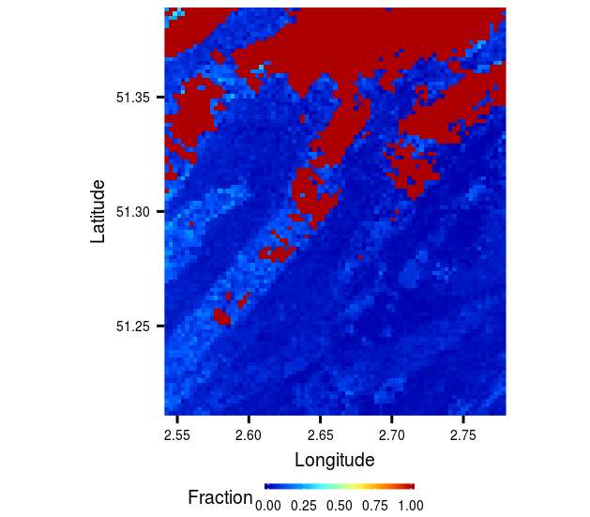
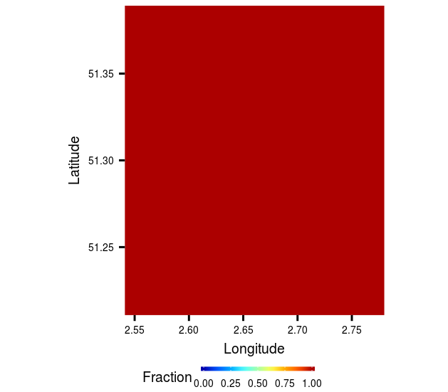
Introduction
From data…
… to model (3D)
… to model (4D)
Concl. & Perspectives
VOXEL-COHERENS: Application (Flemish banks)
extraction areas
monitoring areas
Currents (Spring-Neap cycle):
Fraction 1
Fraction 2
Fraction 3
Fraction 4
Single fraction
Particle ø (d₅₀)
50 µm
150 µm
300 µm
600 µm
150 µm

Slide 9
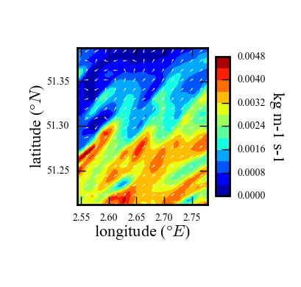
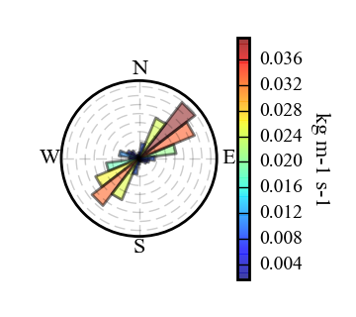
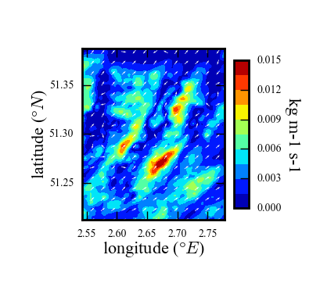
Introduction
From data…
… to model (3D)
… to model (4D)
Concl. & Perspectives
VOXEL-COHERENS: Multiple vs Single fractions
Fraction 1
Fraction 2
Fraction 3
Fraction 4
Total (1+2+3+4)
Single Fraction
Bed load:
Suspended load:

Slide 10
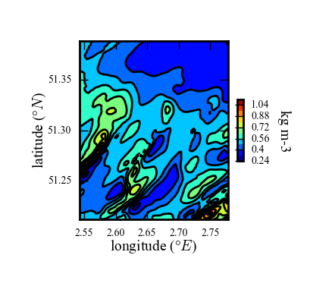
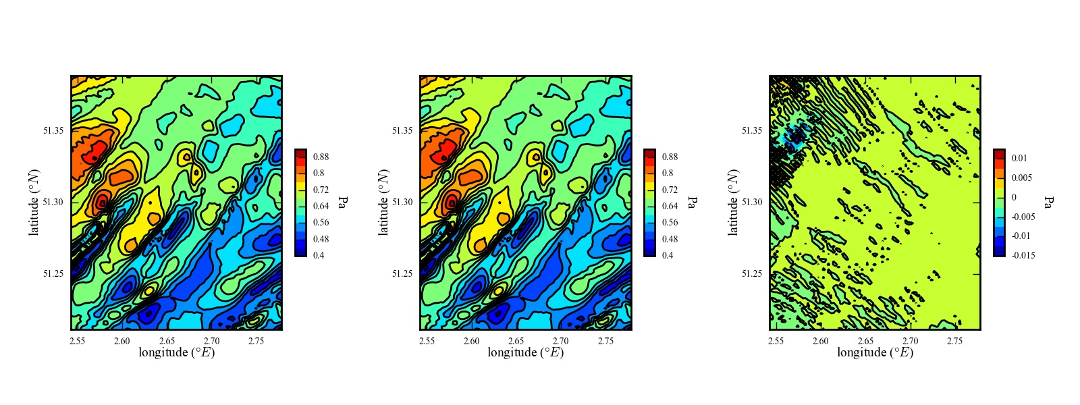
Introduction
From data…
… to model (3D)
… to model (4D)
Concl. & Perspectives
VOXEL-COHERENS: Multiple vs Single fractions
Fraction 1
Fraction 2
Fraction 3
Fraction 4
Total (1+2+3+4)
Single Fraction
Sediment concentration:
Bed shear stress:
Multiple Fractions
Single Fraction
Difference
To be used as indicator of a descriptor for the MSFD!

Slide 11
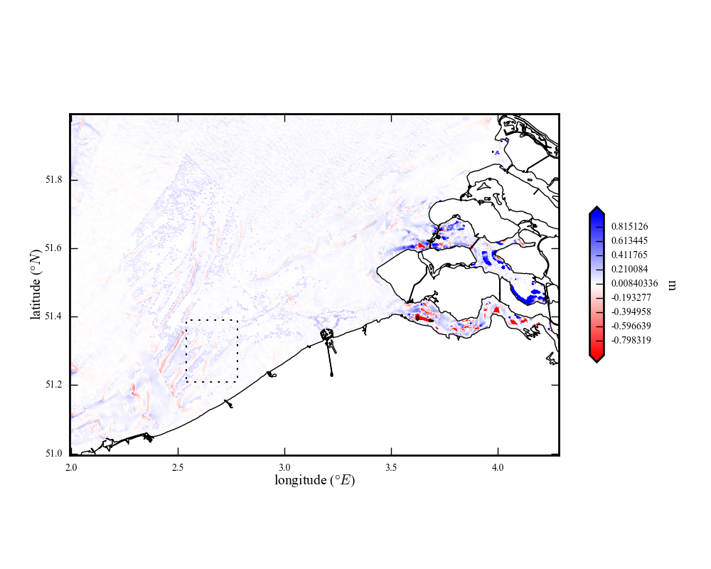
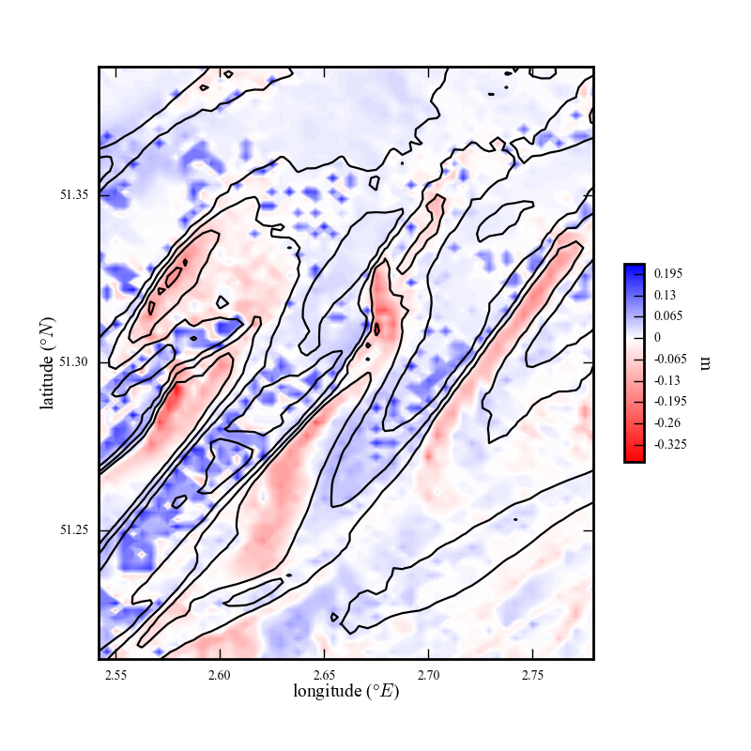
Introduction
From data…
… to model (3D)
… to model (4D)
Concl. & Perspectives
VOXEL-COHERENS: deposition/erosion pattern
Note the importance of the initialization of the sediments
(inside/outside the VOXEL model area)
→ Help producing suitability maps (scenarios)

Slide 12
Introduction
From data…
… to model (3D)
… to model (4D)
Concl. & Perspectives
Conclusions and perspectives
3D VOXEL model:
coarse sand is limited (>< fine sand!)
Resource mapping, volume calculations, …
uncertainty!
4th Dimension (Time)
→ coupling with numerical model
Importance of IC’s and parameterization
(resolve the sedimentological resolution)
Scenarios (sand extraction)
coupling with a wave model, …
From measuring to modelling… to society:
multi-criteria Decision Support System (accounting for uncertainty → confidence limits)
Suitability maps (user-specific)
threshold for habitat change, changes in bed shear stress

Slide 13
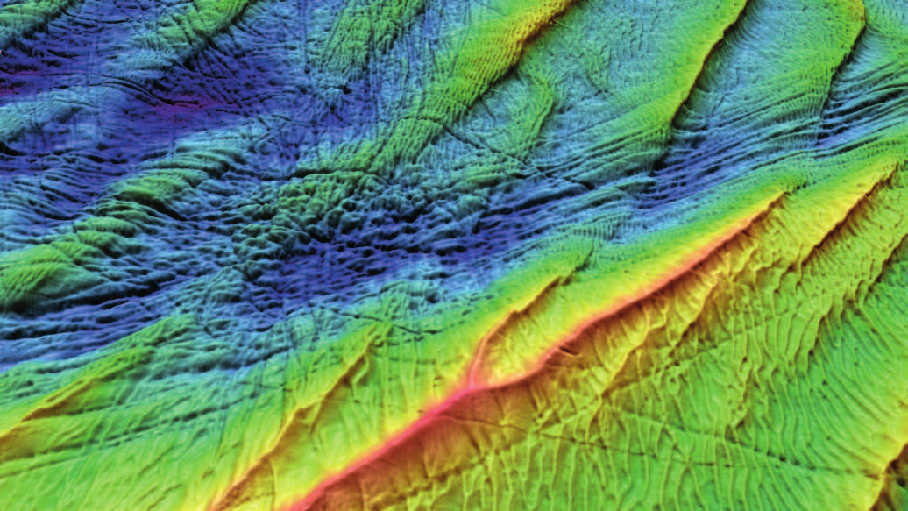
THANK YOU
Picture: M. Roche & K. Degrendele @

