Slide 1
Hydrographic Education (FIG/IHO/ICA Category A) at the HafenCity University Hamburg
Prof. Dr.-Ing. Harald Sternberg
Hydro17, Rotterdam
14 – 16 November 2017

Slide 2
outline
HafenCity University
Geodesy and Geoinformatics at HCU
Specialization in Hydrography
staff and equipment
students and projects

Slide 3
HafenCity University Hamburg
HCU - founded 2006 - brings together under one roof all the areas of study and research needed for “the built environment”
It is an explicit target to improve interdisciplinary innovation in teaching, research and development of all building and planning related disciplines, living up to their common routes
Professors: 45 | Students: 2,500

Slide 4
HafenCity University Hamburg
Discipline-Axis
Design
Conception, Planning and Art
Technology
Construction, Surveying, Technology, Implementation
Sociology
Built Environment
People, Socio-Cultural aspects
Ecology
Economy
Environment / Sustainability
Financial and economic aspects

Slide 5
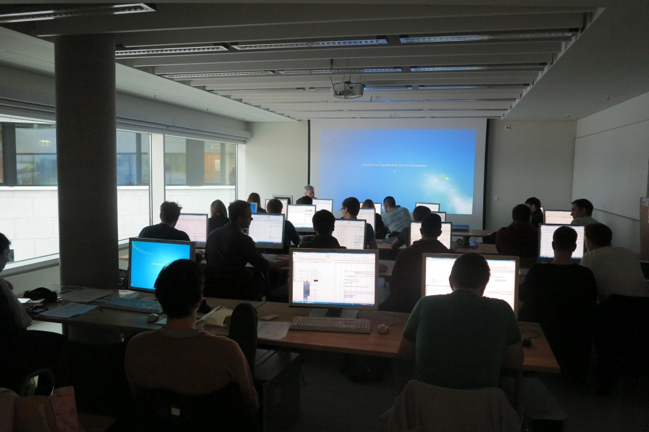
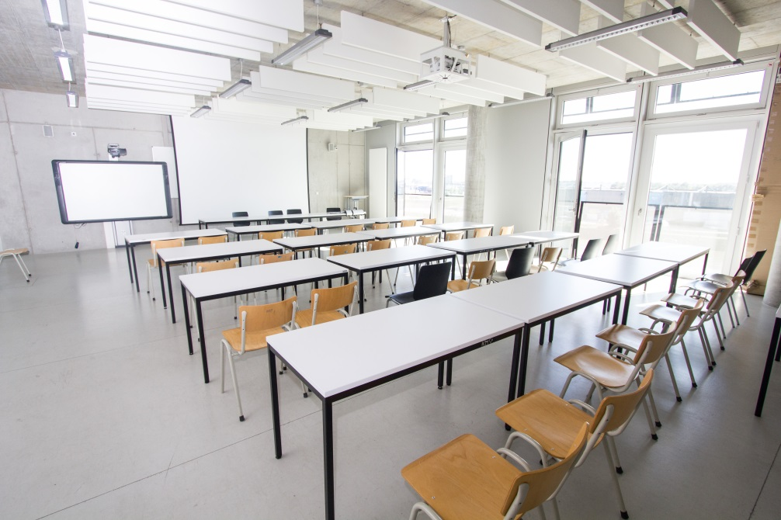
HafenCity University Hamburg
Study programmes: Architecture (BA, MA)
Civil Engineering (BA, MA)
Geodesy and Geoinformatics (BA, MA)
Urban Planning (BA, MA)
Metropolitan Culture (BA)
Resource Efficiency in Architecture and Planning (MA) Urban Design (MA)

Slide 6
History
1981 – FH Hamburg created a consecutive model a course of studies in Hydrography
1990 – Recognition by the FIG/IHO International Advisory Board on Standard of Competence for Hydrographic Surveyors at Category A Academic, with “Specialisation in Nautical Charting“
2010 – Last recognition by the FIG/IHO/ICA IBSC against the “Standards of Competence for Hydrographic Surveyors” for Category A, 10th Edition, 2008
Volker Böder
Delf Egge
Notes:
Volker Böder: professor fot Hydrography and Geodesy / since 2005
Delf Egge: involved since beginning of hydrographic education

Slide 7
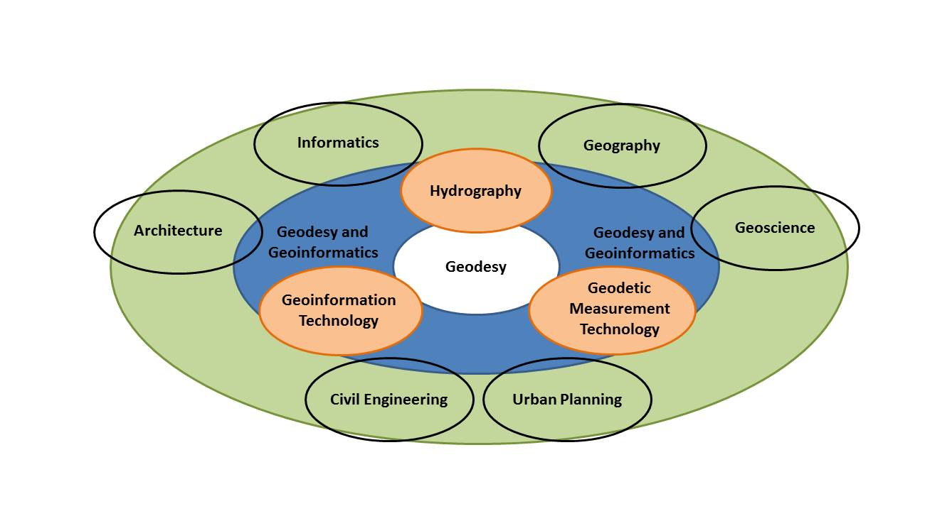
Geodesy and Geoinformatics
Notes:
Within the Master of Science in Geodesy and Geoinformatics at the HCU three specialisations are offered: Geodetic Measurement Technology or Geodetic Metrology, Geographical Information Technology or GI-Science, and Hydrography. The courses within the specialisation in Hydrography are taught in English.

Slide 8
Semester 1 30 | CP |  | Semester 2 30 | CP |  | Semester 3 30 | CP |  | Semester 4 30 | CP
Engineering Mathematics | 2,5 |  |  |  |  |  |  |  | MINT
Software and Interface Technology | 5
GNSS | 2,5 |  | Terrestrial Laser Scanning | 2,5 |  |  |  |  | Geodetic Metrology GMT
 |  |  | Integrated Navigation | 5
optional: Land Surveying Tutorial | 0 |  | Higher Geodesy | 5
GI-Science | 2,5 |  | Spatial data analysis | 5 |  |  |  |  | Geoinformation Technology GIT
Basics of Hydrography Practical Course 1 | 2,5 |  | Advanced Hydrography Practical Course 3 | 5 |  | Marine Geology /Geophysics | 5 |  | Hydrography HYD
Hydr. Data Acquisition and Processing Practical Course 2 | 7,5 |  |  |  |  | Navigation in Hydrography | 2,5
Marine Environment | 5 |  |  |  |  | Oceanography | 5
 |  |  |  |  |  | Nautical Charting | 2,5
 |  |  |  |  |  | LiDAR and Remote Sensing | 2,5
 |  |  |  |  |  | Hydrographic Practice | 7,5
Project Management Lecture |  |  | Seminar | 5 |  | Interdisciplinary Project | 5 |  | QBS
 |  |  | Q-Studies | 5
 |  |  |  |  |  |  |  |  | Master-Thesis | 30
Notes:
The courses are organized in a modular way. It consists of compulsory and eligible modules and the final master thesis. The modules of each semester add up to 30 CP, resulting in an overall workload for the students of 120 CP for the whole 2-years programme. After finishing three regular semesters of lectures the students write their thesis in the fourth semester over period of five months.

Slide 9
Multi- and Interdisciplinary Study Courses
Master 15 CP
 | Content / Fields | Workload CP
Q-Studies | Science, Technology, Knowledge Media, Art, Culture Economy, Politics, Society | 5 CP
Basics | Project Management Business Administration | 5 CP
IP | Interdisciplinary Projects | 5 CP
Notes:
The interdisciplinary approach of the HCU is reflected within the programme structure. Inter-disciplinary and trans-disciplinary topics are offered within the [Q] Studies and the Interdisciplinary Project in the third semester at the interface of various study programmes. Within these modules, the students of different study programmes are working together to gain an insight into the research methods of other disciplines and improve their communication skills within an interdisciplinary team. [Q] Studies and the Interdisciplinary Project are elective courses. The students can choose from a varying variety of offered projects. In previous years, the hydrographic department offered the project “Planning, Processing and Analysing Site Investigations for Offshore Constructions” in cooperation with the Geotechnics department of the HCU.

Slide 10
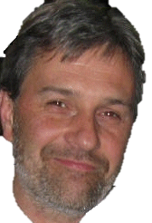
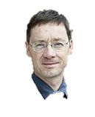
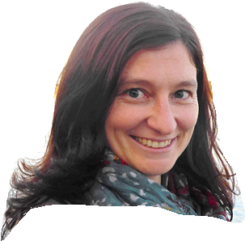
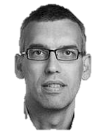
Teaching Staff
Prof. Thomas Kersten (Photogrammetry and Laser Scanning)
Prof. Dr.-Ing. Annette Eicker (Geodesy and Adjustment Theory)
Prof. Dr.-Ing. Jochen Schiewe (Geoinformatics and Geovisualisation)
Prof. Dr.-Ing. Harald Sternberg (Hydrography and Geodesy)
Professors
Research & Teaching Associates
(7 PhD Theses)
External Lecturers (Hydrography)
Prof. Dr. rer. nat. Thomas Schramm (Geomathematics – Informatics and Physics)
Prof. Dr. rer. nat. Karl Traub (GIS and Remote Sensing)
Notes:
All Professors of Geodesy and Geoinformatics involved in Spec. Hydrography
2 Phd -> Hydro

Slide 11
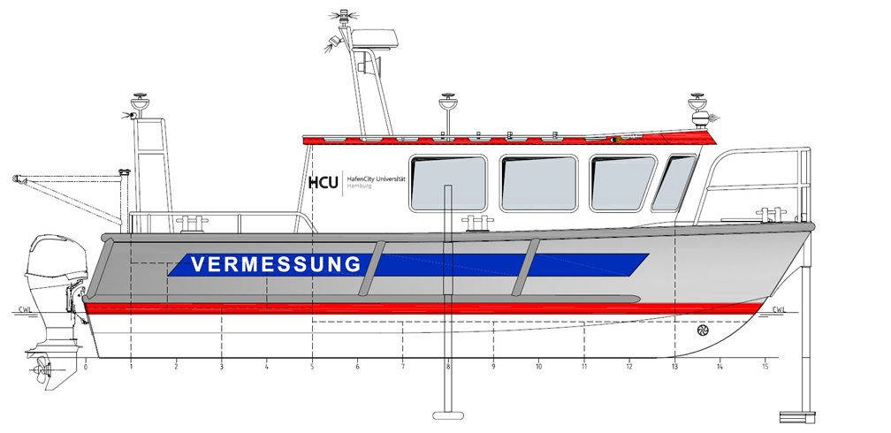
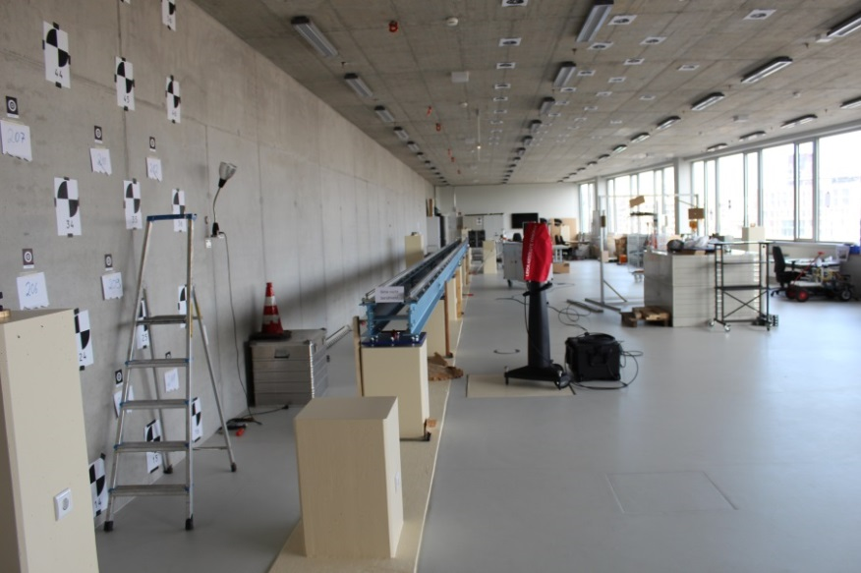
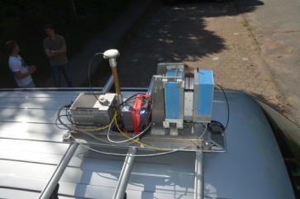
Geodesy and Geoinformatics
Notes:
The hydrographic modules are accompanied with exercises and practical courses. These trainings give students the opportunity to apply the previous gained theoretical knowledge addressed in the lectures within practice.
Well equiped lab for analysis tests calibration (lasertracker/turntable)

Slide 12
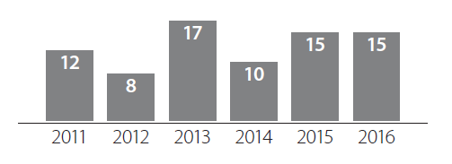
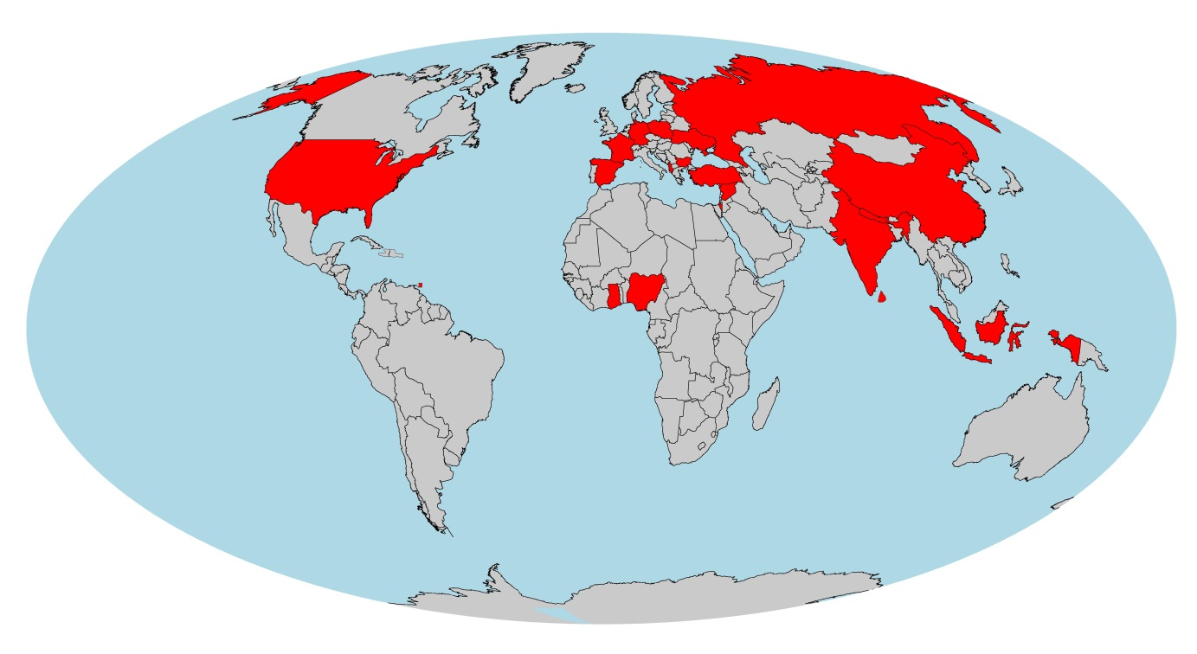
Students forHydrography
Number of first-year students (Specialisation Hydrography)
42 students from 21 countries (status of October 2016):
Notes:
ENTRY REQUIREMENTS AND ENROLMENT STATISTICS
Applicants need a Bachelor or Diploma degree in Hydrography, Geodesy and Geoinformatics, Geomatics, or a related geo-scientific technical or engineering-oriented degree programme. A satisfactory score on the Bachelor’s examination is required. Applicants whose first language is not English must provide proof of their English language capacity.
The programme starts every October. The number of students is limited to sixteen students. The number of first-year students within the Hydrography specialisation varies between eight and fifteen over the last few years. Overall, 42 students from 21 countries all over the world (status of October 2016) are enrolled within the programme.

Slide 13
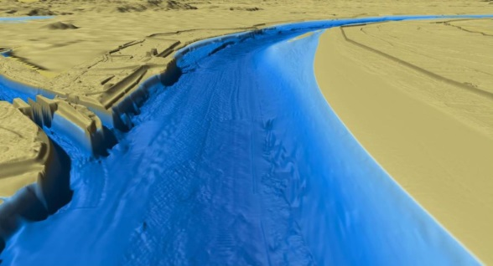
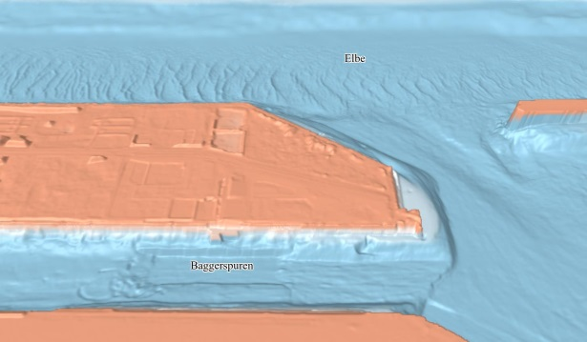
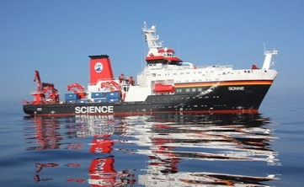
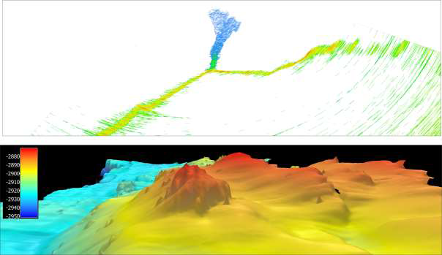
Projects and Research
“A new view on the Elbe“ (2016)
In collaboration with the newspaper WELT
“INDEX 2017 (Indian Ocean Exploration)“
In collaboration with the BGR
(Federal Institute for Geoscience and Natural Resources)
Notes:
In collaboration with the German newspaper WELT dynamic and interactive 3D views and videos of the River Elbe for public information purposes in news media were developed. Those have been integrated into a multimedia special (http://www.welt.de/lesestueck/2016/elbvertiefung) which aims to give people better insight into the complex topic of the fairway adjustment of the Elbe. (Dufek et al., 2016)
Recently, HCU is contracted by the BGR (Bundesanstalt für Geowissenschaften und Rohstoffe / Federal Institute for Geoscience and Natural Resources) within the project INDEX2017 (Indian Ocean Exploration). The project deals with marine resource assessment in the German license area in the Indian Ocean. Besides supporting the BGR during data acquisition on the SO259 INDEX2017 cruise on the German research vessel Sonne, the HCU mainly focuses on processing, analysing, and investigating the data collected with the deep-towed bathymetry sled HOMESIDE and the ship-based multibeam echo sounder data. (Institut für Meereskunde Universität Hamburg, 2017)

Slide 14
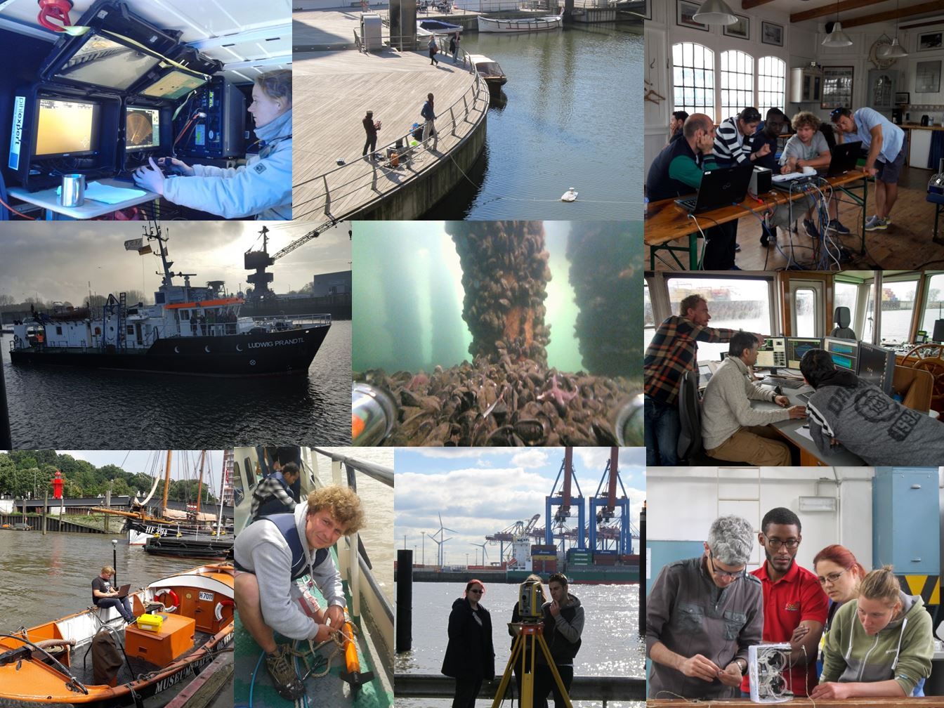
Historical Overview
Notes:
Students during practical courses and the final field training.

Slide 15
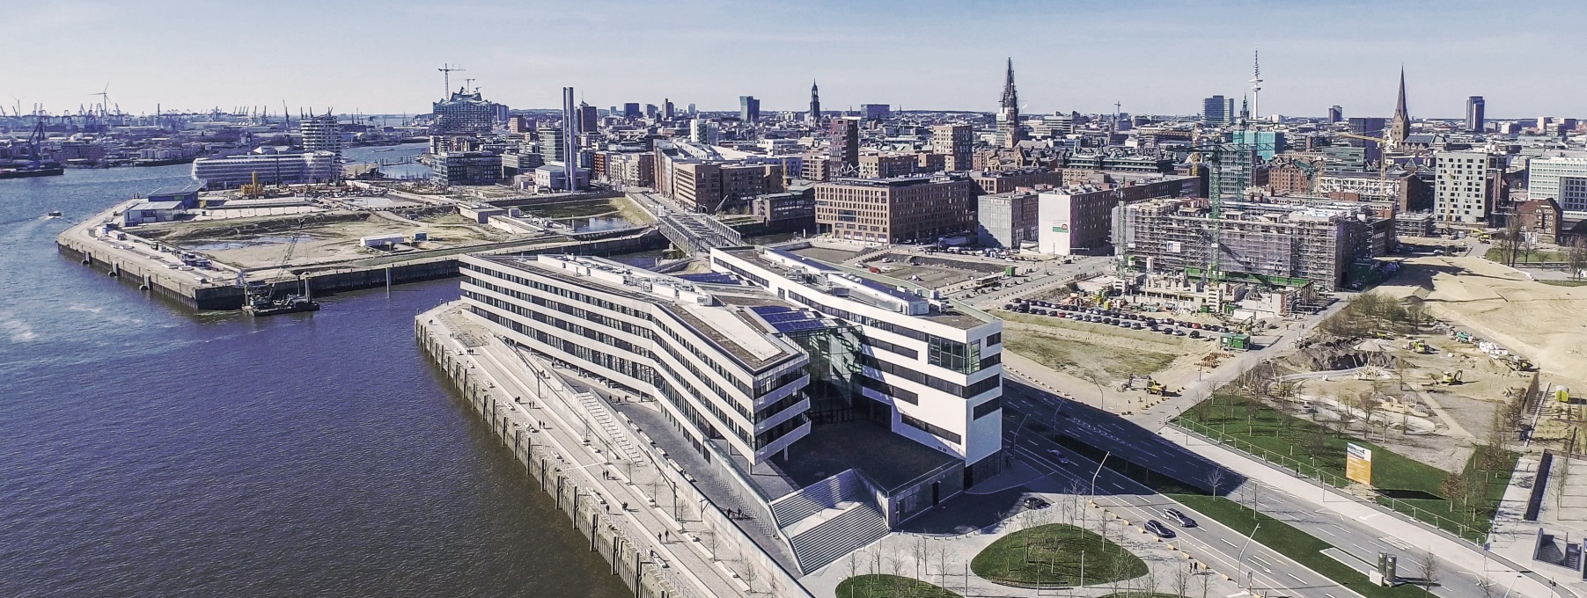
The HafenCity University gained recognition of the Programme entitled "Master of Science in Geomatics / Specialisation in Hydrography", against Edition 1.0.0 of the Standards S-5A on march 31, 2017.
Thank you for your attention

Slide 16
Prof. Dr.-Ing. Harald Sternberg
Professorship for Engineering Geodesy and Geodetic Metrology
Since 2009 Vice President for Studies and Teaching, HCU
Since 2001 Univ.-Prof. Geomatics Engineering Geodesy and Geodetic Metrology
1991 – 2001 Doctorate on the subject “To determine the trajectory of land vehicles with a hybrid measurement system“
Research & Teaching Associate, Institute for Geodesy, Universität der Bundeswehr München
1983-1991 Study of Surveying, Universität der Bundeswehr München
Administrative Chain of Command as Artillery Officer

Slide 17
Hydrography
First Semester (30 CP) | Second Semester (30 CP) | Third Semester (30 CP) | Forth Semester (30 CP)
Tutorial Land Surveying | Terrestrial Laser Scanning | Nautical Charting | Master Thesis
Engineering Mathematics | Integrated Navigation | Navigation in Hydrography
Software and Interface Technology | Higher Geodesy | Marine Geology/Geophysics
GI Science | Spatial Data Analysis | Oceanography
Basics of Hydrography | Advanced Hydrography | Hydrographic Practice
Hydrographic Data Acquisition and Processing | [Q] Studies | LiDAR and Remote Sensing
Marine Environment | Project Management | Interdisciplinary Project
GNSS
Notes:
The courses are organized in a modular way. It consists of compulsory and eligible modules and the final master thesis. The modules of each semester add up to 30 CP, resulting in an overall workload for the students of 120 CP for the whole 2-years programme. After finishing three regular semesters of lectures the students write their thesis in the fourth semester over period of five months.

