Slide 1
SandBox-FM: Augmented reality CFD
Willem Ottevanger, Robert-Jan den Haan, Fedor Baart, Pieter Visser, Jurjen de Jong, Bas van de Pas, Cindy van de Vries, Cilia Swinkels, Arjen Luijendijk

Slide 2
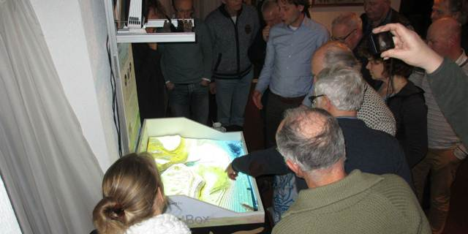
`
The SandBox is an innovative tool enhancing collaboration and education for hydraulic engineering

Slide 3
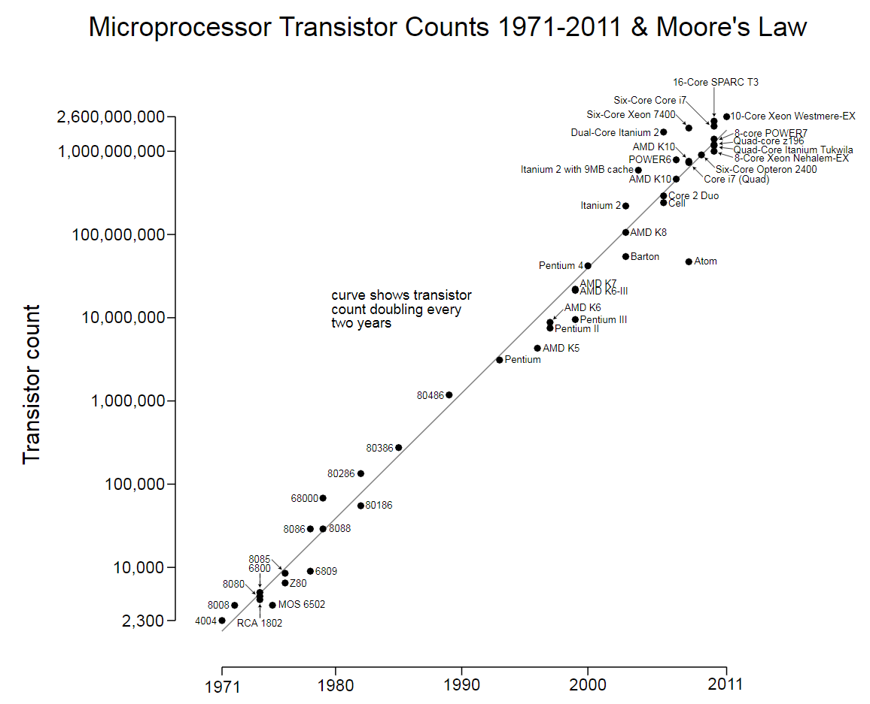
Background (Computational power)
Moores Law
Major increase in computational power since 1980’s
Has lead to increasingly complex models for hydraulic and morphological models
Notes:
(computational power)

Slide 4
Background (CFD models)
Require an expert modeler
(which may limit stakeholder input)
Less design iterations
(due to model complexity)
Difficult to interpret the model results correctly
(too much or too little confidence in results)
Models lack interactivity.
Steep learning curve
(only learning, and not using the model)
Notes:
(computational models)

Slide 5
Goal
Develop a participatory tool:
with a lower threshold to engage with models
that computes designed models faster
and present results in a way which is easier to understand
Ultimate goal:
More accepted designs or shorter design process
Reduction of learning curve
Notes:
Ultimately, the tool should contribute to establishing more accepted designs or a shorter design process and it should reduce the learning curve for students so that they can focus on the research they set out to do.

Slide 6
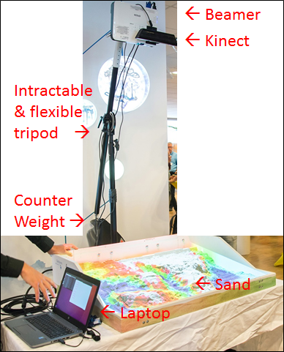
Result: The SandBox-FM
Mould the Sand
Record the geometry (Kinect)
Transfer to bed level in live running Delft3D-FM computation (Laptop)
Generate visualisation (Laptop)
Project onto sand (Beamer)

Slide 7
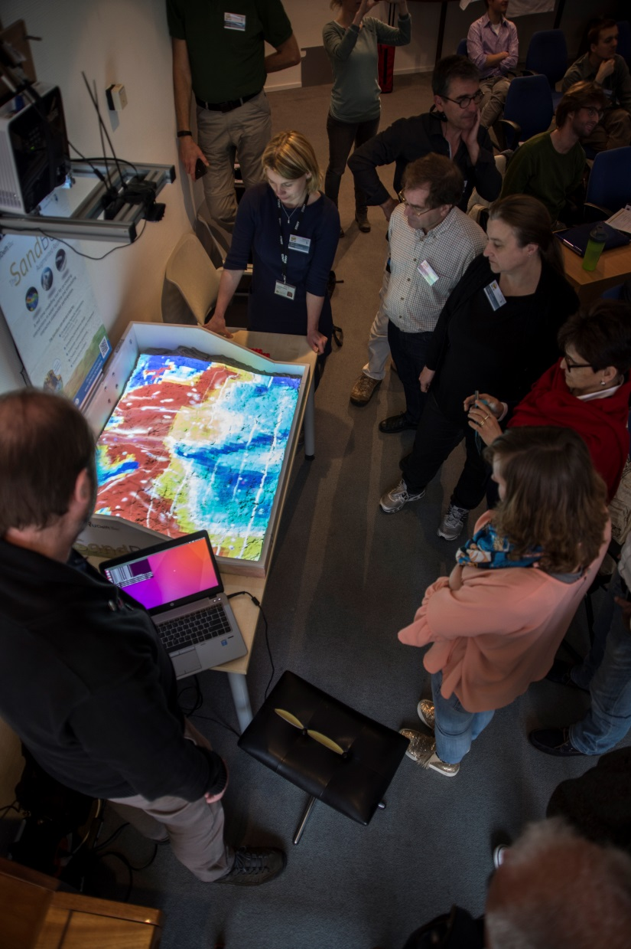
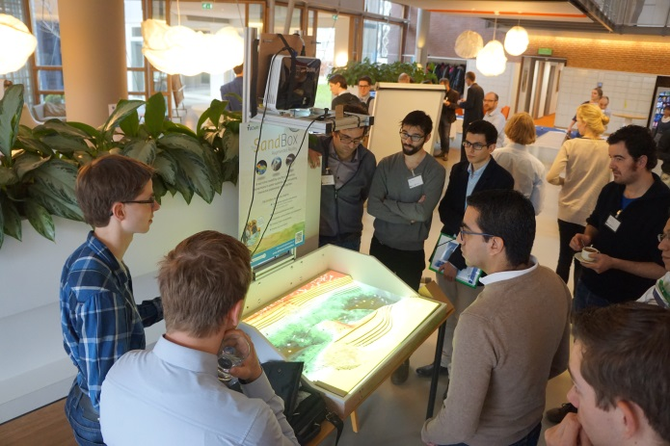
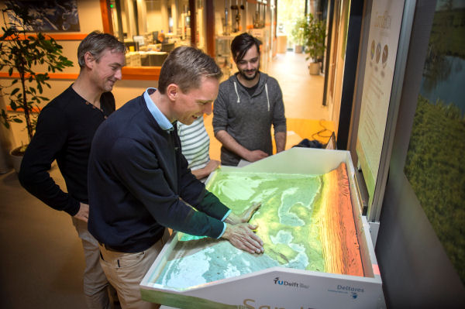
Result: The SandBoxes
Barrier Island (Portugal)
Ameland Tidal Inlet
The Sand Engine
The River Waal

Slide 8
Results
Innovative way of visualizing model results
Well received by the visitors (general public and researchers alike)
Low refresh rate of 6 Hz
But , due to visualization on real bathymetry no hampering of
user experience or
understanding of underlying processes
Notes:
Ultimately, the tool should contribute to establishing more accepted designs or a shorter design process and it should reduce the learning curve for students so that they can focus on the research they set out to do.

Slide 9
Future work
Investigate upscaling the size of the SandBox
Manual intervention step can be improved
Improve low refresh rate
Live multi-PC computation
Add a second screen for visualization of water levels
Notes:
Ultimately, the tool should contribute to establishing more accepted designs or a shorter design process and it should reduce the learning curve for students so that they can focus on the research they set out to do.

Slide 10
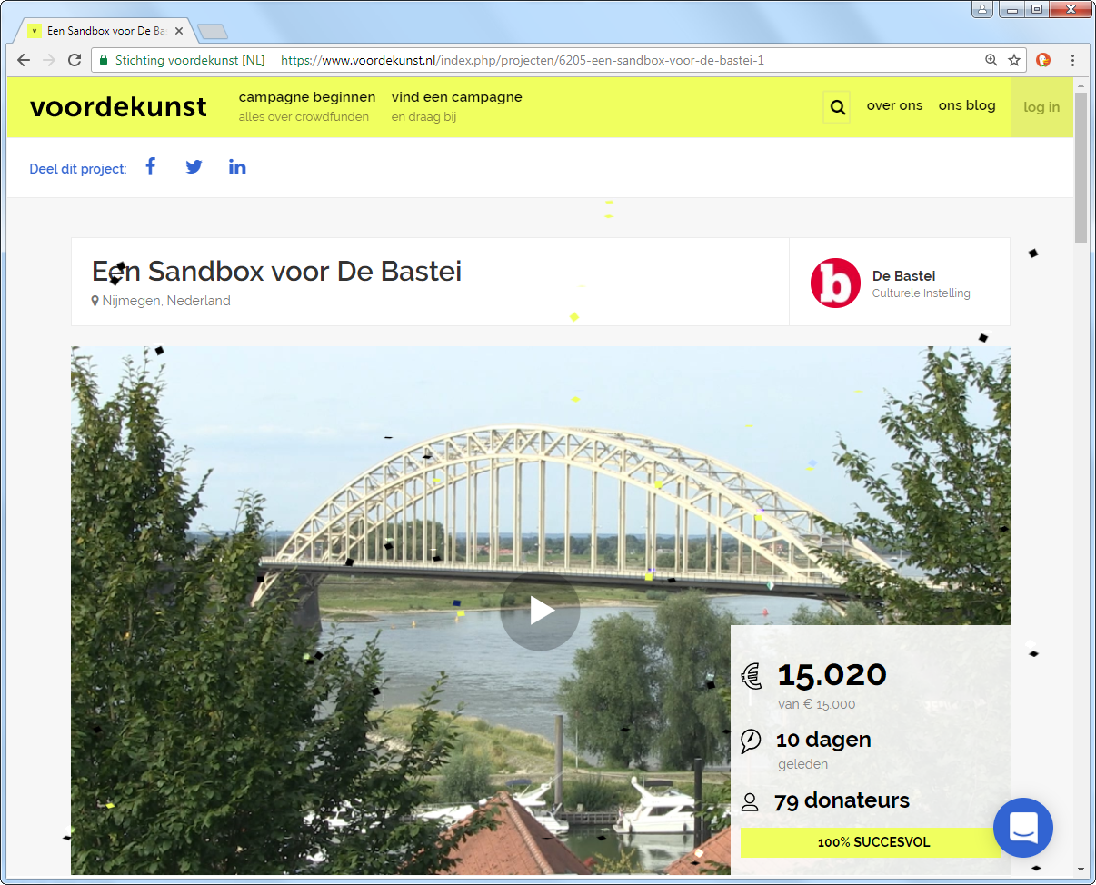

Slide 11
Een SandBox voor De Bastei (Nijmegen)

Slide 12
Een SandBox voor De Bastei (Nijmegen)

Slide 13
Conclusion
Educational tool + tool for stakeholder discussions
Hydrodynamic impacts of hydraulic structures and spatial interventions
Goals have been achieved in part, and there are many ideas to extend and improve the SandBox
Notes:
Ultimately, the tool should contribute to establishing more accepted designs or a shorter design process and it should reduce the learning curve for students so that they can focus on the research they set out to do.

