Slide 1
A Kalman filter approach to realize the lowest astronomical tide surface
D.C. Slobbe, J. Sumihar, T. Frederikse, M. Verlaan, R. Klees, F. Zijl, H.H. Farahani, R. Broekman
Notes:
Based on the paper that recently is published in Marine Geodesy.
1

Slide 2
Our objective…
Required with cm accuracy …
To obtain accurate realizations of the quasi-geoid and lowest astronomical tide surface, including the necessary transformations from/to all common land and marine vertical reference surfaces
…to obtain this one with accuracy of 1 dm!
Notes:
Our objective to obtain LAT with 1 dm accuracy = part of main objective of NEVREF project!
NEVREF = Vertical Reference Frame for the Netherlands Mainland, Wadden Islands and Continental Shelf (NEVREF)
For the discussion, quasi-geoid = geoid. Difference at sea is negligible.
2

Slide 3
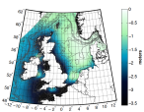
How to achieve (2013)?
No explicit usage of observation-derived LAT values → required to achieve our objective!
Geoid (N)
+
Continuous 3D description LAT (even in coastal waters)
Notes:
3
This was the approach as presented in our Marine Geodesy paper in 2013.
Continuous 3D description of LAT = LAT with respect to a reference ellipsoid. So, we are interested in the ellipsoidal heights of LAT.
Key feature of our approach is that we use the geoid as the intermediate reference surface rather than MSL. Reason for that is that contrary to MSL, the geoid is defined on land.
In the 2013 approach, observed water levels were used to calibrate the hydrodynamic model. To achieve NEVREF objective, usage of a calibrated hydrodynamic model is not sufficient! Even not in case we use the state-of-the-art models available for our region of interest; the latest model only represents the tidal water levels with sub-decimeter accuracy in the root-mean-square sense \citep{Zijl2013}. Indeed, we agree with \cite{Turner2010} that ``\textit{the desired solution is to produce an LAT surface from an optimally merged combination of all data sources}''. Our data sources comprise the model-derived LAT--geoid surface and observation-derived LAT--geoid values at onshore and offshore tide gauges.

Slide 4
How to achieve?
TG/GNSS
Geoid (N)
+
Interpolation?
Continuous 3D description LAT (even in coastal waters)
Notes:
4
What is usually done: merge observation-derived LAT values and model-derived LAT surface in a post-processing step using some spatial interpolation scheme…
In applying such an interpolation approach, you rely on the properties of the applied interpolator / on questionable assumptions like \textit{isotropy} as most commonly applied interpolation methods (both deterministic and stochastic methods) do. That is, they assume there is no directional dependence in computing the weights assigned to the observation- and model-derived LAT values. As, the tide (and hence the LAT) in shallow waters is significantly altered by nonlinear factors including changes in the bathymetry, frictional interactions, and reflections from the coastline or river banks \citep{Schluter1993}, this makes no sense at all!

Slide 5
How to achieve?
TG/GNSS
Data assimilation!
Geoid (N)
+
Continuous 3D description LAT (even in coastal waters)
Notes:
5
Our approach: Assimilate observation-derived tidal water levels into the hydrodynamic model when simulating the tidal water levels from which LAT is derived. In doing so, \textit{the combination is guided by the physics} built into the hydrodynamic model. Another advantage of data assimilation over conventional numerical modeling is that in this way we can account for some known and unknown model deficiencies.

Slide 6
Notes:
This is something, I would like to highlight. You need to make sure that the approach applied to derive the tidal water levels that will be assimilated into the model is consistent to the way tidal water levels are modeled. For example, if you derive modeled LAT from modeled water levels over 20 year period, without allowing for time variations in bathymetry etc. You need to derive observation-derived LAT in same way. This also applies to the way you deal with nodal cycle, average meteorological contribution etc. So, you need to be consistent!
6

Slide 7
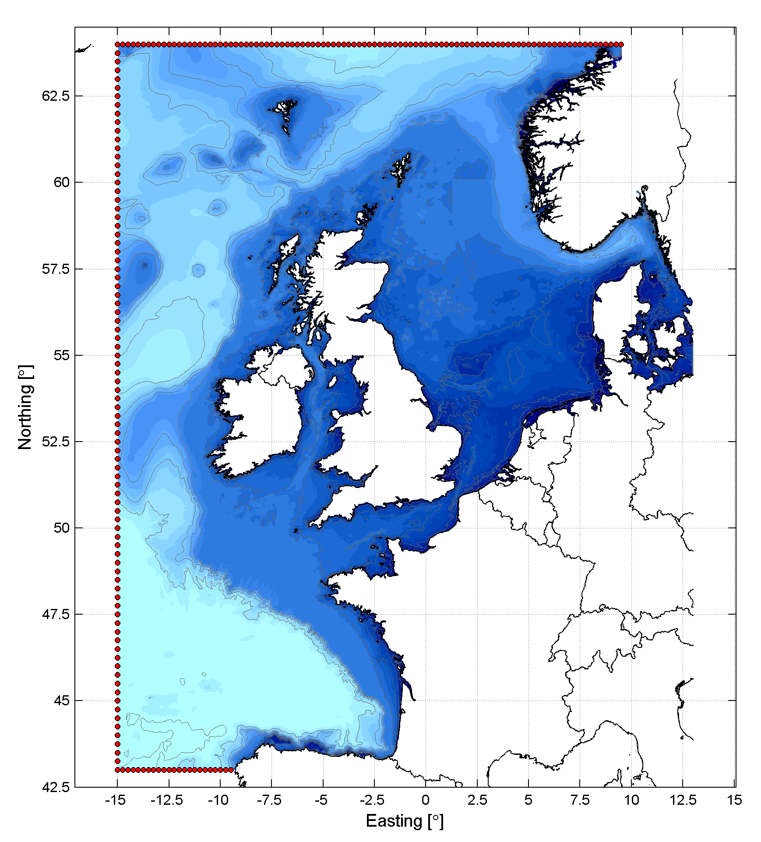
LAT computations: model setup
Simulation period: Jan 1993 - Jan 2012;
Multi-year average monthly mean wind/ atmospheric + barocl. forcing included;
Wind/atmospheric pressure fields: ERA-Interim;
4D Salinity/temperature fields: “Atlantic- European North West Shelf- Ocean Physics Reanalysis (1985-2014);
Open boundary conditions:
Tide, defined in frequency domain
8 main + 5 long-term constituents taken from global ocean tide models;
13 smaller (semi-)diurnal const.;
Surge: MOG2D Dynamic Atmospheric Correction.
Baroclinic contr. : computed from daily mean modeled water levels provided along with S/T fields:
Notes:
This approach is discussed extensively in Sections 2 and 3 of the paper!

Slide 8
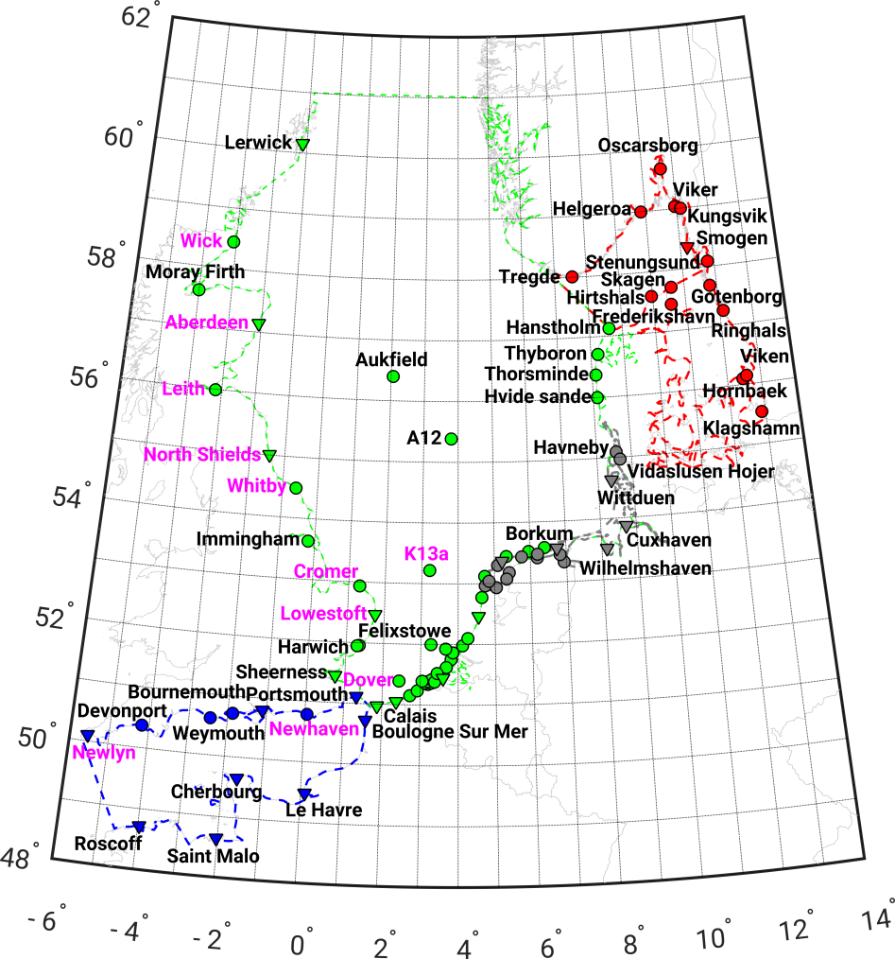
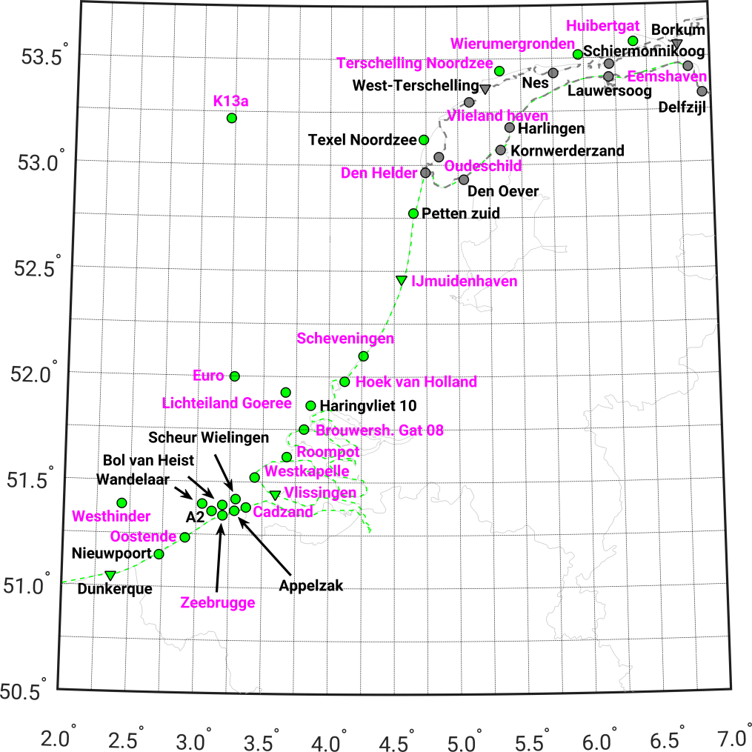
Data assimilation
Kalman filtered LAT solution obtained by assimilating tidal water levels @ 31 tide gauges;
Validation conducted using all TGs (Set A) & TGs not used in DA (Set B)
Notes:
Feel free to add some details about used Kalman filter. To me this is not so relevant for the audience at Hydro17.
What is important is that the set of tide gauges that belong to the observational network is the same set as used in operational storm surge forecasting.
Triangle=GNSS ref
Magenta text=assimilated
Color of symbol is region

Slide 9
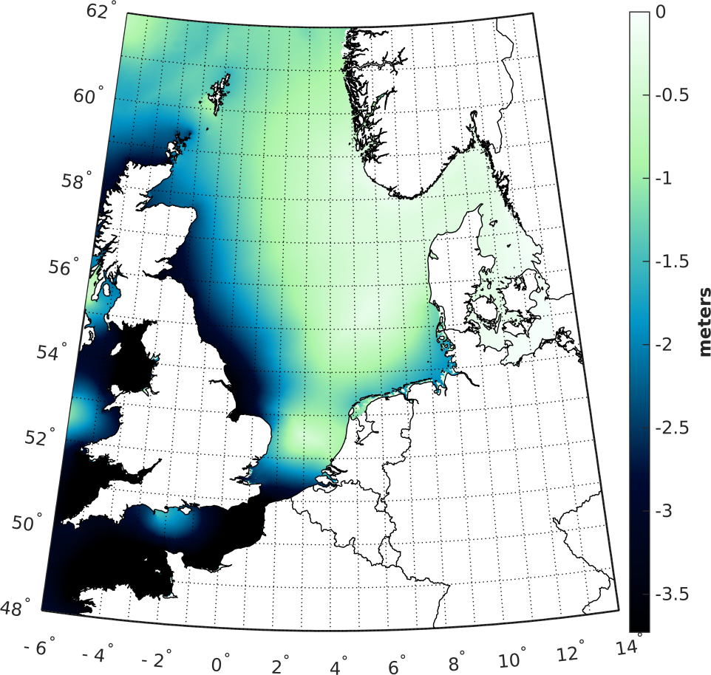
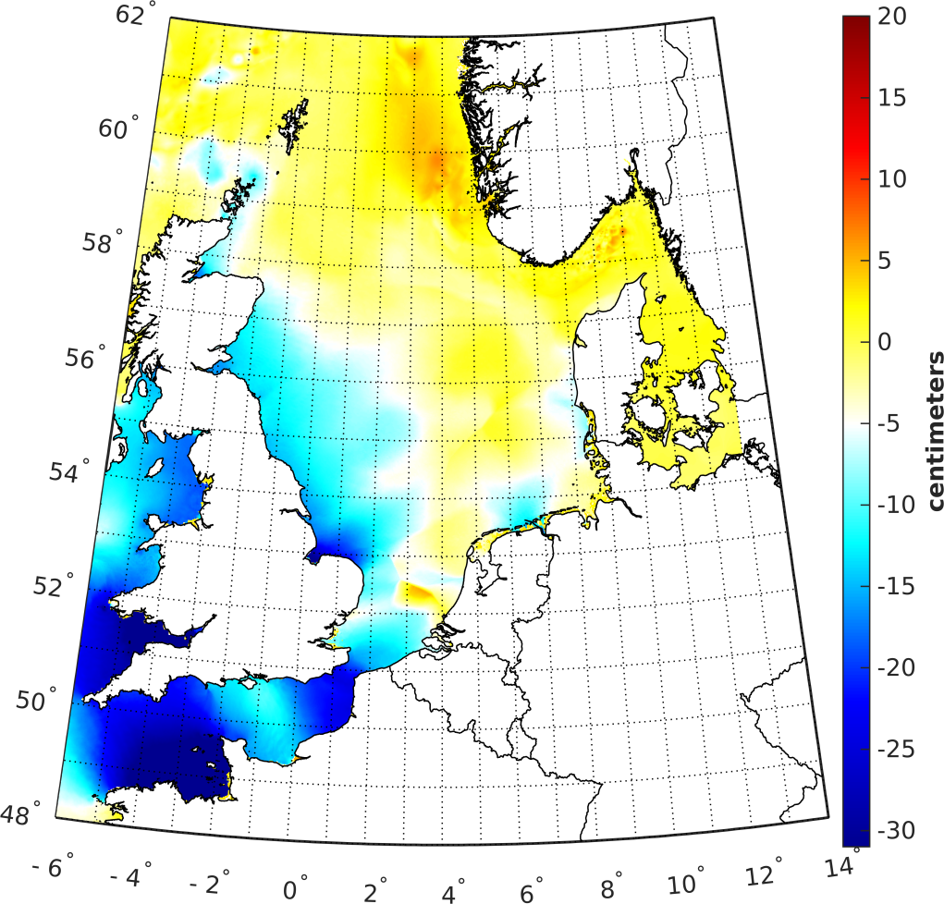
LAT w.r.t. geoid
Kalman filtered LAT
Kalman filtered – model-only LAT
Notes:
Important message here is that differences between both solutions can be up to decimetres. Moreover, they are spread over the entire domain!

Slide 10
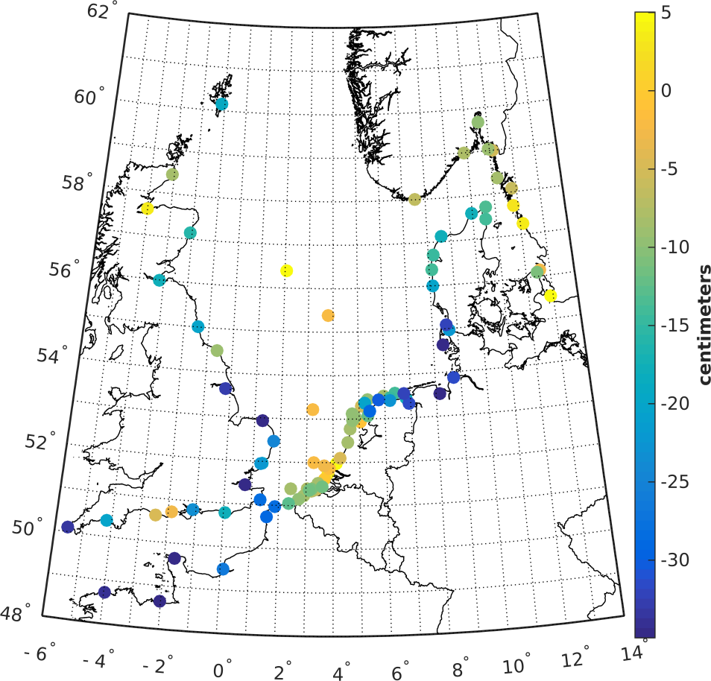
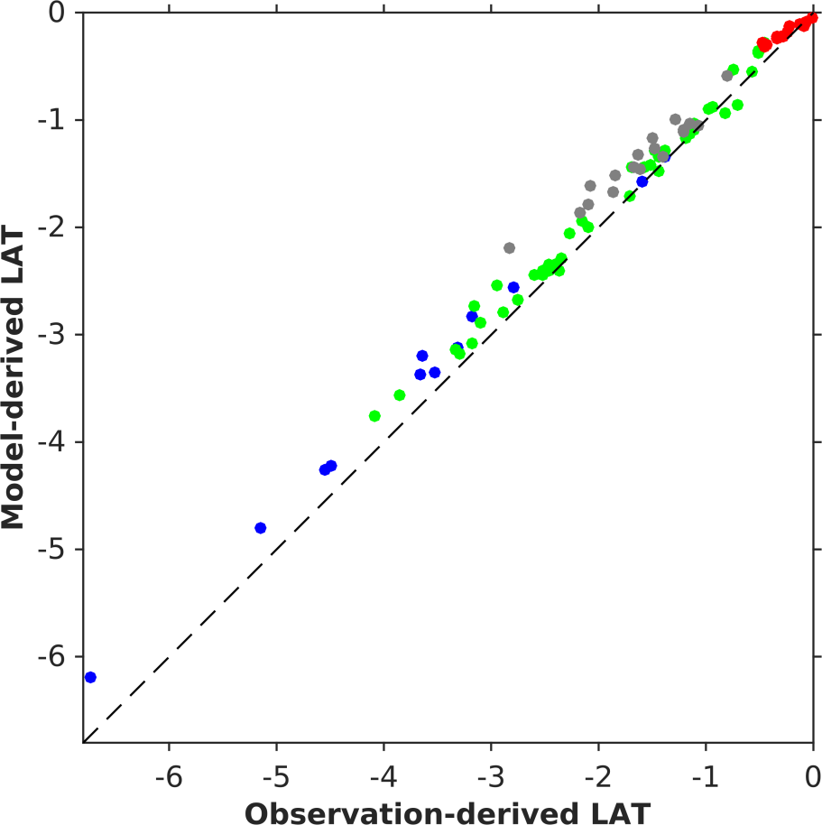
Model-only LAT - validation
Obs – Mod LAT
Set | Region | Nr | Rms (cm) | Range (cm) | Mean (cm) | Std (cm)
A | NS | 47 | 15.7 | 58.3 | -11.2 | 11.2
 | WS | 18 | 28.4 | 62.8 | -24.1 | 15.4
 | All | 92 | 20.4 | 79.3 | -15.0 | 13.9
Notes:
Validation using all tide gauges (including the ones used in the data assimilation).
All tide gauges include ones in English Channel and Skaggerak.
A few outliers have a significant impact on the statistics.
FYI, I discovered a bug in the preprocessing of 8 Danish tide gauges. This results in slightly different LAT values (max a few cm). Also I found a couple of large outliers in the German tide gauge records. So, if someone wonders why these values are different compared to those presented in the paper…
groen = Noordzee
blauw = English Channel
grijs = Waddenzee
rood = Skaggerak/Kattegat

Slide 11
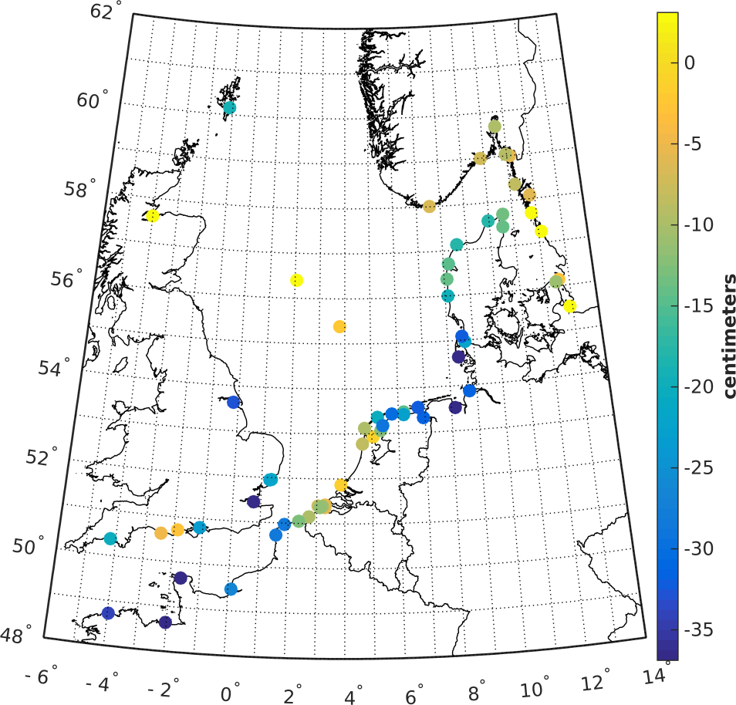
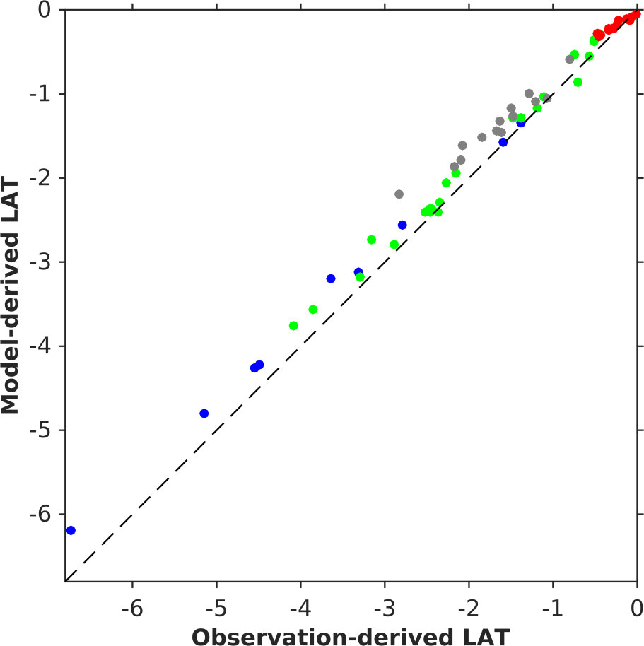
Model-only LAT - validation
Obs – Mod LAT
Set | Region | Nr | Rms (cm) | Range (cm) | Mean (cm) | Std (cm)
B | NS | 23 | 17.6 | 58.3 | -13.0 | 12.2
 | WS | 14 | 31.6 | 62.8 | -28.0 | 15.2
 | All | 61 | 22.5 | 79.3 | -16.9 | 15.1
Notes:
Validation based on tide gauges NOT used in data assimilation. If you feel, you don’t have enough time, I propose not to show this slide!
groen = Noordzee
blauw = English Channel
grijs = Waddenzee
rood = Skaggerak/Kattegat

Slide 12
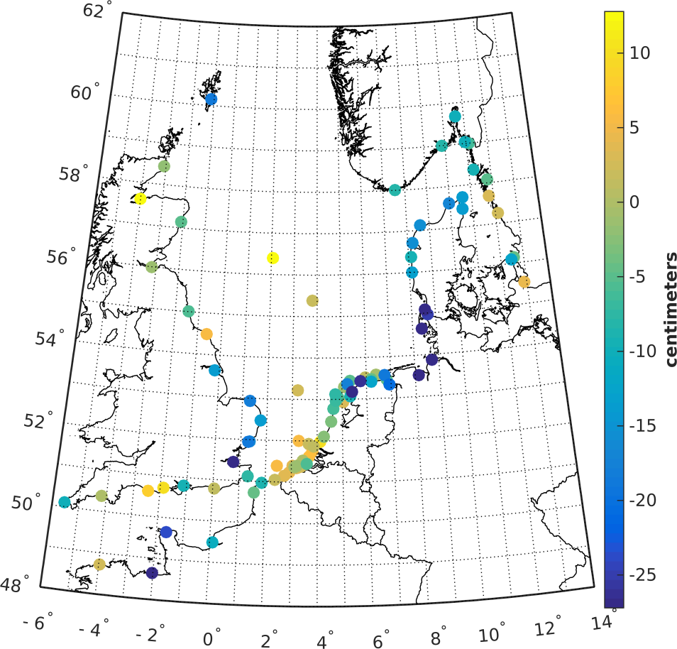
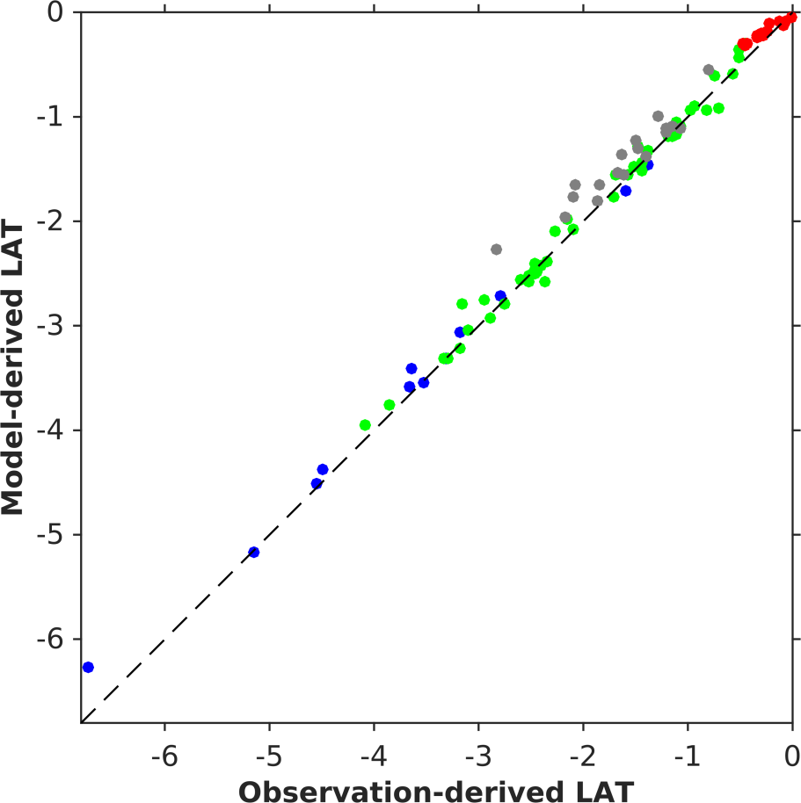
Kalman filtered LAT - validation
Obs – Mod LAT
Set | Region | Nr | Rms (cm) | Range (cm) | Mean (cm) | Std (cm)
A | NS | 47 | 10.6 | 57.6 | -2.7 | 10.4
 | WS | 18 | 24.0 | 59.5 | -18.7 | 15.4
 | All | 92 | 14.9 | 77.6 | -7.2 | 13.1
Notes:
Green color indicates improvement compared to Model-only solution.
Note that differences at tide gauges in German Bight, along Danish coast, and in Skaggerak-Kattegat increase. This is due to the fact that we do not assimilate tide gauges there. So, there model-derived LAT solution is not constrained!
groen = Noordzee
blauw = English Channel
grijs = Waddenzee
rood = Skaggerak/Kattegat

Slide 13
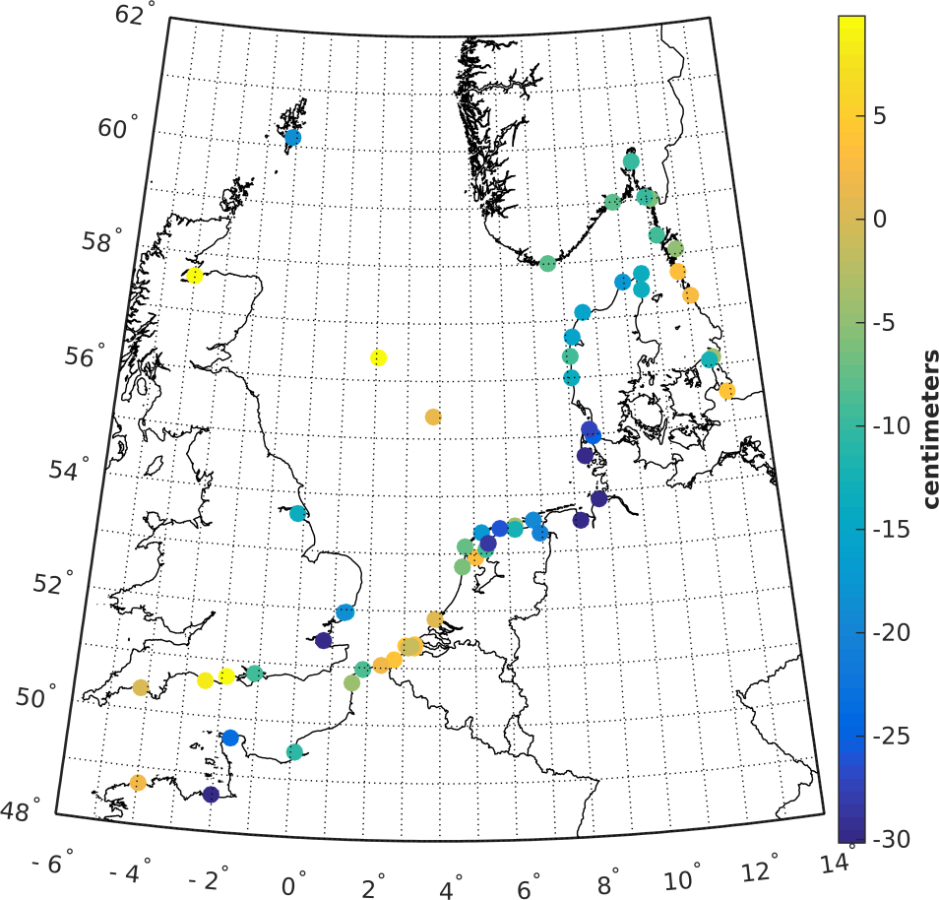
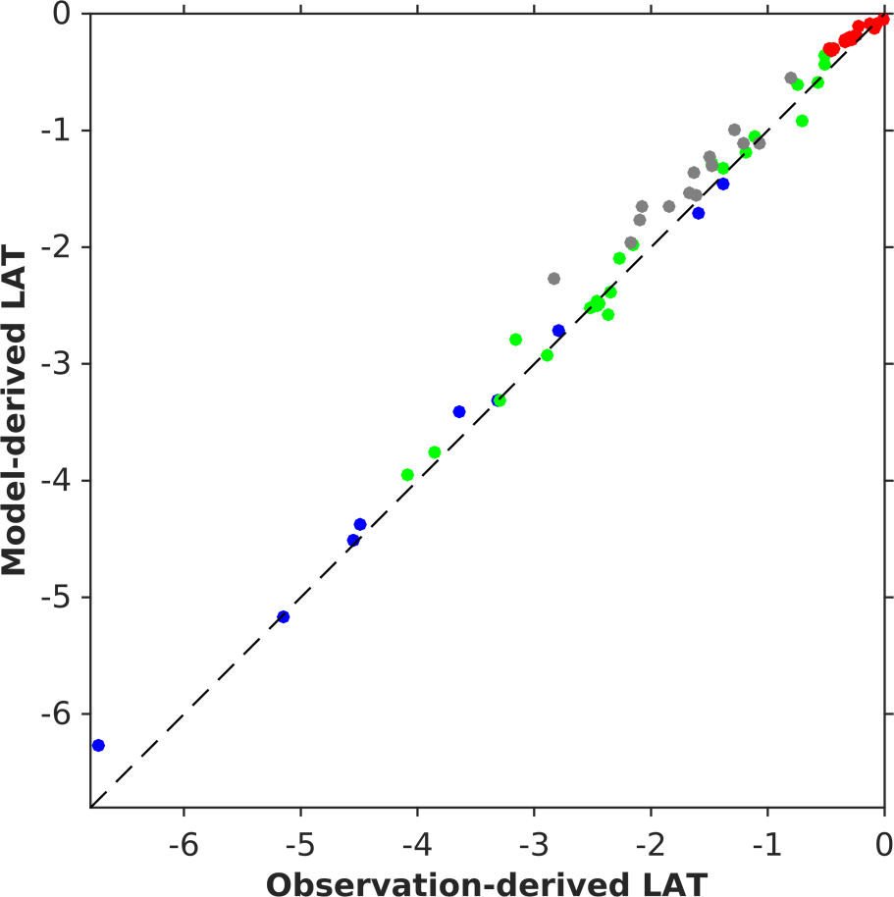
Kalman filtered LAT - validation
Obs – Mod LAT
Set | Region | Nr | Rms (cm) | Range (cm) | Mean (cm) | Std (cm)
B | NS | 23 | 13.7 | 57.6 | -5.2 | 13.0
 | WS | 14 | 27.1 | 59.5 | -22.8 | 15.3
 | All | 61 | 17.7 | 77.6 | -10.2 | 14.6
Notes:
Explanation why std of differences increases is given on previous slide! If you feel, you don’t have enough time, I propose not to show this slide!
groen = Noordzee
blauw = English Channel
grijs = Waddenzee
rood = Skaggerak/Kattegat

Slide 14
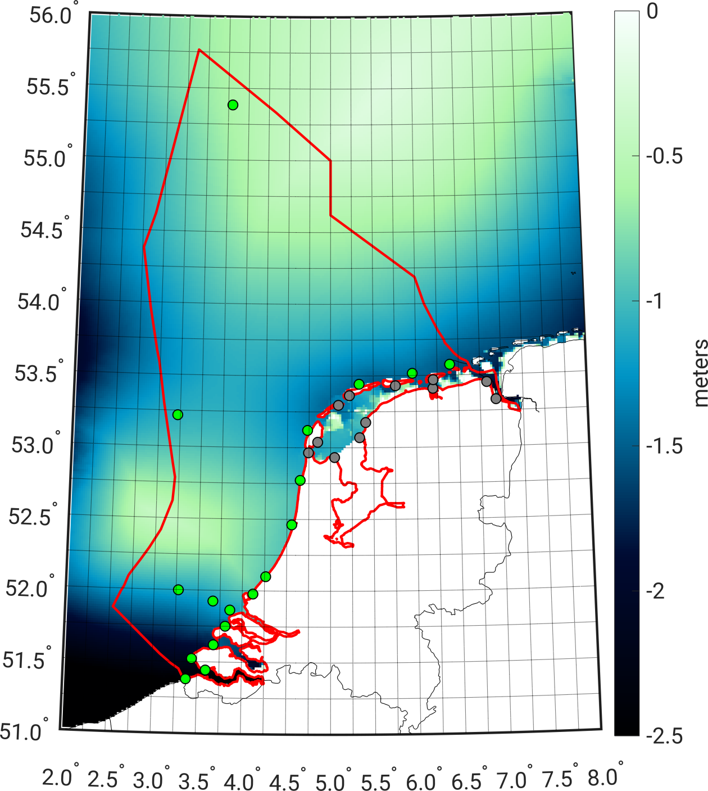
Validation – Dutch waters
Set | Region | Nr | Mod-only LAT rms (cm) | KF LAT – rms (cm)
A | NS | 19 | 8.0 | 6.6
 | WS | 12 | 19.6 | 14.8
 | All | 31 | 13.7 | 10.5
Notes:
Validation conducted over Dutch waters only. Note that here all tide gauges are used (many Dutch tide gauges are used in the assimilation).

Slide 15
Did we achieve our objective of 1 dm?
Set | Region | Nr | Mod-only LAT rms (cm) | KF LAT – rms (cm)
A | NS | 19 | 8.0 | 6.6
 | WS | 12 | 19.6 | 14.8
 | All | 31 | 13.7 | 10.5
However, …
Notes:
Here, you can first elaborate on difficulties we have to model water levels in Wadden Sea.
But than comes the “however”

Slide 16
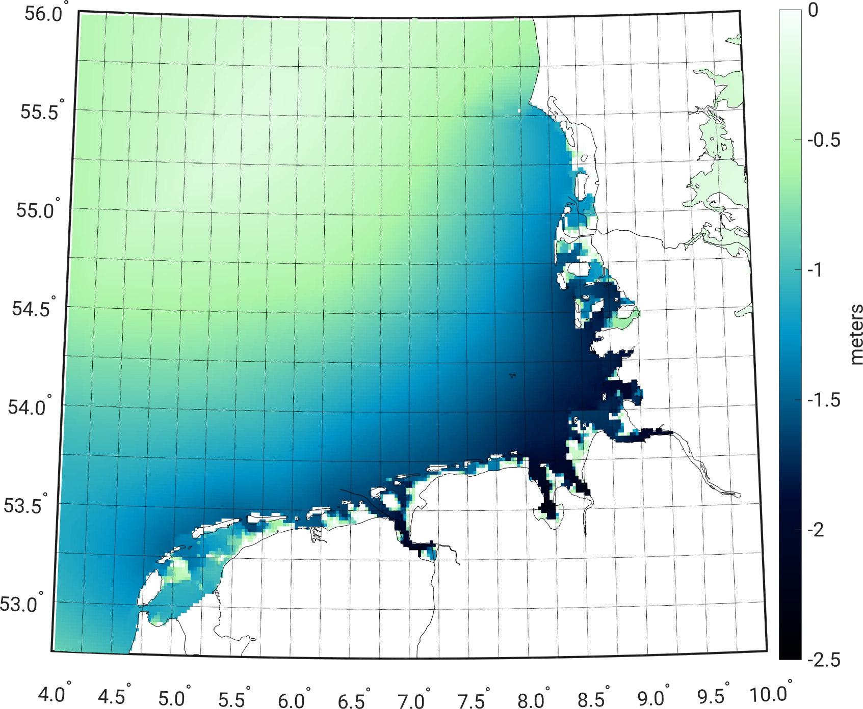
LAT in the Wadden Sea?
In tidal flats, LAT = no-water level!
→ LAT ≠ smooth
Notes:
…in large parts of the Wadden Sea, LAT is not defined. To solve this problem, we propose to replace LAT by pseudo-LAT.

Slide 17
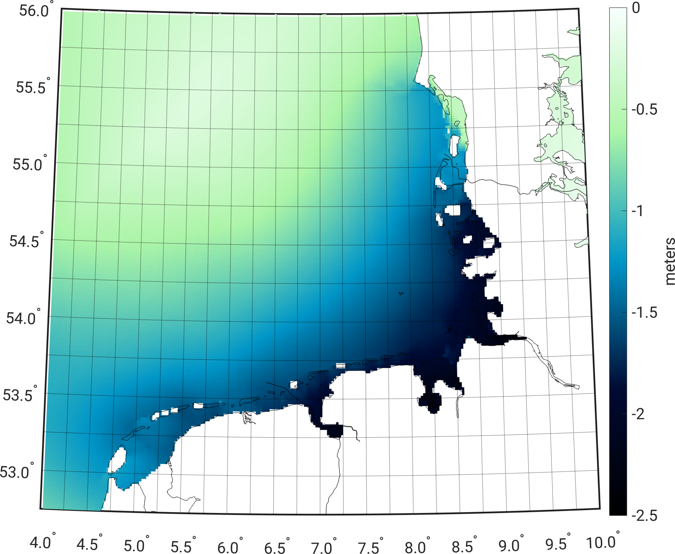
In the Wadden Sea LAT → pseudo LAT
To obtain pseudo-LAT we added 2 m of water to open boundary conditions & assimilated tidal water levels
Notes:
Heb het even nagerekend. De grap is dat in het Nederlandse deel van de Waddenzee de RMS zelfs lager wordt, was 14.8 cm (zie slide 14). wordt 13.5 cm (gaat om 12 stations).
Als je kijkt naar hele Waddenzee (18 stations), krijg ik de volgende statistieken (kun je vergelijken met waarden op slide 12):

Slide 18
Conclusions
Kalman-filter approach allows to realize LAT in Dutch North Sea with decimeter accuracy (rms);
Consistency is the key!
In the Wadden Sea, LAT is not defined!
Pseudo-LAT provides smooth transition at the North Sea/Wadden Sea boundary but has no physical meaning…
Notes:
18

Slide 19
Questions?
Notes:
19

