Slide 1
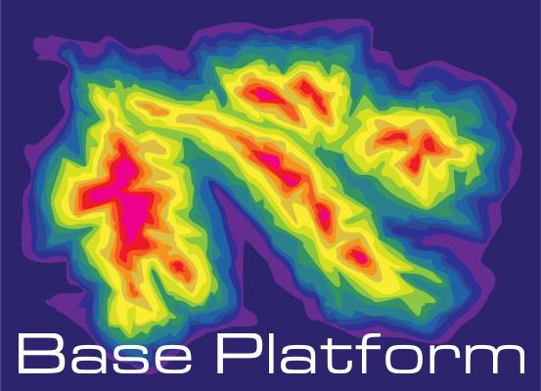
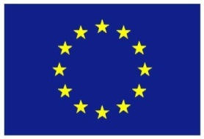
The BASE-platform project: Deriving the bathymetry from combined satellite data
Stefan Wiehle, Bernat Martinez, Knut Hartmann, Martin Verlaan, Tim Thornton, SuiWin Hui, Dick Schaap

Slide 2
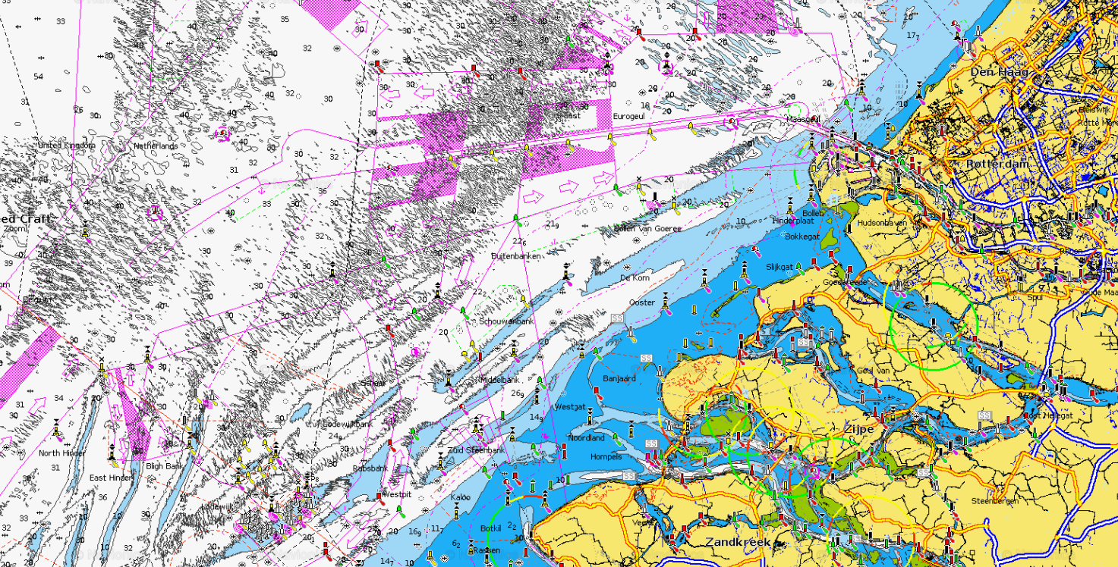
Bathymetry
Measurement of waterdepth
Underwater topography
Charts with isobaths for navigation
Rostock
Screenshot: webapp.navionics.com
Notes:
Charts can have shoal bias – only shallowest depth mentioned; also thinned data when not required for safe navigation

Slide 3
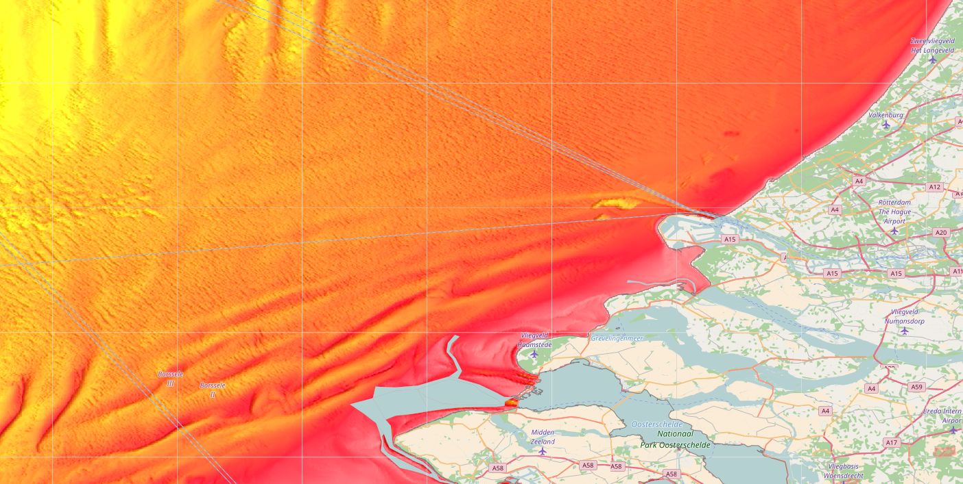
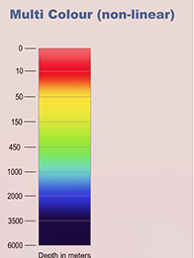
Bathymetry
Measurement of waterdepth
Underwater topography
Charts with isobaths for navigation
Bathymetric maps for scientific applications
Screenshot: EMODnet-bathymetry.eu

Slide 4
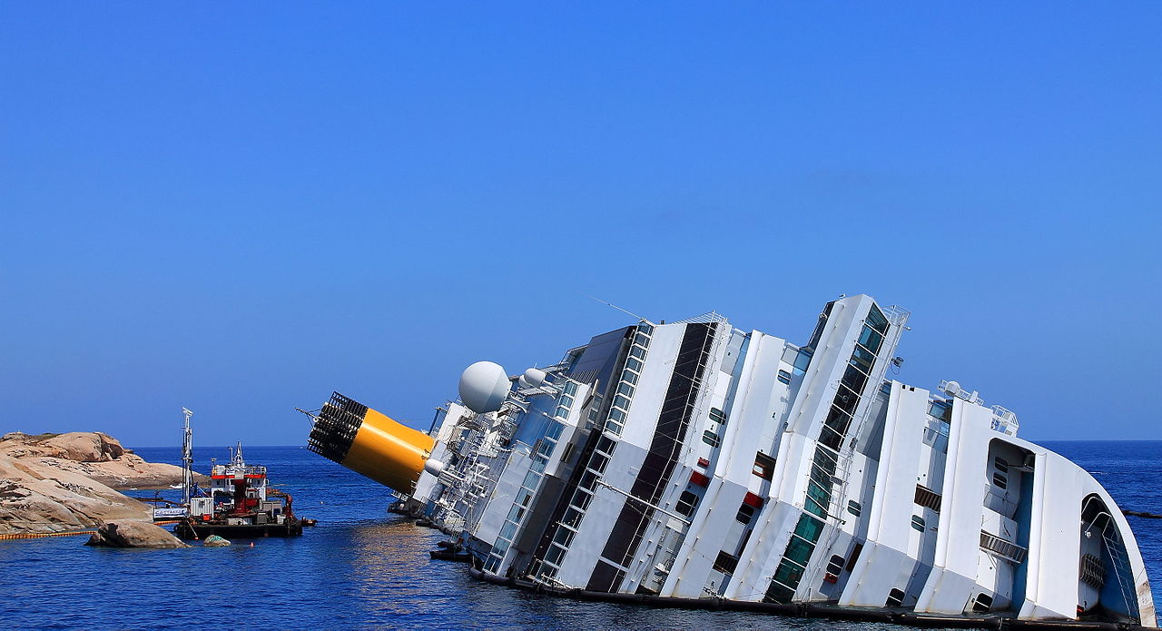
Importance of bathymetry
Safety of navigation
Costa Concordia, 13 July 2012 (Source: Camerist, CC BY SA)

Slide 5
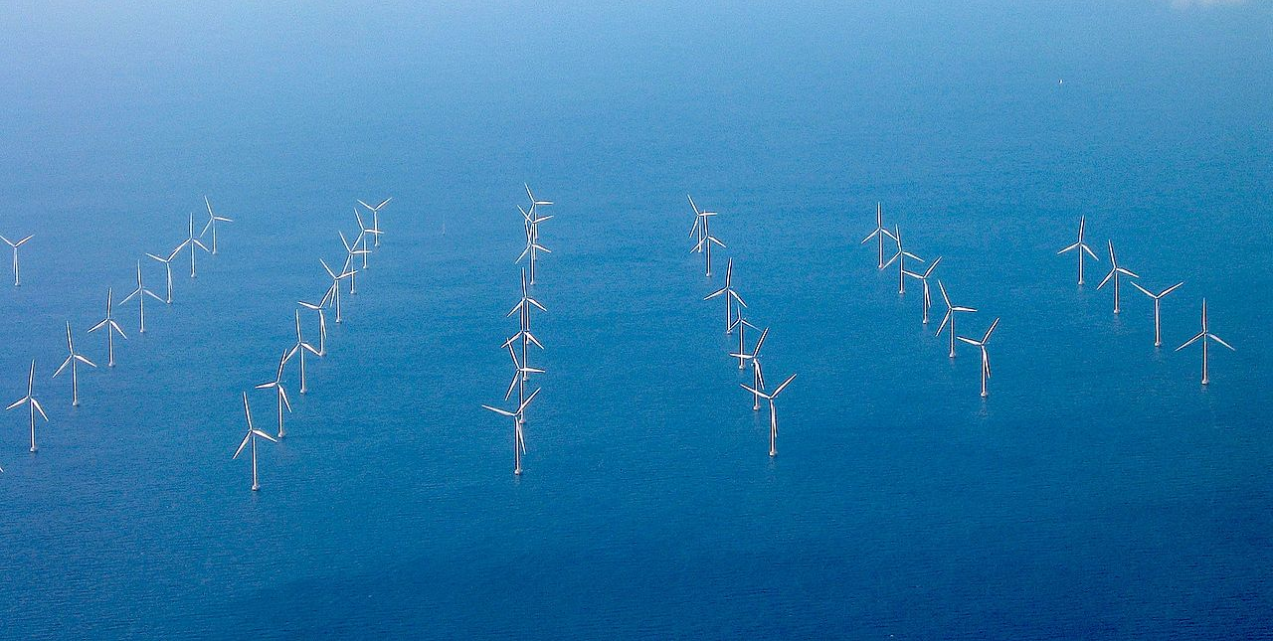
Importance of bathymetry
Safety of navigation
Offshore industries
Lillgrund Wind Farm (Source: Mariusz Paździora, CC BY SA)

Slide 6
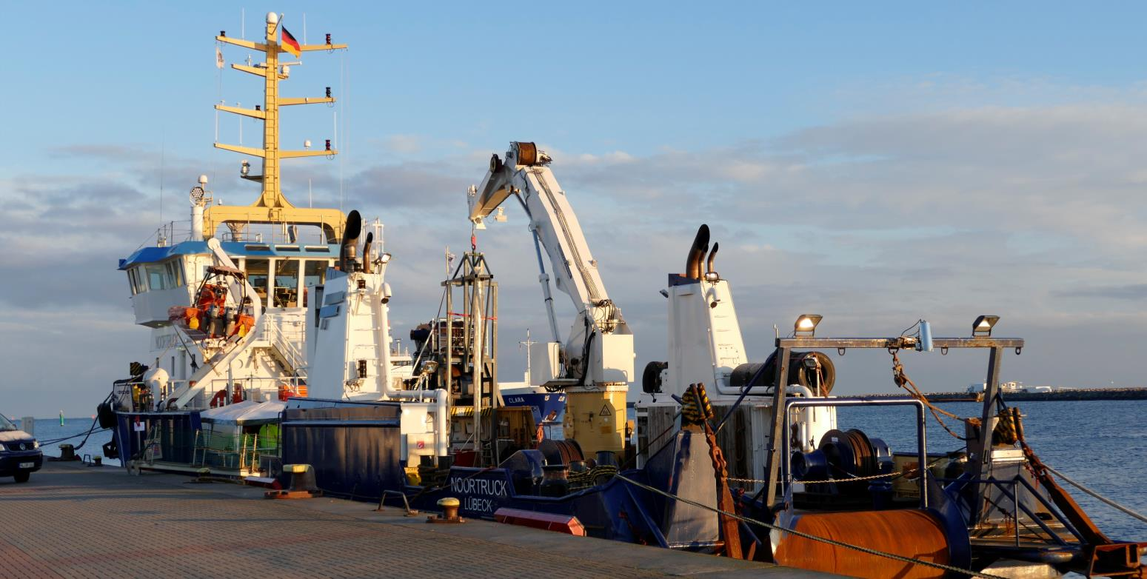
Bathymetry measurement
Most water depths: Survey vessels with echo sounders
Optically shallow waters: LIDAR on planes
Good resolution and accuracy
High costs
Multi-purpose vessel Noortruck in Rostock-Warnemünde during Hydro16
Notes:
Multibeam echosounders

Slide 7
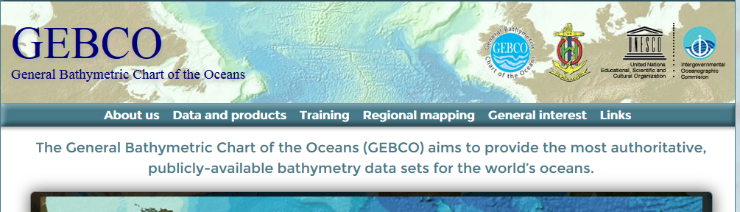
Existing bathymetric data
GEBCO (GEneral Bathymetric Chart of the Oceans)
Free to use
Survey data and interpolation
Available worldwide
~900m resolution
EMODnet
Free to use
Survey data; GEBCO for gaps
Limited to European waters
~230m resolution
Screenshot: www.gebco.net/
Screenshot: www.emodnet-bathymetry.eu/
Notes:
GEBCO: According to a Hydro-Speaker, sometimes it‘s not interpolation, just guessing, as distances between data are too large; some data may be 200 years old
Others: NOAA/NCEI global relief (1‘), US surveys, GEOSS portal (library, but no direct data access),

Slide 8
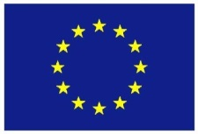
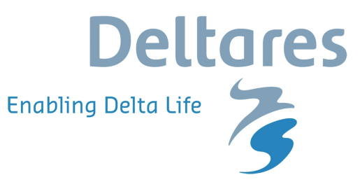
BASE-platform project
Create satellite-derived bathymetry (SDB)
Offer these data on web portal
Bathymetry data combining
Optical SDB
SAR SDB
Altimetry SDB
Crowd-sourced bathymetry (CSB)
Water level modelling
Horizon2020 project (12/2015-11/2017)

Slide 9
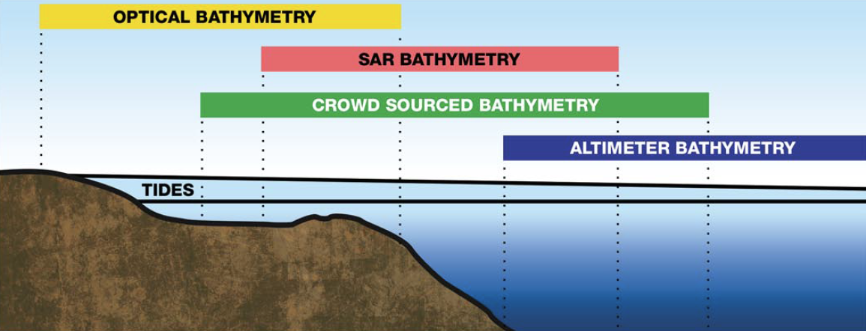
Satellite-derived bathymetry (SDB)
Different techniques
Shallow waters: Optical SDB
Medium depths: SAR SDB
Deep waters: Altimetry SDB
Benefits
Satellite data free or cheap
Fast turnover time
High data quality using validated methods
Notes:
“It has been estimated that a systematic survey of the oceans by ships would take more than 200 years of survey time at a cost of billions of U.S. dollars.” (http://www.gebco.net/general_interest/faq/)

Slide 10
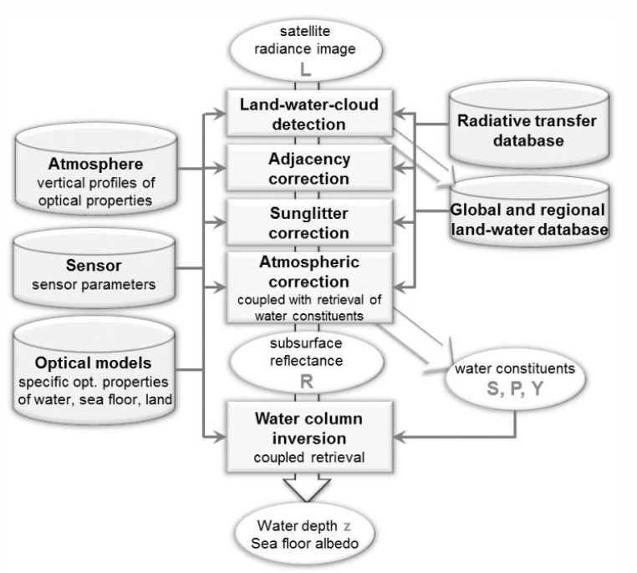
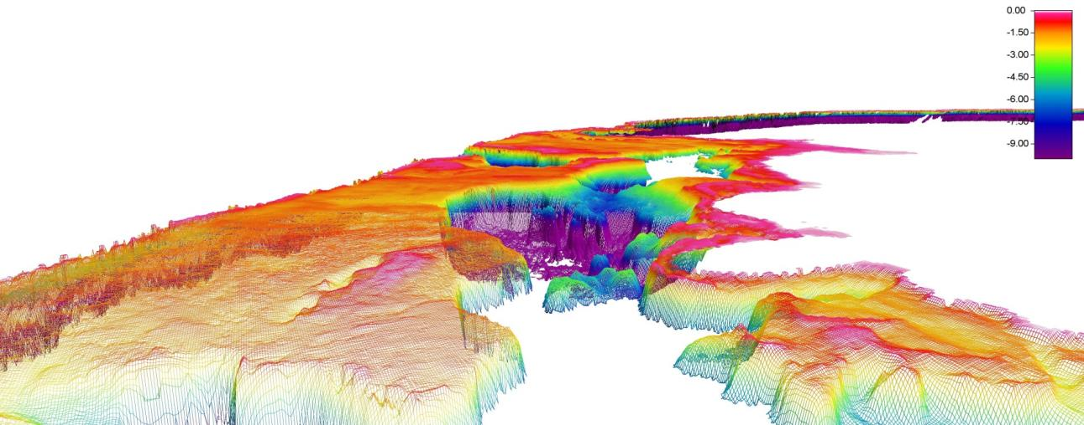
Optical SDB
Using optical satellite image data of multiple missions (e.g. Sentinel-2)
Physics-based inversion methods to determine water depth from seafloor reflectance intensities in different wavelengths
Depths: 0 to 30m; spatial resolution: 2m to 15m
EOMAP’s Optical SDB processing chain
Example of EOMAP’s Optical SDB product

Slide 11
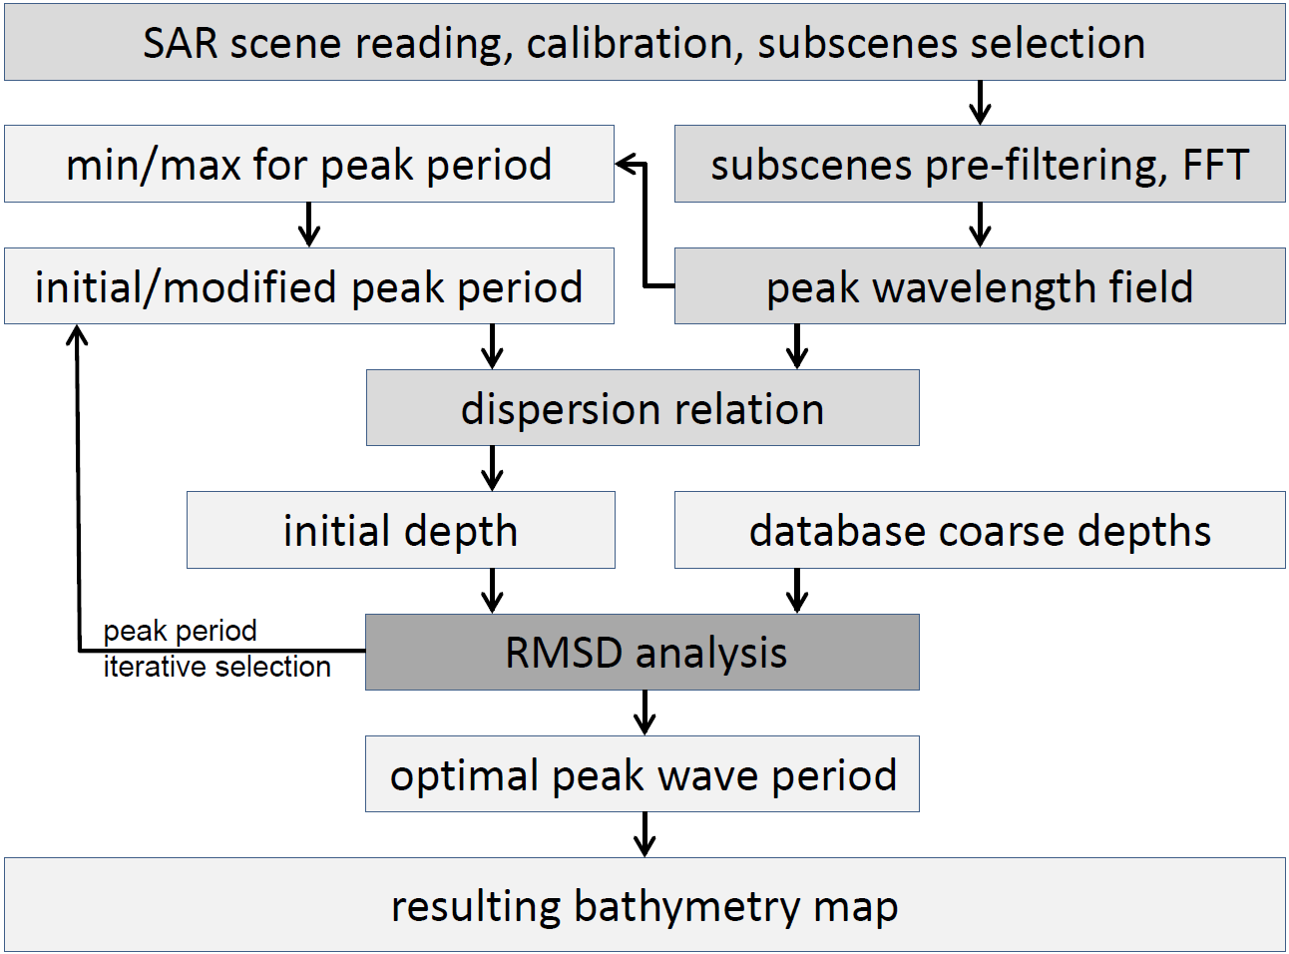
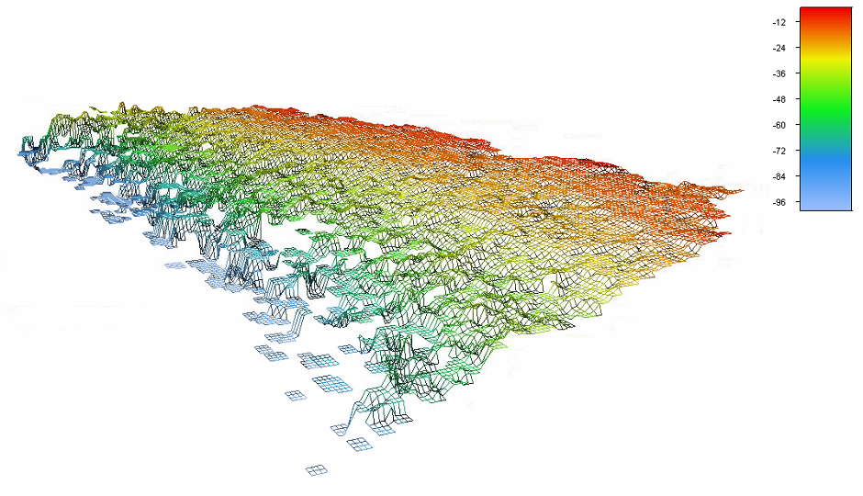
SAR SDB
Using SAR data of multiple missions (e.g. Sentinel-1, TerraSAR-X)
Using wave shoaling effect (wave length reduces in shallow water)
Depths: 10 to 100m; spatial resolution: up to ~100m
DLR’s SAR SDB processing chain
Example of DLR’s SAR SDB product

Slide 12
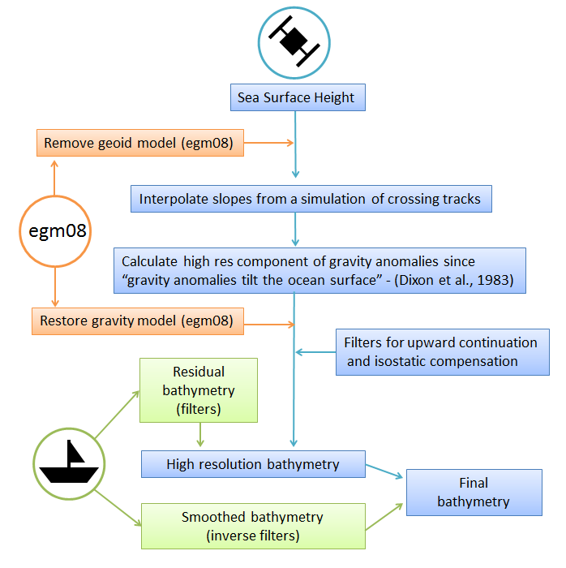
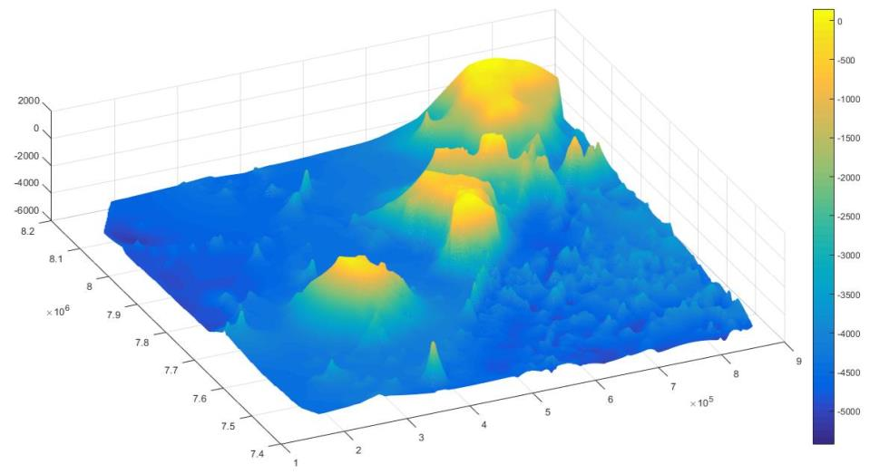
Altimeter SDB
Using Altimeter satellite data (e.g. Jason-1,Sentinel-3A)
Based on changes in gravity affecting sea surface level caused by large underwater structures (~10km to 200km)
Depths: all non-shallow, spatial resolution: 1 km
isardSAT’s Altimeter SDB processing chain
Example for isardSAT’s Altimeter SDB product

Slide 13
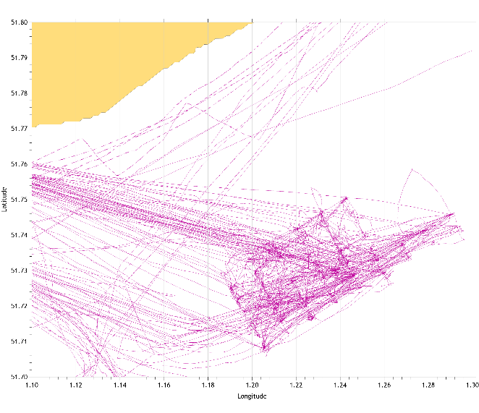
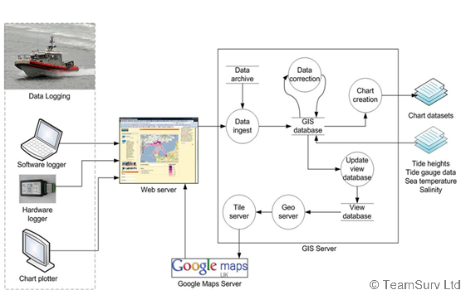
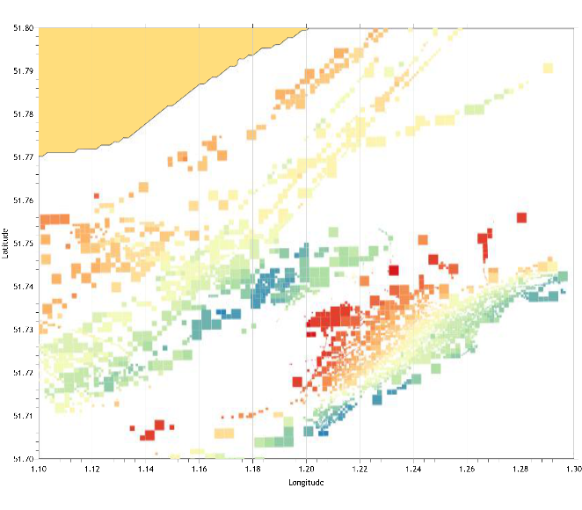
Crowd-sourced bathymetry (CSB)
Using GPS and depth sounding data collected by ships going about their normal activities
Depths: up to 2km, spatial resolution: 32m
Example for teamSurv’s ship tracks and the resulting bathymetry
teamSurv’s CSB processing chain

Slide 14
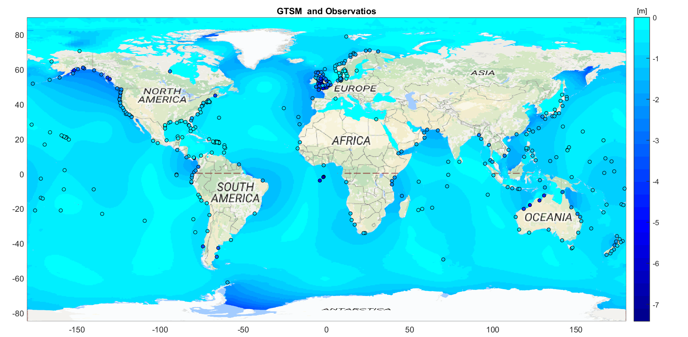
Waterlevel correction
All methods gather depth at time of measurement
Waterlevel simulations allow worldwide correction
Output data in LAT or MSL
Presentation
by Martin Verlaan
on Thu, 14:05h
Lowest Astronomical Tide relative to Mean Sea Level
Notes:
Dots are tide gages used for validation.

Slide 15
Data merging
Combination of the products obtained from each method
Spatial resolution: approx. 15m gridded data
Presentation
by Sandra Gaytán Aguilar
today, 14:25h
Merged data example and GEBCO data for NW Mauritius
Notes:
Dots are tide gages used for validation.

Slide 16
Data accuracy
SDB data compared to CSB and available multibeam surveys
Challenges
Bathymetry changes over time; data may be deprecated
Available multibeam data not free of errors (measurement and localization)
Corrections applied to survey data for obvious errors
Method | Optical | SAR | Altimeter | Merge
Depth range (m) | 0-30 | 10-100 | >1000 | All
Mean error (m) | -1,53 | -7,13 | -58,83 | -3,7
URMSE (m) | 1,18 | 11,67 | 88,98 | 4,27

Slide 17
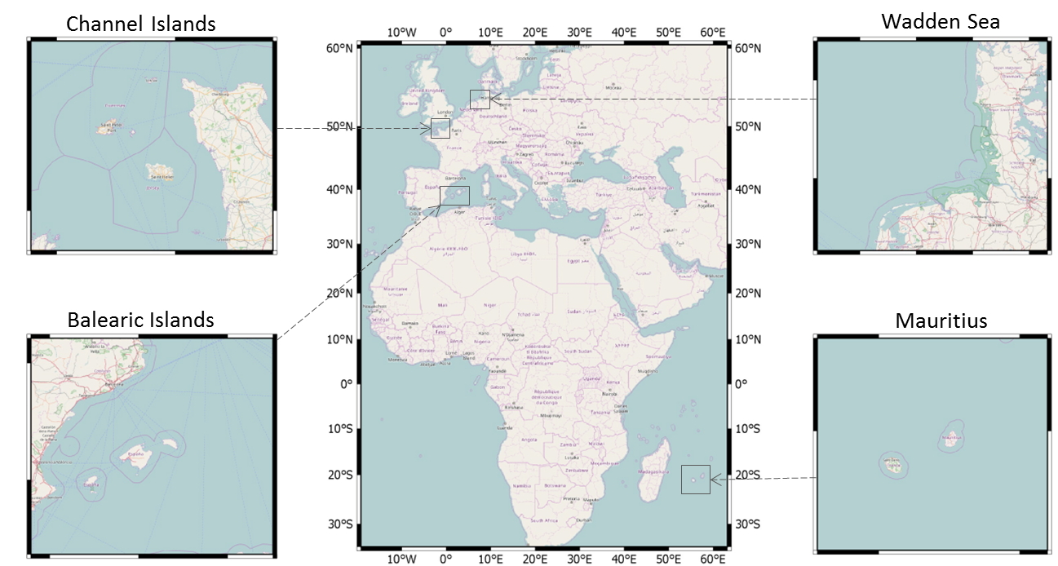
Trial areas
Data for the trial areas is available for free on our website!

Slide 18
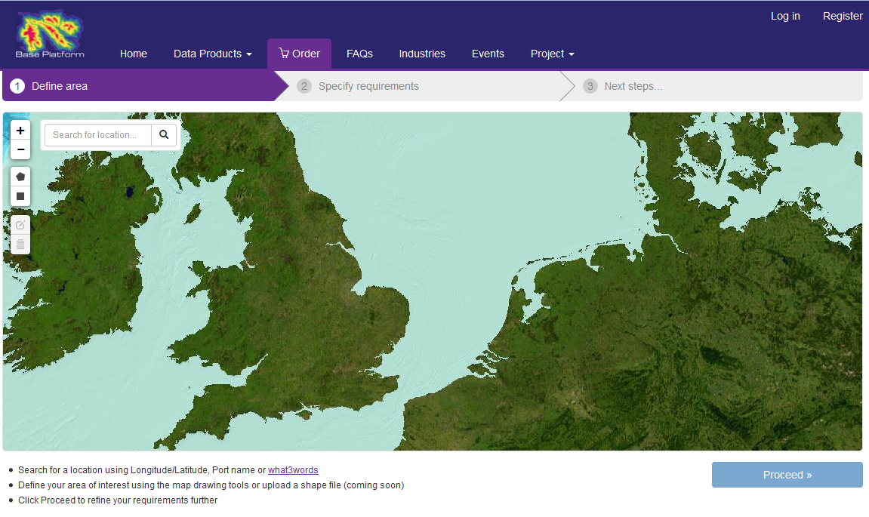
BASE-platform data portal
Provides easy and fast access to data for end users
Off-the-shelf data
Already created
Direct download
Growing amount of areas
Order data
Created on request
All covered areas
Delivery time: ~3 weeks

Slide 19
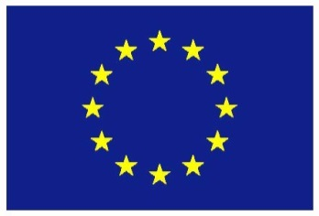
Thanks for your attention!
www.base-platform.com
Stefan Wiehle
DLR Maritime Safety and Security Lab Bremen
Stefan.Wiehle@dlr.de
+49 421 24420 1863
This project has received funding from the European Union’s Horizon 2020 research and innovation programme under grant agreement No. 687323

